Slide 1
Welcome and Introduction CISSP Certification Course Instructor: Kelly Handerhan CISSP, CISSP, CCSP, PMP, CRISC, etc.

Slide 2

Welcome and Introduction
Kelly Handerhan, Instructor, Owner CyberTrain.IT
Over twenty years experience in Information Assurance, and Cybersecurity
Award-winning technical instructor
One of the original instructors for Cybrary.it
Certified in:
CCSP, CISSP, CRISC, PMP, Security+, Etc.
KELLY HANDERHAN, Instructor, Owner of CyberTrain.IT
KellyH@CyberTrain.IT

Slide 3
The CISSP Exam
What to Expect

Slide 4
The 8 Domains of CISSP
Domain 1: Security and Risk Management
Domain 2: Asset Security
Domain 3: Security Architecture and Engineering
Cryptography
Security Architecture and Design
Domain 4: Identity and Access Management
Domain 5: Communications and Network Security
Domain 6: Security Assessment and Testing
Domain 7: Security Operations
Redundancy
Continuity of the Enterprise
Domain 8: Software Development Security

Slide 5
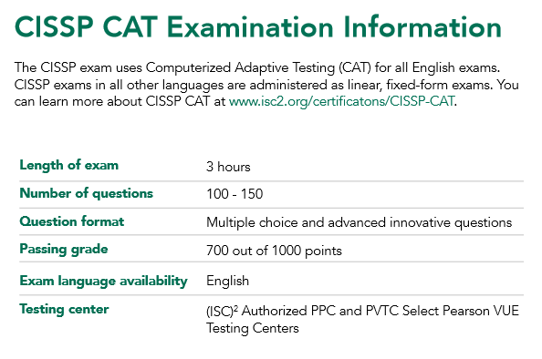
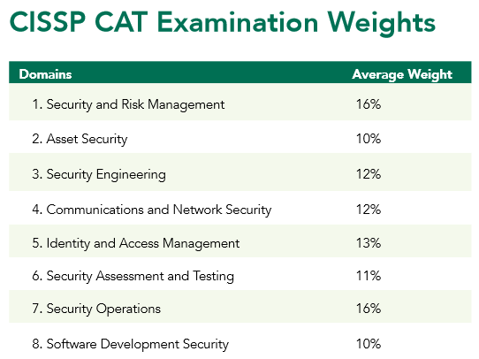
Computer Adaptive Testing (CAT)

Slide 6
How does CAT work?
Each time you answer a question, the system evaluates your ability to get the next question correct based on your previous answers and the complexity of the questions.
With each correct answer, the computer delivers more difficult questions as well as increases its estimate of your ability to pass– you get things right, questions gets harder, if you get things wrong then the questions get easier.
Answering more questions gives the system a greater gauge of your abilities.
Your answers to each question dictate what the next question will be. You can no longer go back to previous questions or mark questions for review
Once you reach the point where the system is confident of your ability, the exam will end and you will receive a “pass” on the exam.

Slide 7
Introductions
Name
What you do
Security Experience
Will you be testing?

Slide 8
The CISSP Mindset
Your Role is a Risk Advisor--Do NOT fix Problems
Who is accountable (ultimate responsibility) for security?
How much security is enough?
All decisions start with risk management. Risk management starts with Identifying and Valuation of your assets.
Think “End Game”
“Value” encompasses all elements of an asset that are meaningful to us”
When multiple answers are correct, choose the one that encompasses the others.
“Security Transcends Technology”
Physical safety is always the first choice
Technical Questions are for Managers. Management questions are for technicians
Incorporate security into the design, as opposed to adding it on later
Layered Defense!

Slide 9
Domain 1
Information Security and Risk Management

Slide 10
Domain 1 Agenda Information Security and Risk Management
Principles of Information Security
Understanding GRC (Governance, Risk and Compliance)
Information Security Strategy and Roadmap
Information Security Frameworks
Information Security Program
Policies, Standards, Procedures, Guidelines
Roles and Responsibilities
Information Security Risk Management
Identification
Assessment
Mitigation
Monitoring
Legal Considerations
Knowledge Transfer
Notes:
This is perhaps the most testable domain on the CISSP exam because all decisions should revolve around risk management. Don’t go too deep in the technical aspects of a problem, when instead a change in the process would be a better long term solution.

Slide 11
Principles of Information Security

Slide 12
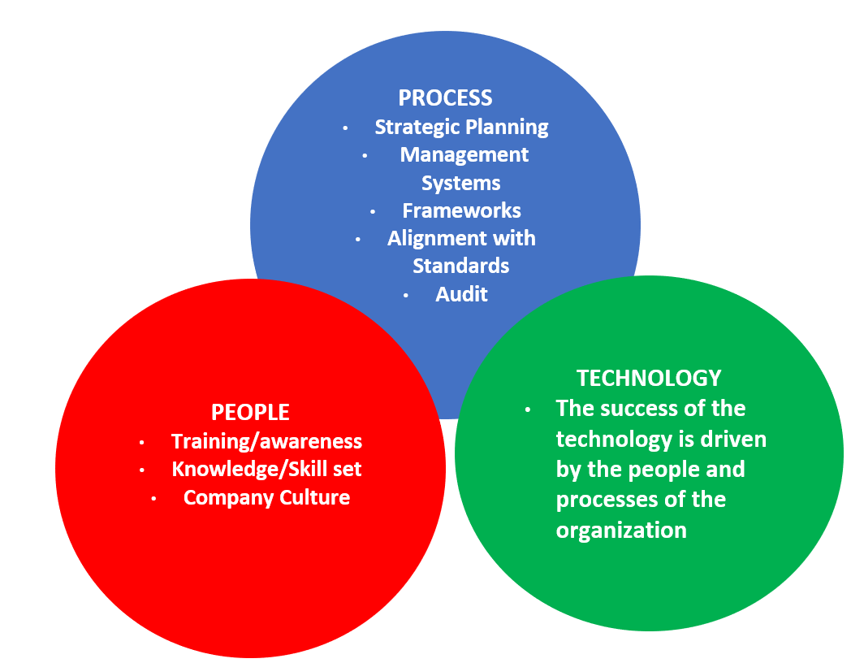
What is Security?
Notes:
A managed, risk-based approach to protecting the assets of an organization through applying controls relating to
People/Human
Processes/Organizational
Technology/Technical

Slide 13
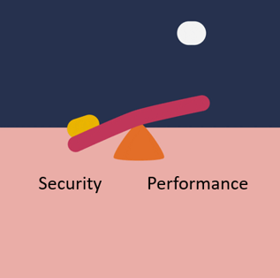
The Information Security Triad
Integrity
Availability
Security
Performance
Confidentiality
Notes:
Threats to the CIA
Confidentiality
Social Engineering
Eavesdropping
Media Reuse
Integrity
Corruption
Malicious Modification
Availability
Unavailability--Redundancy

Slide 14
The Elements of Information Security:
NIST SP 800-12 revision 1
Information security supports the mission of the organization
Information security is an integral element of sound management
Information security protections are implemented so as to be commensurate with risk
Information security roles and responsibilities are made explicit
Information security responsibilities for system owners go beyond their own organization
Information security requires a comprehensive an integrated approach
Interdependencies of security controls
Other interdependencies Information security is assessed and monitored regularly
Information security is constrained by societal and cultural factors
Notes:
NIST SP 800-12 rev 1 replaced what was commonly known as GAISP (Generally Acceptable Information Security Principles) Though remembering the NIST document itself isn’t relevant for the test, the concepts listed above are.

Slide 15
Understanding GRC (Governance, Risk and Compliance)

Slide 16
What is GRC
In response to widescale fraud and the unethical behavior of numerous organizations in the early 2000’s, the Open Compliance & Ethics Group (OCEG) provided a set of published, open source standards addressing Principled Performance through GRC
Includes standards, guidelines, tools and online resources to address governance, risk management, compliance and ethics (GRC) for global corporations and other organizations
Directs organizations to meet objectives through
Sound, principled leadership
Addressing the unknown elements of the business
Maintaining compliance with laws and ethical behavior
https://www.oceg.org
Notes:
In response to widescale fraud and the unethical behavior of numerous organizations in the early 2000’s, the Open Compliance & Ethics Group (OCEG) provided a set of published, open source standards addressing Principled Performance through GRC
Includes standards, guidelines, tools and online resources to address governance, risk management, compliance and ethics (GRC) for global corporations and other organizations
Directs organizations to meet objectives through
Sound, principled leadership
Addressing the unknown elements of the business
Maintaining compliance with laws and ethical behavior

Slide 17
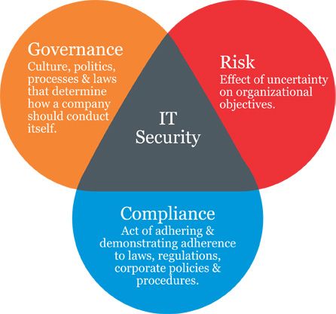
GRC

Slide 18
Governance
Corporate Governance
Providing strategic vision and direction
Reaching security and business objectives
Ensure that risks are managed appropriately and proactively
Verify that the enterprise’s resources are used responsibly
Governance answers four questions:
1.Are we doing the right things?
2.Are we doing them the right way?
3.Are we getting them done well?
4.Are we getting the benefits?
IF the answer is no to any of these questions, how do we close the gap between current state and desired state?
Notes:
Corporate governance is ethical corporate behavior by directors and/or others charged with governance in the creation of value for stakeholders. Also includes the distribution of rights and responsibilities among different participants in the corporation, such as the board, management, shareholders and other stakeholders
Security Governance is a framework allowing the security goals and objectives of an enterprise to be set and expressed by senior management, communicated throughout the organization. Governance provides entities throughout the organization with the authority to implement and enforce security, and further provides oversight and a means to verify performance
Governance: the accountability for protection of the assets of an organization
Board of directors
Applicable to all departments and includes risk management
Value creation = benefits realization, risk optimization and resource optimization

Slide 19
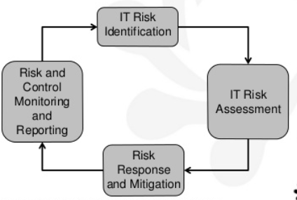
Risk

Slide 20
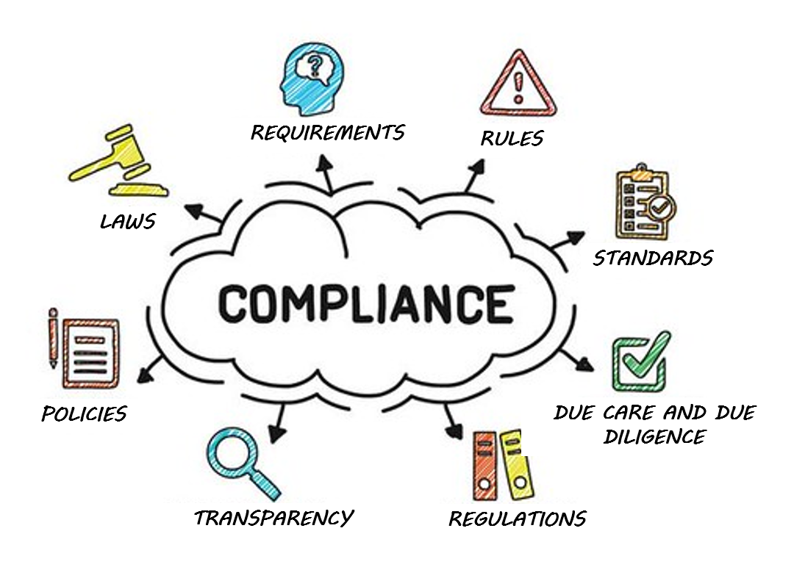
Compliance

Slide 21
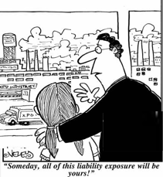
Liabilities
Who is responsible for the security within an organization?
Senior management
Are we liable in the instance of a loss?
Due Diligence
Due Care
Prudent Person Rule
Notes:
Due Care and Due Diligence
The information owner, senior management, has the responsibility of classifying data, dictating how it will be protected, and ensuring that only the necessary individuals access it. If anything happens to the data, they are ultimately responsible.
The owners are expected to practice due care. Due care means to take the necessary steps to protect assets, as in installing anti-virus or intrusion detection system (IDS) software.
Due diligence is the act of investigating and understanding the risks the company faces.
A company practices due care by developing security policies, procedures, and standards. Due care shows that a company has taken responsibility for the activities that take place within the corporation and has taken the necessary steps to help protect the company, its resources, and employees from possible risks.
Thus, due diligence is understanding the current threats and risks, and due care is implementing countermeasures to provide protection from those threats. If a company does not practice due care and due diligence pertaining to the security of its assets, it can be legally charged with negligence and held accountable for any ramifications of that negligence.
If a security incident took place and it was determined that the information owner was not practicing due care, then liability could easily lie at his doorstep.

Slide 22
The Information Security Strategy and Road Map

Slide 23
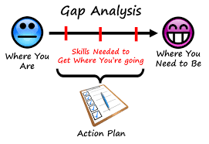
Gap Analysis
Information Security Strategy and Road Map

Slide 24
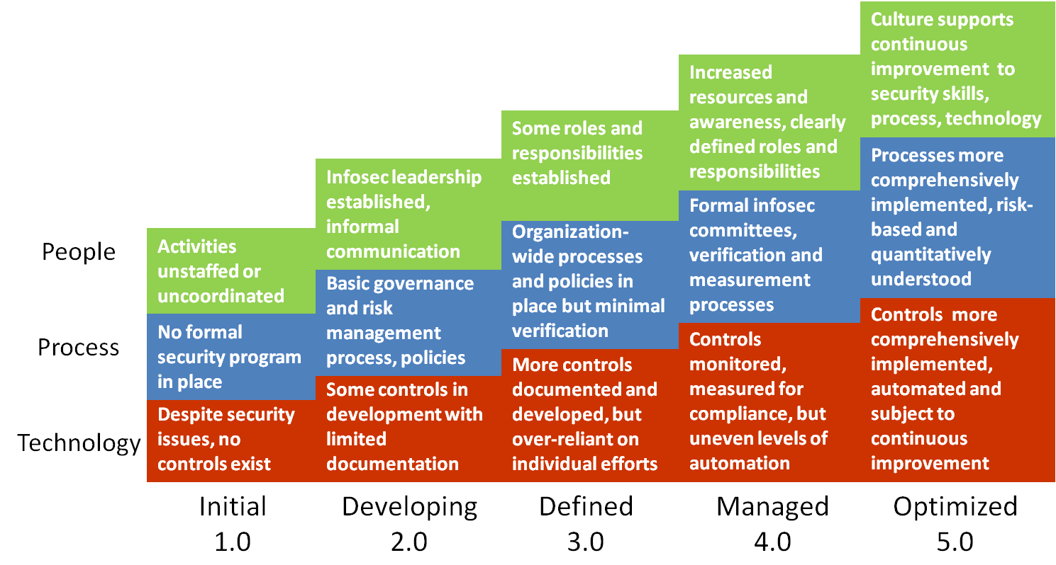
Gap Analysis using the CMMI
Repeatable
Notes:
Capability Maturity Models, such as the CMMI from Carnegie Mellon evaluate an organization on the maturity of its processes. Usually for compliance, or to meet customer requirements an organization may need to pursue a rating from 1-5 from CMMI. Gap analysis looks at the current state vs. the desired state and helps us close the gap.

Slide 25
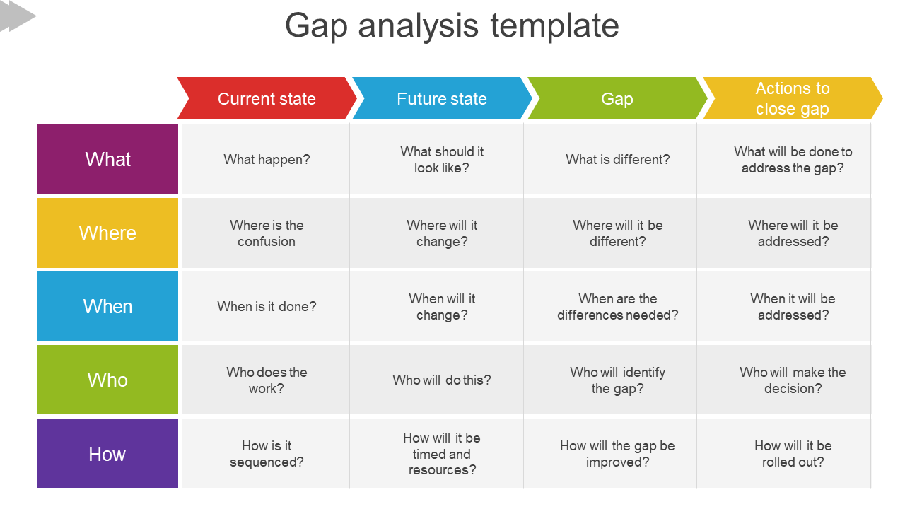
Closing the Gap: Information Security Strategy
Long term perspective to help move the organization from current state to desired state as detailed in gap analysis
Standard throughout the organization
Aligned with business strategy/direction
Understands the culture of the organization
Reflects business needs and priorities
Notes:
The purpose of a strategic plan for security is to provide management with the necessary information to make informed decisions about investment in security. The strategic plan links the security function with the business direction. The strategy must present a business case that describes key business benefits and outcomes related to security, with recommended strategies for achieving those outcomes. Long term vision for the organization is the responsibility of senior management and should be understood throughout the organization. Each department or division within the enterprise should be working in alignment to achieve the desired state.

Slide 26
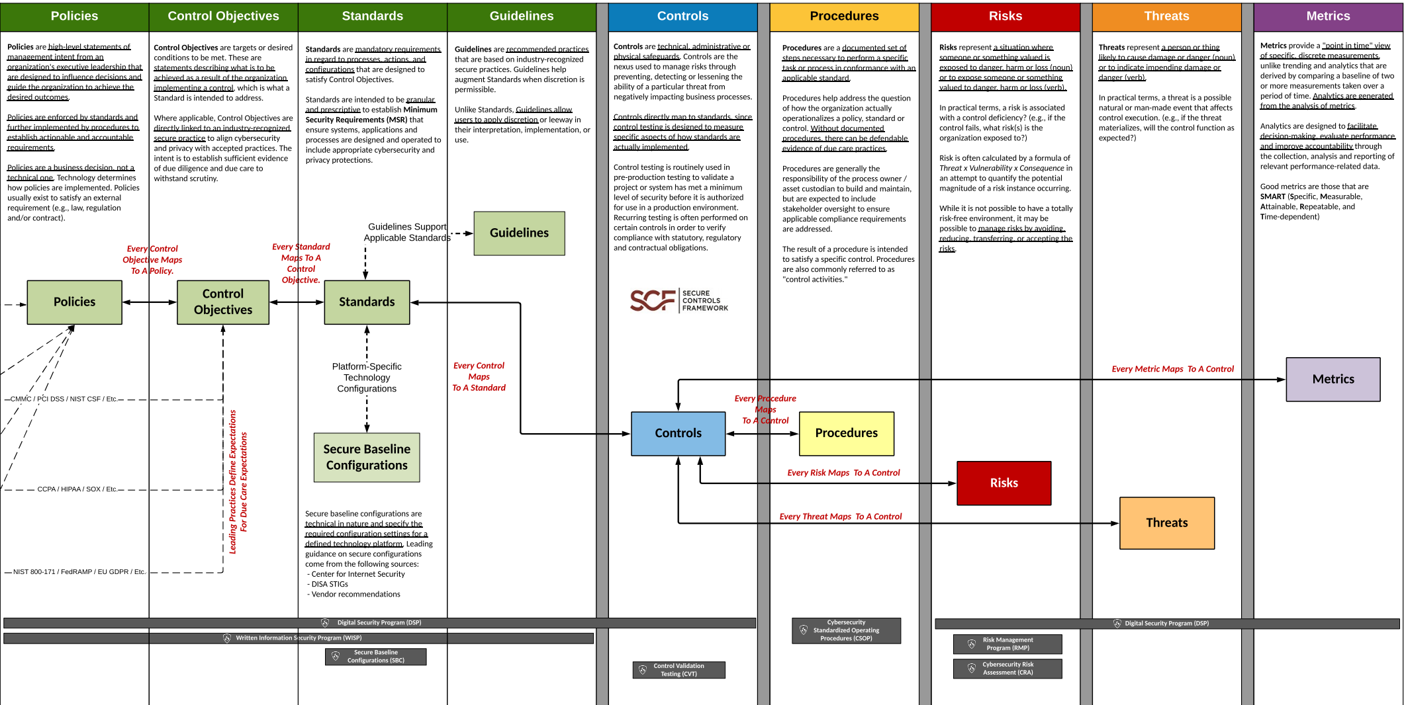
Security Programs Close the Gap

Slide 27
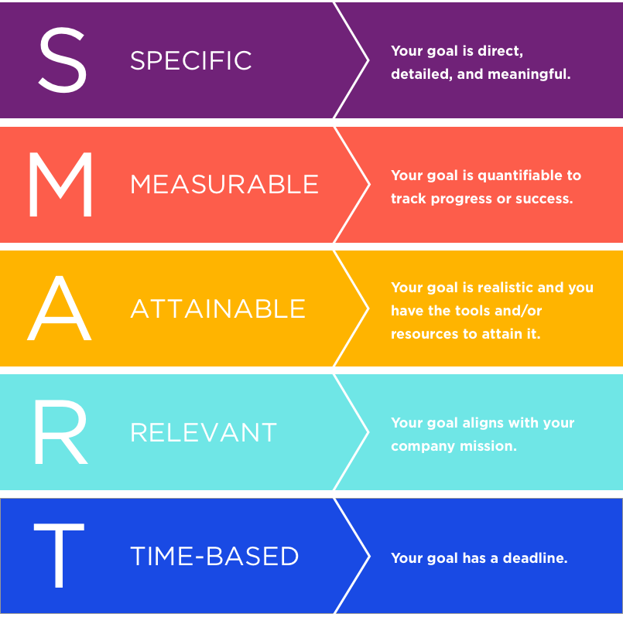
Objectives of an Information Security Strategy
Begin with an understanding of the long-term objectives of the organization. Strategy should describe a well-articulated vision of the desired outcomes for a security program through SMART objectives
Notes:
Short-term objectives help us accomplish long term goals.
Example of a security strategy objective – Protect the confidentiality of customer PII
Key initiative – Strengthen policies and standards clarifying requirements for data protection (These are usually the gaps that were found in the risk assessment.)
Enables objectives – Confidentiality of information, improved security of systems & network services, proactive data security and governance.
Description – Develop, approve, and launch a suite of information security policies, standards, and guidelines based on ISO/IEC 27001.
Key benefits – These benefits need to be aligned with the business.
Clear security baselines for all departments
Policy-based foundation to measure results
Consistent application of security controls across the enterprise
Project – listed technology, service, etc. that will meet the objective.

Slide 28
Information Security Frameworks

Slide 29
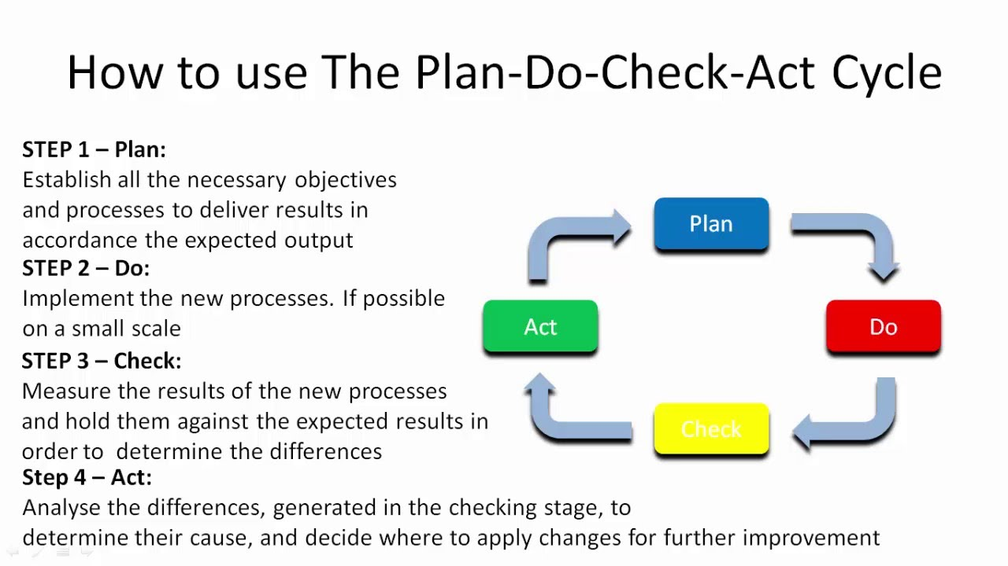
Frameworks: ISO 27001
Standard Framework for implementing and managing an ISMS based on the PDCA model
Requires senior management to
Systematically examine the organization's information security risks, taking account of the threats, vulnerabilities, and impacts;
Design and implement a coherent and comprehensive suite of information security controls and/or other forms of risk treatment (such as risk avoidance or risk transfer) to address those risks that are deemed unacceptable; and
Adopt an overarching management process to ensure that the information security controls continue to meet the organization's information security needs on an ongoing basis.
Notes:
ISO 27001 is a formal standard against which organizations can be certified. ISO 27002 (and other ISO documents) provide assistance with implementation. For instance, ISO 27001 provides a management system in which information security must be planned, implemented, monitored, reviewed, and improved. It means that management has its distinct responsibilities, that objectives must be set, measured and reviewed, that internal audits must be carried out and so on. All those requirements are defined in ISO 27001. Practical implementation and further detail is provided in ISO 27002. For instance ISO 27001 may indicate that access control is essential, but one would look to ISO 27002 to understand the various ways to enforce access control. In reality the two documents are closely related, whereas ISO 27002 is one (of many) tools to accomplish ISO 27001 certification

Slide 30
ISO 27000 Standards
Which standard to use from the ISO 27000 series and when
27001: A framework designed to develop, build, implement, assess and improve an ISMS (Information Security Management System)
27002: Describes the implementation of the controls referenced in Appendix A of ISO 27001.
Specifies 14 Domains, 35 control objectives (each of which is supported by at least one control) and 114 controls
27003:2017: Provides practical guidance for the implementation of an Information Security Management System (ISMS) in an organization based on ISO/IEC 27001.
ISO/IEC 27004:2016 provides guidelines intended to assist organizations in evaluating the information security performance and the effectiveness of an information security management system in order to fulfil the requirements of ISO/IEC 27001. It establishes:
The monitoring and measurement of information security performance
the monitoring and measurement of the effectiveness of an information security management system (ISMS) including its processes and controls
The analysis and evaluation of the results of monitoring and measurement
ISO 27005: Provides guidelines for Information Security Risk Management for organizations following ISO 27001 Framework

Slide 31
ISO 27002: The 14 Domains
ISO 27001 Appendix A/ISO 27002 Controls
ISMS Structure | Physical and Environmental Security
Security Policy | Operations Security
Organization of Information Security | Communications Security
Human Resources Security | Information Systems Acquisition, Development, Maintenance
Asset Management | Supplier Relationships
Asset Control | Information Security Incident Management
Cryptography | Information Security Aspects of Business Continuity
Compliance
Notes:
Provides best practice recommendations on information security controls for use by those responsible for initiating, implementing or maintaining information security management systems (ISMS).
Information security is defined in the context of the C-I-A triad:
The preservation of confidentiality (ensuring that information is accessible only to those authorized to have access)
The preservation of integrity (safeguarding the accuracy and completeness of information and processing methods)
The preservation of availability (ensuring that authorized users have access to information and associated assets when required)

Slide 32
Other Common Frameworks
SABSA(Sherwood Applied Business Security Architecture)
TOGAF (The Open Group Architecture Framework)
COBIT (Control Objectives for Information and related Technology)
COSOERM and COSO IC
Business Model for Information Security
Six Sigma
Model originated at the Institute for Critical Information Infrastructure Protection
Publications from NIST and ISF
US Federal Information Security Management Act (FISMA)
Securing quality
ISO standards on quality (ISO 9001:2000)
Notes:
These other frameworks are not testable, but are used in numerous environments

Slide 33
Information Security Program

Slide 34
Information Security Program
Provides the means for achieving strategy
Policies/Standards/Procedures/Guidelines
Roles and Responsibilities
SLA's Service Level Agreements/Outsourcing
Data Classification/Security
C&A (Certification and Accreditation) aka Assessment and Authorization
Auditing
Notes:
The information security program should be based on a comprehensive risk analysis. The controls that are implemented are a direct result of the risk mitigation strategy, and should provide a positive return on investment (keeping in mind that costs/benefits are not always monetary). You can think of the security program as the set of controls we implement to bring residual risk down to an acceptable level.

Slide 35
Types of Policy
Three main types of policies exist:
Corporate Policy
System Specific Policy
Issue Specific Policy
Notes:
The Corporate (Organizational) Security Policy can be thought of as a blueprint for the whole organization’s security program. It is the written document that indicates the organization’s approach to security and voices senior management’s commitment to support the security function. Addresses issues like the C-I-A triad, authenticity, and compliance with regulations and other drivers.
A System-specific policy is concerned with a specific or individual computer system. It is meant to present the approved software, hardware, and hardening methods for that specific system.
An Issue-specific policy is concerned with a certain functional aspect that may require more attention. For this reason, a separate policy is prepared for that issue to explain with details the required level of security, and the instructions that all staff in the organization must abide by to achieve this level.

Slide 36
System and Issue Specific Policies
System Specific Policies | Issue Specific Policies
Web Servers must be configured according to a consistent image with baseline configuration approved by Director of IT and Director of Marketing Multifactor authentication must always be used when accessing domain controllers Client systems must be validated periodically against a baseline image Etc. | Change Management Policy Acceptable Use Policy Privacy Data/System Ownership Separation of Duties (SOD) Mandatory Vacations Job rotation Least privilege Need to know Dual control M of N control
Notes:
Change Management Policy: all changes to baseline security configuration must be submitted for approval, approved, tested, documented, scheduled, implemented, monitor. NOTHING HAPPENS ON THE FLY
Acceptable Use Policy: Management's expectation for how company resources are to be used
Privacy: Privacy can be infringed upon, but employees must be notified
Data/System Ownership: Can’t always assume senior management is the owner. For instance, patients maintain ownership of their Personal Healthcare Information, even though they may share it with a doctor
Separation of Duties: Protects against a single individual having too much power, makes sure there is a clear reporting path that is unconflicted, and forces employees to collude with someone else to commit fraud
Mandatory Vacations: Frequently used in banking or other financial industries. Used as a detective control, for investigations while the employee is on a mandated leave from work.
Job Rotation: Serves as a detective control, but also provides redundancy of personnel
Least Privilege: Employees are granted the ability to perform only the actions they need to perform their jobs.
Need to Know: Employees are granted access to only the data they need to perform their work
Dual Control: Prevents abuse of power. For instance, Admin A and Admin B both must enter their passwords in order to recover private keys from archival
M on N Control is an extension of dual control, but is not dependent on specific employees being present. M and N are simply variables. Example: Any 4 out of 9 network admins must be present to recover private keys from archival

Slide 37
Standards
Mandatory
Created to support policy, while providing more specifics details.
Reinforces policy and provides direction
Can be internal or external
Notes:
Whereas policies are few and broad, standards fill in the specifics. A policy may indicate that all PII data must be encrypted, and they standard defines the current encryption algorithm to be used is AES 256

Slide 38
Procedures
Mandatory
Step by step directives on how to accomplish an end-result.
Detail the “how-to” of meeting the policy, standards and guidelines

Slide 39
Guidelines
Not Mandatory
Suggestive in Nature
Recommended actions and guides to users
“Best Practices”

Slide 40
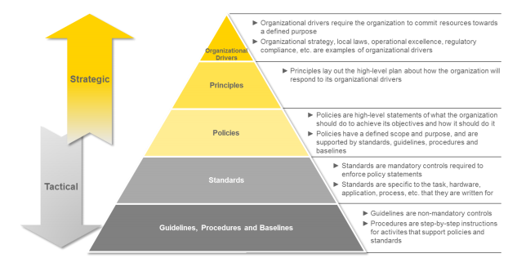
Information Security Policy Framework

Slide 41
Baselines
Mandatory
Minimum acceptable security configuration for a system or process
The purpose of security classification is to determine and assign the necessary baseline configuration to protect the data
Notes:
Baselines are often implemented through the use of images. Different images are needed to support different operating systems and are used for variance control purposes, as well as to determine and control changes to systems.

Slide 42
Roles and Responsibilities

Slide 43
Senior Management’s Responsibilities
Senior Management is ultimately responsible to:
Provide oversight
Provide funding and support
Ensure testing (and that appropriate results are achieved)
Prioritize business functions
Establish a common vision/strategy/framework for the enterprise
“Sign off” on Policy, BIA and other organizational documents
Notes:
The purpose of a strategic plan for security is to provide management with the necessary information to make informed decisions about investment in security. The strategic plan links the security function with the business direction. The strategy must present a business case that describes key business benefits and outcomes related to security, with recommended strategies for achieving those outcomes. Long term vision for the organization is the responsibility of senior management and should be understood throughout the organization. Each department or division within the enterprise should be working in alignment to achieve the desired state.

Slide 44
Steering Committee
Oversight of Information Security Program
Acts as Liaison between Management, Business, Information Technology, and Information Security
Assess and incorporate results of the risk assessment activity
into the decision-making process
Ensures all stakeholder interests are addressed
Oversees compliance activities

Slide 45
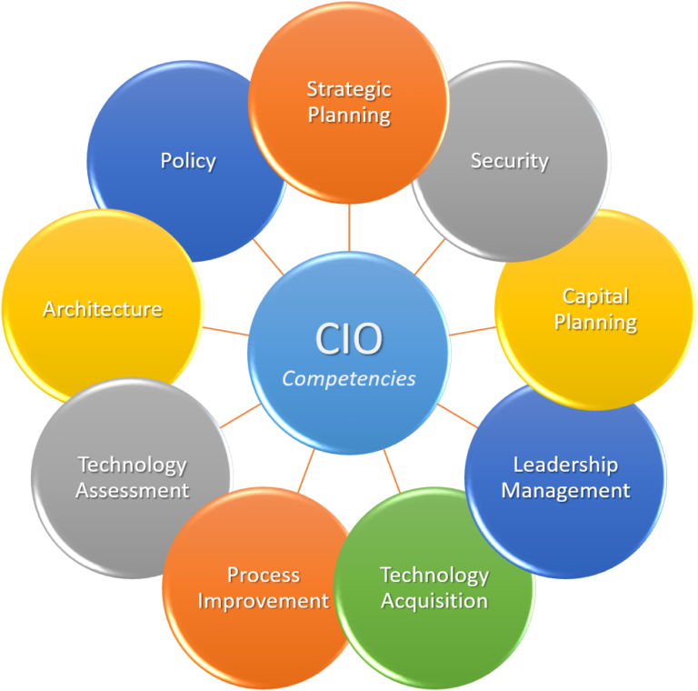
Chief Information Officer (CIO)
Strategic Planning
Policy Development
Technology Assessments
Process Improvement
Acquisitions
Capital Planning
Security
Notes:
The CISO isthe senior manager ultimately responsible for providing C-I-A for information assets.
Responsible for protecting the CIA of information through the following:
Policy
Investigation
Testing
Compliance
IT planning, budgeting, and performance, including its information security components

Slide 46
Information Security Manager
Functional Manager, responsible for achieving for determining the “how”
Play a leading role in introducing an appropriate, structured methodology
Act as major consultants in support of senior management

Slide 47
Business Managers
Responsible for business operations. The individual lines of business are our customers
Provide direction to ensure security is implemented in such a way as to meet business objectives
Responsible for security enforcement and direction
Responsible for day-to-day
Monitoring
Reporting
Disciplinary actions
Compliance
Notes:
Business managers are often our customers as we fulfil our role in information security. Remember, our ultimate purpose is to support the objectives of the business, the business managers are the ones who are closest to the business and are often owners of the systems and the data. If there is ever a conflict between InfoSec and the business function owner, the business will always be the ultimate decision makers.

Slide 48
Security Practitioners
Responsible for proper implementation of security requirements in their IT systems
Support or use the risk management process to identify and assess new potential risk and implement new security controls as needed to safeguard their IT systems

Slide 49

Auditors
Objective Evaluation of controls and policies to ensure that they are being implemented and are effective.
If internal auditing is in place, auditors should not report to the head of a business unit, but rather to the Chief Operating Officer or some other entity without direct stake in result
Auditors document and do not modify

Slide 50
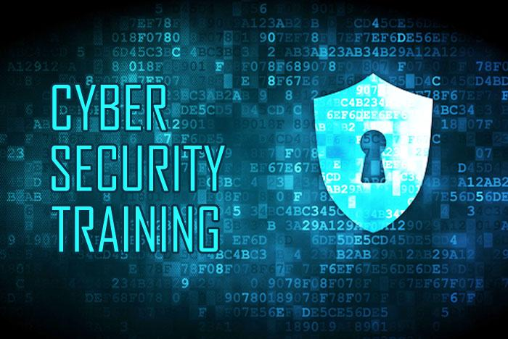
Security Trainers
Must understand the risk management process
Develop appropriate training materials
Conduct security trainings and awareness programs catered to roles within the organization
Incorporate risk assessment into training programs to educate the end users
Encourage users to report violations

Slide 51
Information Security Risk Management

Slide 52
Information Security Risk Management
Information security risk management, or ISRM, is the process of managing risks associated with the use of information technology. It involves identifying, assessing, and treating risks to the confidentiality, integrity, and availability of an organization's assets.

Slide 53
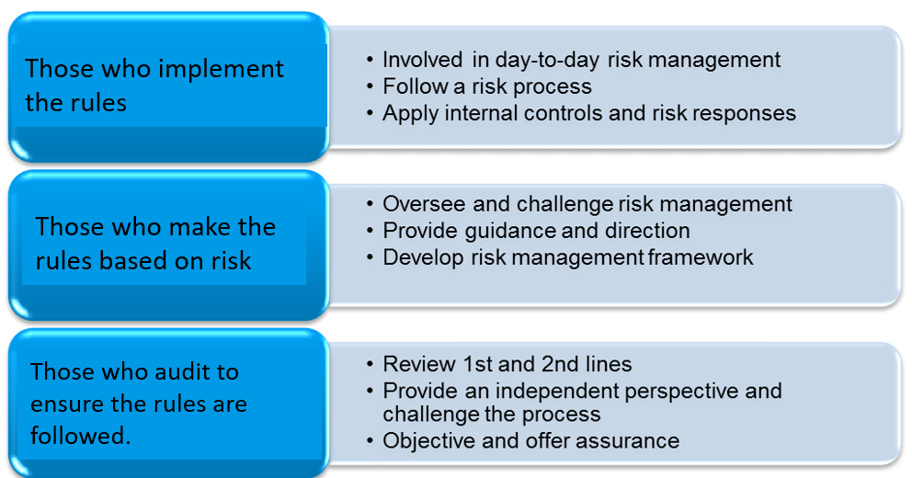
Three Lines of Risk-based Defense

Slide 54
Risk Definitions
Asset: Anything of Value to the company
Vulnerability: A weakness; the absence of a safeguard
Threat: Something that could pose loss to all or part of an asset
Threat Agent: What carries out the attack
Exploit: An instance of compromise
Risk: The probability of a threat materializing
Controls: Physical, Administrative, and Technical Protections
Safeguards—Deterrents or Preventives
Countermeasure—Detectives or Correctives
Total Risk: The risk that exists before any control is implemented
Residual Risk: Leftover risk after applying a control
Secondary Risk: When one risk response triggers another risk event
Incident: A risk event that has transpired

Slide 55
Risk Management Lifecycle

Slide 56
The Risk Management Lifecycle
Risk Identification (Threat x Vulnerabilty=Risk)
Identify and determine the value for assets
Identify Threats and Vulnerabilities
Risk Assessment (Value)
Analysis (Probability X Impact = Loss Potential)
Qualitative vs. Quantitative
Evaluation (Loss Potential vs. Cost of Countermeasure)
Risk Mitigation/Response
Reduce
Accept
Transfer
Avoid
Reject
Ongoing Controls Evaluation

Slide 57
Risk Management Life Cycle:
Risk Identification

Slide 58
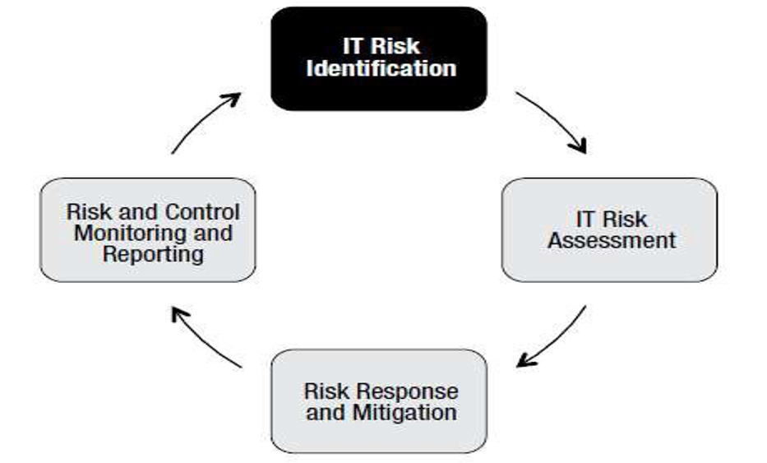
The IT Risk Management Lifecycle: Identification

Slide 59
Alignment with Business Goals and Objectives
The first and most important step for a CISSP is to understand the business. Review organizational vision and strategy FIRST
Look beyond IT—Risk is measured by the impact the risk has on the business, not on a particular system
In order for risk to be integrated into the enterprise, senior management must be supportive and involved.
If management funds and supports the risk management processes we will have what we need to be successful
Good metrics mean that we have attainable objectives which will help us accomplish our goals
Good communication and transparency helps us make risk-aware business decisions

Slide 60
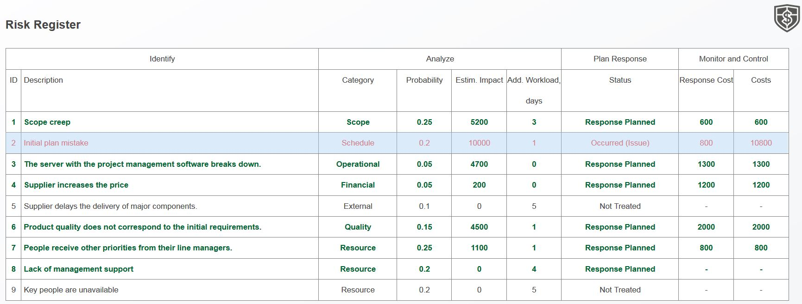
Risk Identification
AV * Threat * Vulnerability = Risk
This may also appear as AV * Threat * Vulnerability
At this stage, risks are ONLY being identified.
Often this is the step where a risk register begins to be populated

Slide 61
Threats and Vulnerabilities
STRIDE (Threats) | DREAD (Vulnerabilities)
 | Damage potential
Spoofing | Reproducibility
Tampering | Exploitability
Repudiation | Affected user base
Information Disclosure | Discoverability
Denial of Service
Escalation of Privilege

Slide 62
Risk Management Life Cycle:
Risk Assessment

Slide 63
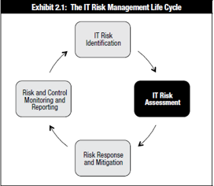
Risk Management Lifecycle: Assessment

Slide 64
Risk Assessment/Analysis
Qualitative
Subjective analysis to help prioritize probability and impact of risk events.
May use Delphi Technique
Quantitative:
Providing a dollar value to a particular risk event.
Much more sophisticated in nature, a quantitative analysis if much more difficult and requires a special skill set
Business decisions are made on a quantitative analysis
Can't exist on its own. Quantitative analysis depends on qualitative information
Notes:
Risk Approach: Quantitative vs. Qualitative
There are two basic ways of performing a risk assessment, quantitative and qualitative. The quantitative approach deals with numbers. It attempts to assign numeric values to assets and present the potential losses in monetary values. Qualitative does not apply monetary values to items but uses a type of rating system instead. For example, if a qualitative analysis was going to be performed, the analysis team can ask different department representatives and IT individuals to rate specific risks on a scale of 1-5 to determine which risks the employees see as most dangerous. The team could then ask the same individuals to rate the recommended countermeasures on what they see as the best solutions.
The quantitative approach tries to assign assets and risks monetary values because that format easily integrates into business plans and budgets and allows management to see how certain items affect their bottom line. The qualitative approach has a different goal, which is to get the “gut feeling” about the risks and the necessary solutions of the people closest to the problem who are seen as experts within their company.
Note
The Delphi method allows people to express their ideas anonymously

Slide 65
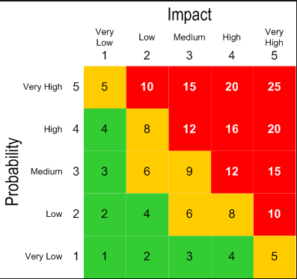
Qualitative Assessments
Assess risks based on subjective input
Uses terms like high, medium, low
Inexpensive, and quick way to begin the prioritization and ranking of risks
Notes:
Qualitative analysis always proceeds quantitative analysis. A purely quantitative analysis is not possible.

Slide 66
Quantitative Analysis
More experience required than with Qualitative
Involves calculations to determine a dollar value associated with each risk event
Business Decisions are made on this type of analysis
Goal is to the dollar value of a risk and use that amount to determine what the best control is for a particular asset
Necessary for a cost/benefit analysis

Slide 67
Quantitative Analysis Formulas and Terms
(AV) Asset Value: Dollar figure that represents what the asset is worth to the organization
(EF) Exposure Factor: The percentage of loss that is expected to result in the manifestation of a particular risk event.
(SLE) Single Loss Expectancy: Dollar figure that represents the cost of a single occurrence of a threat instance
(ARO) Annual Rate of Occurrence: How often the threat is expected to materialize
(ALE) Annual Loss Expectancy: Cost per year as a result of the threat
(TCO) Total Cost of Ownership is the total cost of implementing a safeguard. Often in addition to initial costs, there are ongoing maintenance fees as well.
(ROI) Return on Investment: Amount of money saved by implementation of a safeguard. Sometimes referred to as the value of the safeguard/control.

Slide 68
Quantitative Analysis Formulas
SLE = AV * EF
ALE = SLE * ARO
TCO = Initial Cost of Control + Yearly fees
ROI= Return on Investment:
ALE (before implementing control)
– ALE (after implementing control)
– cost of control
= ROI (Value of Control)
Notes:
(AV) Asset Value: Dollar figure that represents what the asset is worth to the organization
(EF) Exposure Factor: The percentage of loss that is expected to result in the manifestation of a particular risk event.
(SLE) Single Loss Expectancy: Dollar figure that represents the cost of a single occurrence of a threat instance
(ARO) Annual Rate of Occurrence: How often the threat is expected to materialize
(ALE) Annual Loss Expectancy: Cost per year as a result of the threat
(TCO) Total Cost of Ownership is the total cost of implementing a safeguard. Often in addition to initial costs, there are ongoing maintenance fees as well.
(ROI) Return on Investment: Amount of money saved by implementation of a safeguard. Sometimes referred to as the value of the safeguard/control.

Slide 69
Warehouse worth $300,000
Threat: Fire
ARO (Annual Rate of Occurrence) Likelihood of fire is 1/20 years = .05
EF (Exposure Factor) Amount of the asset that will be lost = 70%
Cost of control = $5,000 per year
SLE = AV * EF = 210,000
ALE = SLE * ARO = 10,500
AFTER Control is implemented, the new EF is 10%
SLE = 30,000
ALE = 1,500
ALE Before 10500
-ALE After -1500
-cost -5000
ROI 4,000

Slide 70
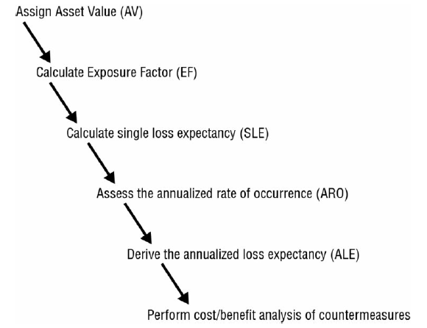
Steps for Quantitative Analysis

Slide 71
Risk Management Life Cycle:
Risk Response and Mitigation

Slide 72
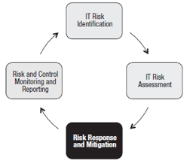
Risk Management Lifecycle: Mitigation

Slide 73
Risk Mitigation and Response
Risk Assessment will dictate the appropriate risk response
Reduce
Avoidance
Transfer
Accept
Rejection
Notes:
The three preferred methods are Reduce, Accept, Transfer
Reduce: Lessen the probability or an impact of a risk
Accept: Choose that the risk amount is within the organization's tolerance for loss. No control is implemented
Transfer: Share the risk with someone else. Ex: SLAs, Outsourcing, Insurance
Avoidance: Remove all elements of risk. Choose not to implement a technology because the risks are too high.
Rejection: Not an acceptable response! Does not use Due Diligence—Security through Obscurity, Denial of a risk.
Mitigate Risk
▪ Be Aware: By y now, risk analysis is complete and management is aware of the team’s findings.
▪ Set Controls: Present the controls which mitigate each risk.
▪ Know the Limits: These controls mitigate risk but do not abolish it; complete reduction is impossible to achieve.
▪ Accept Limits: Establish an acceptable risk, since risk always remains.

Slide 74
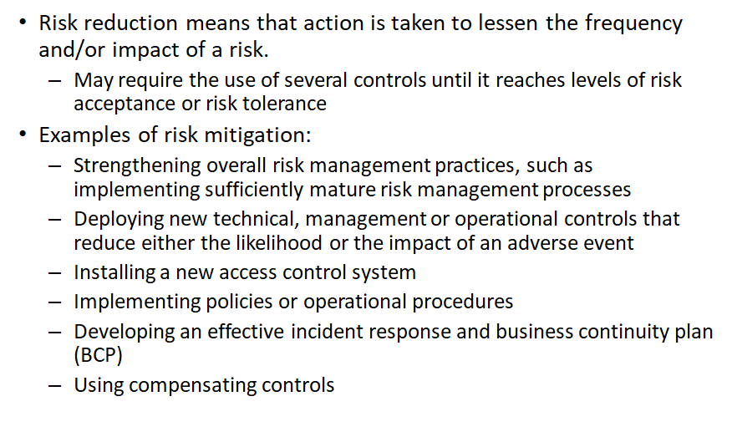
Risk Reduction/Avoidance
**The ultimate risk reduction is avoidance
Notes:
If either probability or impact is reduced to zero, there is no risk.

Slide 75
Risk Transference
Risk transference is a decision to reduce loss through sharing that risk with another organization
SLAs (Service Level Agreements) and contracts establish the degree of transference
Remember: You can’t transfer liability
Notes:
Risk transference does not (necessarily) lessen probability or impact of a risk. Just because I purchase fire insurance doesn’t make my house any less likely to catch fire. Also, the damage to the home will be the same. The fact that I can pursue financial compensation based on my loss is what risk transference indicates. Simple definition: Sharing the loss potential

Slide 76
Risk Acceptance
Examples of risk acceptance:
Provides no active mitigation
Based on a cost/benefit analysis, it is determined the cost of the control is less than the potential for loss
Sometimes acceptance is the only choice.
Risk acceptance still includes due diligence, and can still be used to indicate good business decisions were made
Level of risk and impact is always changing, so regular reviews are needed
Notes:
Risk rejection also provides no active mitigation, however, the decision is not based on due diligence, but often based on an unwillingness to examine the risks associated with an asset.

Slide 77
Risk Management Life Cycle:
Risk Monitoring and Reporting

Slide 78
Risk Monitoring and Reporting
•A risk response is designed and implemented based on a risk assessment that was conducted at a single point in time
•Because of the changing nature of risk and associated controls, ongoing monitoring is an essential step of the risk management life cycle.
– controls can become less effective
–the operational environment may change
and new threats, technologies and vulnerabilities may emerge

Slide 79
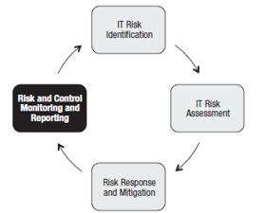
Risk Management Lifecycle: Control Monitoring and Reporting

Slide 80
Key Risk Indicators (KRIs)
–Provide early warning
–Provide backward-looking view on risk events
–Enable documentation and analysis of trends
–Provide an indication of risk appetite and tolerance
–Increase the likelihood of achieving strategic objectives
–Assist in optimizing risk governance

Slide 81
Key Risk Indicators (KRIs)
Examples of KRIs:
–Quantity of unauthorized equipment or software detected in scans
–Number of instances of SLAs exceeding thresholds
–High average downtime due to operational incidents
–Excessive average time to research and remediate operations incidents
–Number of desktops/laptops that do not have current antivirus signatures or have not run a full scan within scheduled periods
•KRIs support:
–Risk appetite
–Risk identification
–Risk mitigation
–Risk culture
–Risk measurement and reporting
–Regulatory compliance

Slide 82
Risk Management Process Review
Risk Identification
usually the most difficult to accomplish
Many unknowns
Necessary effort of gathering the right data
Risk Assessment:
can be done qualitatively and/or quantitatively
Analysis: Value of Potential for loss
Evaluation compares potential for loss vs. cost of countermeasure
Risk Mitigation
Take steps to reduce risk to acceptable level
Risk Monitoring
***Remember - Risk must be managed, since it cannot be totally eliminated
Notes:
82

Slide 83
Legal Considerations

Slide 84
Liabilities – who is at fault?
Failure of management to execute Due Care and/or Due Diligence can be termed negligence
Culpable negligence is often used to prove liability
Prudent Man Rule
Perform duties that prudent people would exercise in similar circumstances
Example: Due Diligence: researching industry standards and best practices
Due Care: setting and enforcing policy to bring organization into compliance
Downstream Liabilities
Integrated technology with other companies can extend one’s responsibility outside the normal bounds
Notes:
Liabilities
If a company has a facility that burns down to the ground, the arsonist is only one small piece of this tragedy. The company is responsible for providing fire detection and suppression systems, fire-resistant construction material in certain areas, alarms, exits, fire extinguishers, and backups of all the important information that could be affected by a fire. If a building burns to the ground and takes all the records (information, customer data, inventory records, and the data that is necessary to rebuild), then this company did not perform its due care in ensuring that it is protected from such disasters. In this case, the employees, shareholders, customers, and everyone affected could successfully sue the company. However, if the company did everything expected of it in the previously listed respects, it could not be successfully sued for negligence and not practicing due diligence.
Due Care means that a company did all that it could have reasonably done to try and prevent security breaches, and also took the necessary steps to ensure that if a security breach did take place that the damages were much reduced because of the controls or countermeasures put into place. Due care means that a company practiced common sense and prudent management practices with responsible actions. Due diligence means that the company properly investigated all of their possible weaknesses and vulnerabilities before carrying out any due care practices. The same type of responsibility is starting to be expected of corporations pertaining to computer crime and resource protection. Computer security is developed and implemented to protect an organization’s valuable resources — thus, appropriate Liabilities.
Who is at fault?
Based on Due Care and Due Diligence
Prudent Man Rule
• Perform duties that prudent people would exercise in similar circumstances
• Downstream Liabilities
• Integrated technology with other companies can extend one’s responsibility outside the normal bounds
If the management of an organization does not practice due care and diligence, those individuals could be found negligent in their responsibilities. This deliberate behavior is considered unethical and could be illegal in certain circumstances.
Safeguards need to be in place to protect the company’s mission by protecting its tangible and intangible resources, reputation, employees, and legal position. Computer and information security is one piece of this that works as a means to an end, and not an end within itself. Security is not practiced just for the sake of doing it. Security should be practiced in a way to accomplish fully understood, planned, and attainable goals.
Senior management has an obligation to protect the company from a long list of activities that can negatively affect the company, including protection from malicious code, natural disasters, privacy violation, infraction of the law and more.
When companies come together to work in an integrated manner such as extranets and VANs, special care must be taken to ensure that each party promises to provide the necessary level of protection, liability and responsibility needed, which should be clearly defined in the contracts that each party signs. (These topics are sometimes referred to as downstream liabilities). Auditing and testing should be performed to ensure that each party is indeed holding up its side of the bargain and that its technology integrates properly with all the other parties.
The following list describes some of the actions required to show that due care is being properly practiced in a corporation:
· Physical and logical access controls
· Telecommunications security, which could require encryption
· Information, application and hardware backups
· Disaster recovery and business continuity plans
· Periodic review, drills, tests and improvement to disaster recovery and business continuity plans
· Properly informing employees of expected behavior and ramifications of not following these expectations
· Developing a security policy, standards, procedures and guidelines
· Performing security awareness training
· Running updated anti-virus software
· Periodically performing penetration tests from outside and inside the network
· Implementing dial-back or preset dialing features on remote access applications
· Abiding by and updating external service level agreements (SLAs)
· Ensuring that downstream security responsibilities are being met
· Implementing measures that ensure that software piracy is not taking place
· Ensuring that proper auditing and reviewing of those audit logs is taking place
· Conducting background checks on potential employees

Slide 85
Types of Laws
Criminal
Civil
Regulatory
Intellectual Property

Slide 86
Criminal Law
Beyond a reasonable doubt—can be difficult to meet this burden of proof in computer-related crimes
Penalties: Financial, Jail-time, death
Felonies: More serious of the two. Often penalty results in incarceration of at least a year.
Misdemeanors: Normally the less serious of the two with fines or jail-time of less than one year.
The Goal of criminal penalties is:
Punishment
Deterrence
Notes:
Criminal Law: Crimes committed against a society. Burden of proof is “beyond a reasonable doubt”. Penalties for violation of Criminal law are financial penalties, jail, and in extreme instances, death. Since the news events surrounding leaks made to the press and various news/media agencies, talks of treason and other crimes against the government have been a topic of interest. Oran's Dictionary of the Law (1983) defines treason as "...[a]... citizen’s actions to help a foreign government overthrow, make war against, or seriously injure the [parent nation]." Certain instances of computer crime could fall under this category, so penalty of death can not be ruled out as a possible option.

Slide 87
Civil (Tort) Law
Preponderance of evidence
Damages
Compensatory: Paid for the actual damage which was suffered by a victim, including attorney fees, loss of profits, medical costs, investigative costs, etc.
Punitive: Designed as a punishment for the offender
Statutory: an amount stipulated within the law rather than calculated based on the degree of harm to the plaintiff. Often, statutory damages are awarded for acts in which it is difficult to determine the value of the harm to the victim.
Liability, Due Care, Due Diligence, Prudent Person Rule are all pertinent to civil law , as well as administrative law
Notes:
Civil Law: Also known as Tort law addresses wrongful acts committed against an individual or a business, whether intentional or not. The violation must result in damage, loss, injury or death. The burden of proof requires that the jury believe in the guilt of the accused, based upon the preponderance of evidence. Simply put, this means that the evidence leads the judge or jury to a conclusion of guilt. Obviously this results in a lighter burden of proof than required in criminal court. Frequently individuals acquitted in criminal court are found guilty in civil court.

Slide 88
Administrative (Regulatory) Law
Defines standards of performance and regulates conduct for specific industries
Banking (Basel II)
Energy (EPAct) of 2005
Health Care (HIPAA)
Burden of Proof is “More likely than not”
Penalties consist of financial or imprisonment
Notes:
Administrative law encompasses the laws created by the agencies/departments of the government, and which carry out the laws passed by Congress or a particular state legislature. If Congress passes a law on a complicated issue, Congress may needs help determining the details and specifics of how that law will be enforced &implemented. Various Administrative agencies & government departments will fill in those gaps for Congress & pass additional rules & regulations to achieve the goals of Congress.

Slide 89
Intellectual Property
Intellectual Property Law
Protecting products of the mind
Company must take steps to protect resources covered by these laws or these laws may not protect them
Main international organization run by the UN is the World Intellectual Property Organization (WIPO)
Licensing is the most prevalent violation, followed by plagiarism, piracy and corporate espionage

Slide 90
Trade Secret
Resource must provide competitive value
Must be reasonably protected from unauthorized use or disclosure
Proprietary to a company and important for survival
Must be genuine and not obvious
Notes:
Intellectual Property Laws
Trade Secret
The trade secret law protects certain types of information or resources from unauthorized use or disclosure. For a company to have their resource qualify as a trade secret, it must provide the company with some type of competitive value or advantage. A resource can be protected by law if it is not generally known and if it requires special skill, ingenuity and/or expenditure of money and effort to develop it. This means that a company cannot say that the sky is blue and call it a trade secret. A trade secret is something that is proprietary to that company and important for its survival and profitability. The resource that is claimed to be a trade secret must be confidential and protected with certain security precautions and actions. A trade secret could be the recipe of a soft drink, source code of a program, method of making the perfect jellybean, or ingredients in a barbeque sauce. Many companies require their employees to sign a nondisclosure agreement contract indicating that they understand and promise not to share the company’s trade secrets with competitors. Companies do this to inform the employees of the importance of keeping certain information secret, deter the act of sharing this information and provide them the ability to fire the employee or bring charges if the employee does not uphold their part of the contract.

Slide 91
Copyright
Copyright
Copyright protections lasts for the lifetime of the author plus 70 years or 75 years for corporations
Work does not need to be registered or published to be protected.
Protects expression of ideas rather than the ideas themselves
Author to control how work is distributed, reproduced, used
Protects the expression of the resource instead of the resource itself
Two Limitations on Copyright:
First sale
Fair Use
Notes:
Copyright
In the United States, the copyright law protects the rights of an author to control the public distribution, reproduction, display and adaptation of their original work. The law covers many categories of work; pictorial, graphic, musical, dramatic, literary, pantomimes, motion picture, sculptural, sound recording and architectural. A copyright law does not cover the specific resource like the trade secret law does - instead; it protects the expression of the idea of the resource instead of the resource itself. A copyright law is usually used to protect an author’s writings, song lyrics, an artist’s drawings, a programmer’s source code or specific rhythms and structures of a musician’s creation. Names of products can be protected under copyright laws. Computer programs and manuals are just two examples of items protected under the Federal Copyright Act. The item is covered under the copyright law once the program or manual has been written. Although it is not required to include a warning and the copyright symbol, ©, it is encouraged so that others cannot claim innocence after copying another’s work. The protection does not extend to any method of operations, process, concept or procedure, but it does protect from unauthorized copying and distribution of a work. It protects the form of expression rather than the subject matter. A patent deals more with the subject matter of an invention - copyright deals with how that invention is reproduced and distributed. Computer programs can be protected under the copyright law as literary works. The law protects both the source and object code, which can be an operating system, application or database. In some instances, the law can protect not only the code, but also the structure, sequence and organization. The user interface is part of the definition of a software application structure - therefore, one vendor could not copy the exact composition of another vendor’s user interface.
Note:
Copyright act grants the owner the following rights:
Right to reproduce work
Right to prepare derivative works based on work
Right to distribute copies of work to the public
Right to perform work publicly
Right to display work publicly
Does not deal with profits of work
In the US, some extremely high value copyrights have been extended just as they were about to become part of the public domain. The Copyright Term Extension Act, extended. The Copyright Term Extension Act is sometimes referred to as the Mickey Mouse Protection Act, as it coincided with Mickey Mouse’s original scheduled entry into the public domain
Two Limitations on Copyright:
First sale: allows a legitimate purchaser of copyrighted material to sell it to another person. Example: Selling a music cd you purchased to someone else
Fair use: allows someone to duplicate copyrighted material without payment or consent. No specific guidelines for fair use—based on a judge’s decision. Considerations would include purpose, nature of work, amount duplicated, reductions in value of original work

Slide 92
Trademark
Protect word, name, symbol, sound, shape, color or combination used to identify product to distinguish from others
Protect from someone stealing another company’s “look and feel”
Corporate Brands and operating system logos
Trademark Law Treaty Implementation Act protects trademarks internationally
Notes:
Trademark
A trademark is slightly different than a copyright in that it is used to protect a word, name, symbol, sound, shape, color, or combination of these. The reason a company would trademark one of these, or a combination, is because it represents their company to a group of people or to the world. Companies have marketing departments that work very hard in coming up with something new that will make them get noticed and stand out in a crowd of competitors, and trade marking the result of this work is a way of properly protecting it and ensuring that others cannot copy and use it.

Slide 93
Patent
Valid for 20 years
Protection for those who have legal ownership of an invention
Invention must be novel and non-obvious
Owner has exclusive control of invention for 20 years
Cryptographic algorithm
The strongest form of protection
Published to stimulate other inventions
PCT (Patent Cooperation Treaty) has been adopted by over 130 countries to provide the international protection of patents
No organization enforces patents. It is up to the owner to purse the patent rights through the legal system
Notes:
Patent
Patents are given to individuals or companies to grant the owner legal ownership and enable the owner to exclude others from using or copying the invention covered by the patent. The invention must be novel, useful and non-obvious, which means, for example, that a company could not patent air. After the inventor completes an application for a patent and it is approved, the patent grants a limited property right to exclude others from making, using or selling the invention for a specific period of time. This has been used by pharmaceutical companies where one company develops a specific drug and acquires a patent for it. This company is the only one that can manufacture and sell this drug until the stated year in the patent is up. After that, all companies are allowed to manufacture and sell this product. This also takes place with algorithms. If an inventor of an algorithm acquires a patent, they have full control over who can use it in their products. If the inventor lets a vendor incorporate the algorithm, then they will most likely get a fee and possibly a royalty fee each instance the product is sold.
Software piracy indicates that the intellectual or creative work of an author has been used or duplicated without permission or compensation to the author. It is an act of infringement on ownership rights and if someone is caught, the person could be sued civilly for damages, be criminally prosecuted, or both. Duplicate software is everywhere and software piracy is everywhere. Up until now, there have not been efficient mechanisms put into place to ensure that software could not be copied and illegally used. Companies are testing out new features, and with time, it will most likely not be as easy to illegally copy and use software as it is now. When a vendor develops an application, the program is usually licensed and not sold outright. The license agreement contains provisions relating the use and security of the software and the corresponding manuals. If an individual or company fails to observe and abide by those requirements, the license may be terminated and, depending on the actions, criminal charges may be implemented. The Software Protection Association (SPA) has been formed by major companies to enforce proprietary rights of software. The association was formed to protect the founding companies’ software developments, but it also helps others to ensure that their software is properly licensed. These are huge issues for companies that develop and produce software because a majority of their revenue comes from licensing fees. Other international groups have been formed to protect against software pirates and stealing. These include the Federation Against Software Theft (FAST), headquartered in London, and the Business Software Alliance (BSA), based in Washington, D.C. They provide similar functionality as the SPA and make efforts to protect software around the world.
Software Piracy
Intellectual or creative work of an author has been duplicated without permission or compensation
SPA, BSA, FAST – protect against piracy
Of note, in the US, drug patents give twenty years of protection, but they are applied for before clinical trials begin, so the effective life of a drug patent tends to be between seven and twelve years

Slide 94
Export/Import Restrictions
Export restriction
WASSENAAR Agreement makes it illegal to export munitions to terrorist sponsored nations
Exporting of cryptographic software is allowed to non-government end-users of other countries
No exporting of strong encryption software to terrorists states
Import restriction
In many countries, the import of cryptographic tools with strong encryption requires a copy of the private keys be provided to law enforcement
US Safe Harbor Laws
Notes:
“The Wassenaar Arrangement (WA) was founded in 1996 by a group of 33 countries including United States, Russia, Japan, Australia, and the members of the European Union. Its purpose is to control exports of conventional weapons and sensitive dual-use technology, which includes cryptographic products; ``dual-use'' means that a product can be used for both commercial and military purposes. The Wassenaar Arrangement controls do not apply to so-called intangible products, which include downloads from the Internet.
WA is the successor of the former Coordinating Committee on Multilateral Export Controls (COCOM), which placed export restrictions to communist countries. It should be emphasized that WA is not a treaty or a law; the WA Control lists are merely guidelines and recommendations, and each participating state may adjust its export policy through new regulations. Indeed, there are substantial differences between the export regulation policies of the participating countries.
As of the latest revision in December 1999, WA controls encryption and key management products where the security is based on one or several of the following:
A symmetric algorithm with a key size exceeding 56 bits.
Factorization of an integer of size exceeding 512 bits.
Computation of discrete logarithms in a multiplicative group of a field of size is excess of 512 bits.
Computation of discrete logarithms in a group that is not part of a field, where the size of the group exceeds 112 bits.
Other products, including products based on single-DES, are decontrolled. For more information on the Wassenaar Arrangement, see http://www.wassenaar.org/”
***Above source: http://www.rsa.com/rsalabs/node.asp?id=2335

Slide 95
Privacy Issues – Employee Monitoring
Notify of monitoring that may be used, or do not monitor the employees at all
Banner and security awareness
Ensure that monitoring is lawful
Do not target individuals in monitoring
Monitor work-related events:
Keystroke, Cameras, Badges, Telephone, E-mail
Local labor laws related to privacy cannot be violated
Be mindful of the reasonable expectation of privacy (REP)
Gain an employee waiver by signature on policies, etc.
Notes:
Employee Monitoring: The most important element is notification. Don’t forget the importance and effectiveness of deterrence.

Slide 96
HIPAA (Health Insurance Portability and Accountability Act)
Applies to
Health Insurers
Health Providers
Health care clearinghouses (claim processing agencies)
As of 2009, covered entities must disclose security breaches regarding personal information
Liabilities cannot be outsourced

Slide 97
Gramm-Leach-Bliley Financial Services Modernization Act
Known as GLBA
Requires financial agencies to better protect customer’s PII (Personally Identifiable Information)
Three Rules:
Financial Privacy rule-Requires financial institutions to provide information to customers regarding how PII is protected
Safeguards Rule-Requires each financial institution to have a formal written security plan detailing how customer PII will be safeguarded
Pretexting Protection-Addresses social engineering and requires methods be in place to limit information that can be obtained by this type of attack

Slide 98
PCI DSS (Payment Card Industry Data Security Standard)
Not a legal mandate
Payment Card Industry self-regulates its own security standards
Applies to any business worldwide that transmits, processes or stores payment card transactions to conduct business with customers
Compliance is enforced by the payment card vendor
Compliance requirements are dictated by the number of transactions, as well as any previous security issues

Slide 99
PCI DSS Principles
Six Core Principles:
Build and maintain a secure network
Protect cardholder data
Maintain a vulnerability management program
Implement strong access control measures
Regularly monitor and test the networks
Maintain an Information security policy

Slide 100
Knowledge Transfer

Slide 101

Knowledge Transfer
Awareness
To focus attention on security.
Training
To produce relevant and needed security skills and competency, often particular to a discipline
Education
To integrate all (security skills and competencies) into a common body of knowledge, adding a multidisciplinary study of concepts, issues, and principles.
Remember…
Employees cannot and will not follow the directives and procedures, if they do not know about them
Employees must know expectations and ramifications, if not met
Employee recognition award program
Part of due care
Administrative control
Notes:
101
Knowledge Transfer
Awareness is accomplished by creating an environment which values security. Security related posters that remind users of common issues and controls helps users remember to consider security. Memos that inform users of the company’s expectations, or inclusion at staff meetings can help keep security at the forefront of employee’s minds.
Training is used to provide employees with the latest information that is relevant to their jobs and responsibilities. Whether class-room or CBT-based, training is part of due care, and a valuable part of information security
Education involves making resources available to employees to extend their knowledge and have a greater comprehension of security. A technical library or online resources make information available when needed.

Slide 102
Domain 1 Review: Information Security and Risk Management
Principles of Security
Security Governance
Security strategy
Security Blueprints and Frameworks
Information Security Program
Policies, Standards, Procedures, Guidelines
Roles and Responsibilities
Information Security Risk Management
Identification
Assessment
Mitigation
Monitoring
Legal Considerations
Knowledge Transfer
Notes:
This is perhaps the most testable domain on the CISSP exam because all decisions should revolve around risk management. Don’t go too deep in the technical aspects of a problem, when instead a change in the process would be a better long term solution.

Slide 103
Domain 2
Asset Security

Slide 104
Asset Security Agenda
Asset Value and Classification
Data Protection
Secure Data Disposal

Slide 105
Asset Value and Classification

Slide 106
Considerations for Determining an Asset’s Value
What makes up the value of an asset?
Value to the organization
Loss if compromised
Legislative drivers
Liabilities
Value to competitors
Acquisition costs
And many others
Notes:
Asset Valuation
Elements that Determine the Value of an Asset
Three basic elements determine an information asset’s value:
1. The initial and ongoing cost (to an organization) of purchasing, licensing, developing, and supporting the information asset
2. The asset’s value to the organization’s production operations, research and development, and business model viability
3. The asset’s value established in the external marketplace and the estimated value of the intellectual property (trade secrets, patents, copyrights, and so forth)

Slide 107
Data Classification
Development of sensitivity labels for data and the assignment of those labels for the purpose of configuring baseline security based on value of data
Cost: Value of the Data
Classify: Criteria for Classification
Controls: Determining the baseline security configuration for each
Data Owner determines the classification of data
Data Custodian maintains the data
Notes:
Data Classification
The primary purpose of classifying data is to indicate the level of security to protect confidentiality, integrity, and availability of resources (CIA); that level is determined based on the sensitivity of the data. The rational behind assigning a value to data is to be able to gauge the amount of funds and resources that should go towards protecting that data. Not all data has the same value to a company. After the exercise of identifying important information, it should then be properly classified. Classification allows us to organize it according to its sensitivity to loss or disclosure.
Once data is segmented according to its sensitivity level, then the company can decide upon what security controls are necessary to protect these different types of data. This ensures that information assets receive the appropriate level of protection ; classifications indicate the priority of that security protection. The primary purpose of data classification is to indicate the level of confidentiality, integrity, and availability that is required for each type of information.
Data classification helps to ensure that the data is protected in the most cost effective manner. Security costs are come from overhead, maintenance, and funds. It is important to expect these costs for the information that actually requires this type of protection. Using our very sophisticated example of spies and peanut butter and banana sandwiches, if a company was in charge of protecting spy files, it would classify this data as “Top secret” and apply complex and highly technical security controls and procedures to ensure that it is not accessed in an unauthorized method and disclosed. On the other hand, the sandwich recipe would have a lower classification, and you might protect it by not talking about it.
Each sensitivity classification should have separate handling requirements and procedures pertaining to how that data is accessed, used, and destroyed. For example, in a Corporation, “Confidential” information may only be accessed by senior management and a select few people throughout the company. Two or more people may be required to enter their access codes to access the confidential information, the auditing may be very detailed and monitored daily, and paper copies of the information may be kept in a vault. To properly erase this data from the media, degaussing or zeroization may be required. Other information in this company may be classified as “Sensitive,” which a slightly larger group of people would be able to view. Access control on the information that is classified as “Sensitive” may require a specific set of credentials, auditing may happen but only be viewed weekly, paper copies may be kept in locked file cabinets, and the data may be deleted using regular measures when it is time to do so. Then, any remaining information is marked “Public,” all employees can access it, and no special auditing or destruction methods are required.
Note
If an auditor or vulnerability assessor needs access to data protected by logical controls, approval should be given in written form before the auditor attempts to access any information.

Slide 108
Government and Military Data Classifications
Top Secret | Grave damage to national security—Blueprints of wartime weapons, Spy satellite information
Secret | Serious Damage to national security—Troop movements
Confidential | Data exempt from Freedom of Information Act. Would cause damage to national security
Sensitive but Unclassified (SBU) | Minor Secret. No national damage. Personnel information
Unclassified | Not sensitive. Recruiting processes

Slide 109
Private Sector Data Classifications
Confidential | Company Secrets. Serious implications if this information is released.
Private | Personal information of employees within an organization
Sensitive | Financial Information, Forecasts, Project-related Information
Public | Disclosure is not necessarily welcome, but the impact would not have an adverse affect

Slide 110
Sensitivity vs. Criticality
Sensitivity describes the amount of damage that would be done should the information be disclosed
Criticality describes the time sensitivity of the data. This is usually driven by the understanding of how much revenue a specific asset generates, and without that asset, there will be lost revenue

Slide 111
Data Protection

Slide 112
Location and Access
Though the data lifecycle model does not specify requirements for location and access, these two factors are essential in planning the implementation of security controls
Location? Where is the data stored/processed/transmitted
Jurisdiction
Audit
Threat landscape
What actors have access to the data
Does data move between locations and how?
Access
Who has access to the data
What controls are in place
What devices can be used to access data

Slide 113
States of Data
At Rest: File System Encryptions, EFS, TPM
In Process: ?
In Transit: SSL/TLS, IPSec, SSH

Slide 114
System Hardening & Baselining
Removing Unnecessary Services
Installing the latest services packs and patches
Renaming default accounts
Changing default settings
Enabling security configurations like auditing, firewalls, updates, etc
***Don’t forget physical security!***
Notes:
Regardless of the function of a system, there are certain basic steps that can be taken to secure that system. Removing unnecessary applications and services is always the first step in hardening a system. Applications and services often have associated ports that are configured to “listen”. Essentially this provide an attacker with an entry point into the network.
Ensuring that the latest security patches and services packs are installed is another way to work towards creating a secure environment. Often software that is “buggy” is put on the market. Attackers will find these flaws and often will make these exploits public. In response, the vendor will create a security patch to shore up these weaknesses. If an administrator doesn’t keep up with the latest patches, then he or she will run the risk of leaving their systems exposed.
Further, keep in mind that systems are rarely configured with the most robust security settings out of the box. Often, ease of use and performance are the first considerations. Default settings and accounts, though useful, are well known and easy targets. Everyone knows the administrative account is often named simply “administrator” and many people may choose a very simple password, like “password”. These weak setting need to be modified. Personal firewalls, auditing and automatic updates should be enabled to provide extra protection. The security baseline details the minimum acceptable security configuration and must be followed.

Slide 115
Threats to Data Storage
Unauthorized usage/access
Strong Authentication
Encryption
Obfuscation, anonymization, tokenization, and masking
Organizational policies & layered Defense
Liability due to noncompliance
Due care and due diligence
SLAs
Dos and DDoS
Redundancy
Data Dispersion
Corruption, modification, destruction of data
Hashes/Digitally signed files
Data leakage and breaches
DLP
Theft or accidental media loss
TPM
Malware attack
Anti-malware
Improper treatment or sanitization of data at end of lifecycle

Slide 116
Data Security in the Cloud
Protecting Data moving to and within the cloud
SSL/TLS/IPSec
Protecting Data in the Cloud
Encryption
Detection of Data Migration to the Cloud
DAM, DLP
Data Dispersion: Data is replicated in multiple physical locations across your cloud. Is used for higher availability
Data Fragmentation involves splitting a data set into smaller fragments (or shards), and distributing them across a large number of machines.

Slide 117
Data Loss Prevention DLP
Can also be know as Data Leakage Prevention describes the controls put in place by an organization to ensure that certain types of data (SSNs, Account Numbers, etc) remain under organization controls in line with policies, standards, and procedures
Detects exfiltration of certain types of key data (SSNs, Account number, etc.)
Help ensure compliance with regulations like HIPAA, PCI-DSS and others

Slide 118
Data rights management
DRM or IRM (Information Rights Management) adds an extra layer of access controls on top of the data object or document and provides granularity flowing down to printing, saving, copying and other options
Useful for protecting sensitive organization content and intellectual property
ACLs are embedded into the file, it is agnostic to the location of data. IRM will travel with the file (persistent)
Dynamic policy control allows the owner to define and change user permissions and recall or expire content even after distribution

Slide 119
Masking, Obfuscation, Anonymization, and Tokenization
Obfuscation is the process of hiding, replacing or omitting sensitive information
Masking is the process of using specific characters to hide certain parts of a specific dataset. For instance, displaying asterisks for all but last 4 digits of SSN.
Data Anonymization is the process of either encrypting or removing personally identifiable information from data sets, so that the people whom the data describe remain anonymous
Tokenization: Public cloud service can be integrated and paired with a private cloud that stores sensitive data. The data sent to the public cloud is altered and contains a reference to the data residing the in the private cloud.
Scoping: Limiting what information is stored—the less I store, the less I have to protect

Slide 120
Data Redundancy

Slide 121
Backups and Archives
Keep Data Retention Requirements in mind
Select Backup methods appropriate with Business Objectives
Use Numbers from BIA: RTO and RPO
RTO Recovery Time Objective: How quickly the service/server must get back up and running
RPO Recovery Point Objective: How current data must be—tolerance for data loss
Remember security of backup media
Backups are copies of current data, intended for fault tolerance
Archives are data considered to be out of use, but preserved in the event that it is required at a later time

Slide 122
Data Protection policies: Retention
Data retention: Established protocol for keeping information for operational or regulatory compliance needs.
Cloud considerations:
Legal, regulatory and standards requirements must be well-documented and agreed upon
Data mapping should map all relevant data in order to understand formats, data types and data locations
Data Classification based on locations, compliance requirements, ownership and business usage
Each category’s procedures should be followed based on appropriate policy that governs the data type

Slide 123
Data Protection policies: Data archiving
Data archiving is the process of identifying and moving inactive data out of current productions systems and into specialized long-term archival storage systems. Considerations include:
Encryption
Monitoring
Granular retrieval
Electronic discovery (also called e-discovery) any process in which electronic data is sought, located, secured, and searched with the intent of using it as evidence in a civil or criminal legal case
Backup and recovery
Media Type
Restoration procedures

Slide 124
Secure Data Disposal

Slide 125
Sanitizing Media
What types (e.g., optical non‐rewritable, magnetic) and size (e.g., megabyte, gigabyte, and terabyte) of media storage need to be sanitized?
What is the confidentiality of the data stored on the media?
Will the media be processed in a controlled area?
Should the sanitization process be conducted within the organization or outsourced?
What is the anticipated volume of media to be sanitized by type of media?
What is the availability of sanitization equipment and tools?

Slide 126

Media Sanitation
Data
Media
Magnetic Optical
Electrical
Hard copy
Electronic copy
Disposal, Clearing, Purging, Destroying

Slide 127
Removing Data Remnants
Disposal
Clearing—overwriting—renders data in accessible by normal means
Purging—degaussing—renders media unusable by normal means
Destruction—Physical destruction Irreversible by all known techniques
Cryptoshredding: Encrypt data with a strong, publicly known algorithm and destroy the key

Slide 128
Asset Security Review
Determining the Value of Assets
Classification of Data
Data Security Lifecycle
Security Across Data States
In Storage
In Process
In Transit
Data Lifecycle SecurityStorage Architectures
Data Retention
Database Security
Data Loss Prevention (DLP)
Data Encryption
Key Management
Secure Data Disposal

Slide 129
Domain 3
Security Engineering
Part 1 : Cryptography

Slide 130
Module 3 Security Engineering and Architecure Part 1: Cryptography
Cryptography Through History
Cryptography Basics
Symmetric Cryptography
Asymmetric Cryptography
Hybrid Cryptography
Public Key Infrastructure
MACs
IPSec
Email Cryptosystems
Attacks on Cryptography

Slide 131
Cryptography Through History

Slide 132
Cryptography in History
Caesar Cipher
Scytale
Vignere
Vernam
Enigma Machine and Purple Machine

Slide 133
Caesar Cipher
Simple Substitution
Shift Characters 3 spaces
A=D, B=E, C=F, etc
Substitution Ciphers are subject to pattern analysis

Slide 134
Scytale
Spartans used this cipher to communicate messages to generals in the field
Wrapped tape around a rod
Diameter of the rod is the pre-agreed upon secret (key)

Slide 135
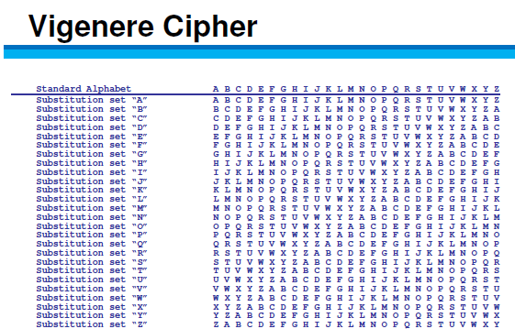
Vignere
First polyalphabetic cipher
Key word is agreed upon ahead of time
First letter of the key is matched up against first letter of the message, and so on

Slide 136
C | I | S | S | P
S | T | U | D | Y
U

Slide 137
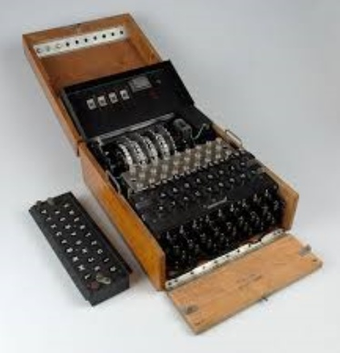
Cryptography in Warfare
Enigma Machine/Purple Machine
Used by the Germans/Japanese in WWII
Breaking the cryptography of these devices is credited with reducing the length of the war.

Slide 138
Vernam Cipher
One Time Pad
Only mathematically unbreakable form of cryptography
Key must be used only once
Pad must be at least as long as the message
Key pad is statistically unpredictable
Key Pad must be delivered and stored securely
XOR (Exclusive Or)
Alike= 0
Different= 1
Plaintext 1 0 1 1 1 0 1 1
Secret (Key) 0 1 1 0 1 1 0 1
Ciphertext 1 1 0 1 0 1 1 0

Slide 139
Cryptography Basics

Slide 140
Security Services provided by Cryptography
Privacy: Prevents unauthorized disclosure of information
Authenticity: Verifies the claimed identity
Integrity: Detects modification or corruption
Non-Repudiation: Combines authenticity and integrity. A sender can’t dispute having sent a message, nor its contents.

Slide 141
Definitions and Concepts
Plain Text + Initialization Vector + Algorithm (aka Cipher) + Key
=
Cipher Text
Plain Text + Initialization Vector + Algorithm (aka Cipher) + Key
=
Cipher Text

Slide 142
Initialization Vector
Here are some random numbers (I promise, they’re really random!)
7 5 2 3 4 9 4
If we start at track 0 and +7 +5 – 2 +3 + 4 +9 -4
We still don’t have randomness. Vary the starting point and that will make the process more random
Very similar to a “seed” or a “salt”---Password

Slide 143

Algorithm

Slide 144
Elements of Cryptography
Desirable Qualities of an Algorithm
Confusion
Diffusion
Chaining
Permutations
Open—Kerckhoff's Principle
Desirable Qualities of a Key
Long
Random
Secret

Slide 145
Definitions and Concepts
Plain text is unencrypted text
Initialization Vector (IV) adds randomness to the beginning of the process
Algorithm is the collection of math functions that can be performed
Key: Instruction set on how to use the algorithm

Slide 146
Symmetric Cryptography

Slide 147
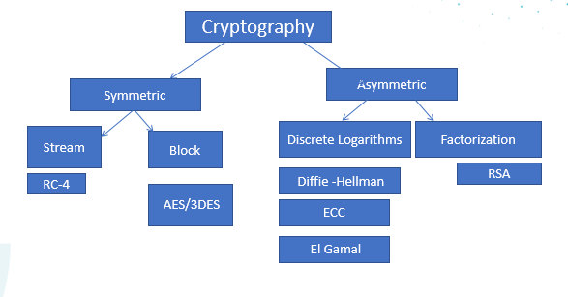
Cryptography
PGP (Pretty Good Privacy)
Proprietary Algorithm: IDEA

Slide 148
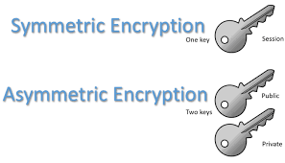
Cryptography Overview
N * (n-1)
2
Symmetric Cryptography
Pros
Provides FAST data transfer
Good strong privacy
Cons
Out of band key distribution
Doesn’t scale well
Doesn’t provide non-repudiation
Can be called “Secret,” “Private,” “Shared,” or “Session” Key
A single key is shared by both parties and is used to encrypt and decrypt
Symmetric ciphers are either
Stream (One bit at a time)
Block (chunks of data)
Asymmetric Cryptography
Every user has a “key pair” which consists of a public and a private key
Anything encrypted with one key can only be decrypted by the other. More on this later!

Slide 149
Symmetric Cryptography: Stream vs. Block
Stream Ciphers encrypt one bit (up to one byte) of data at a time.
Transposition, Substitution, XOR
Very fast and efficient
Not as Secure
RC-4 is the only stream cipher necessary for the test
Block Ciphers chunk data into blocks. Each chunk goes through a series of math functions called S-boxes

Slide 150
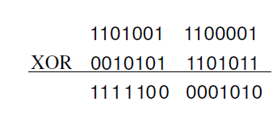
Stream Ciphers XOR
If Values are:
Alike 0
Different 1

Slide 151
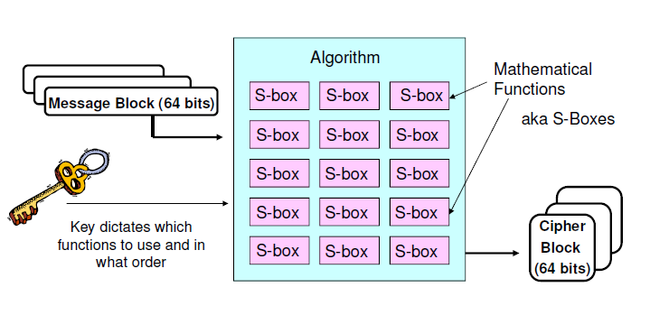
Block Ciphers

Slide 152
Common Symmetric Algorithms
Blowfish
IDEA
CAST
MARS
Skipjack
DES
3DES
AES
RC-4
RC-5
Two Fish

Slide 153
Asymmetric Cryptography

Slide 154
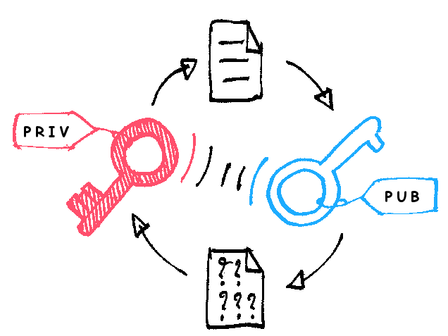
Asymmetric Cryptography
Every user has a key pair.
Public key is made available to anyone who requests it
Private key is only available to that user and must not be disclosed or shared
The keys are mathematically related so that anything encrypted with one key can only be decrypted by the other.

Slide 155
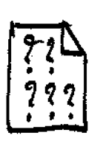
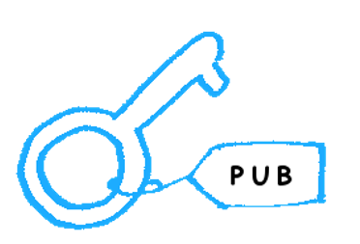


Privacy through Asymmetric Cryptography
Receiver’s
Sender encrypts message with receiver’s
Public Key
EncryptedMessage
Receiver decrypts message with receiver’s
Private Key
Receiver’s
Decrypted Message

Slide 156
Authenticity through Asymmetric Cryptography
Sender encrypts something small and meaningless (timestamp) to an attacker with Sender’s Private Key
Sender’s Private
Timestamp, (not message)
Receiver decrypts timestamp with Sender’s
Public Key, proving it had to have been encrypted by Sender’s private key
Sender’s Public
Timestamp, (not message)
Being able to decrypt the timestamp with Sender’s public key PROVES it was encrypted with Sender’s private key
Notes:
What are we trying to prove? The AUTENTICITY of the SENDER. What does the sender have that no one else does? Sender’s private key. Why must what’s encrypted be meaningless to an attacker? Because anyone with the sender’s public key can decrypt it. Remember, this is not about privacy. The sender just needs something to encrypt with its private key. If the Sender’s public key can decrypt, it CAN ONLY have been encrypted with the sender’s private key, which proves it came from the sender.

Slide 157
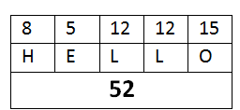

Hashing (Checksums/Message Digests)
Fixed length digital representation of the contents of the file
If the file changes, the hash will change
One-way math
When two different documents produce the same hash it is called a collision
A birthday attack is an attempt to cause collisions. It is based on the idea that it is easier to find two hashes that happen to match than to produce a specific hash.
If an attacker has the ability to change the message, why wouldn’t they change the hash also? THEY WOULD. So……remember this for later.
MD-5 128-bit
SHA-1 160-bit
SHA-2 256, 384, 512, etc.
HAVAL, TIGER, RIPEMD are lesser known hashing algorithms
Encrypted with Sender’s private

Slide 158
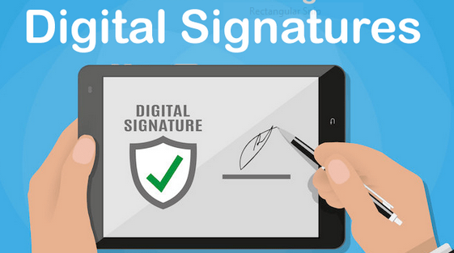
Non-Repudiation
Sender hashes document for integrity
Hash is encrypted with SENDER’S PRIVATE Key
Message is sent to user, who tries to decrypt the hash with the SENDER’S PUBLIC KEY. Only something that was encrypted by the sender’s private key can be decrypted with the sender’s public. This proves the authenticity of the sender
Sender encrypts the hash with Sender’s Private Key

Slide 159
Asymmetric P.A.I.N—Digital Envelope
Asymmetric Key Xchange Encrypted with a Receiver’s Public Key
Privacy: Receiver’s Public Key
Authenticity: Sender’s Private Key
Integrity: Hash/checksum/Message Digest—neither symmetric nor asymmetric
Non-Repudiation: Hash encrypted by sender’s private key
Message Contents
Symmetric Key
Encrypted with a Symmetric Key (Symmetric Data Xchange)
Encrypted with a Sender’s Private Key Non-Repudiation (Digital Signature)
Hash (Integrity)

Slide 160
Common Asymmetric Algorithms
DSA
RSA
ECC (Elliptical Curve Cryptography)
El Gamal
Diffie Hellman
Knapsack

Slide 161
Asymmetric RSA and DSA ECC El Gamal DH Knapsack

Slide 162

The Buddy System for Asymmetric Algorithms
RSA and DSA
ECC and El Gamal
DH (Diffie Hellman) and Knapsack

Slide 163
RSA
Named for Rivest, Shamir, and Adleman, the creator
Currently the standard for Digital Signatures
Uses the idea that there is no efficient way to factor the product of large prime numbers
The math used for RSA is sometimes referred to as a trap-door function
****Factorization*****
Notes:
Y

Slide 164
Diffie-Hellman
The first asymmetric algorithm
Secure key-agreement without pre-shared secrets
Based on discrete logarithms in a finite field

Slide 165
ECC (Elliptical Curve Cryptography)
Based upon plotting points along a curve
Very efficient, but only applicable for key agreement, digital signatures, pseudo-random generators and other tasks
Frequently used for handheld devices due to their limited processing capability

Slide 166
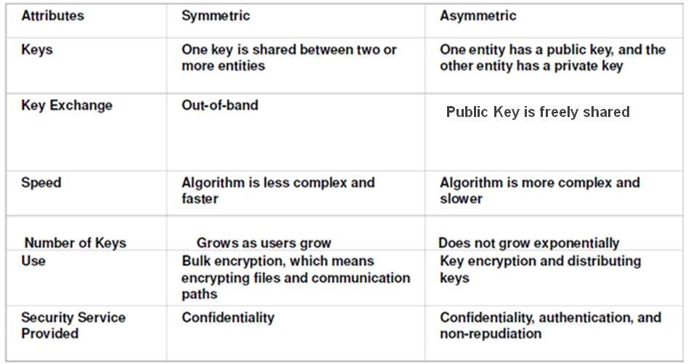
Summary of Symmetric vs. Asymmetric
Each communication channel is encrypted with a single key (Same key encrypts and decrypts so it must be shared between parties
Every user has a public and private key related so that anything encrypted with one key can only be decrypted by the other
N*(N-1) / 2
10* 9/2 = 45
2N

Slide 167
Hybrid Cryptography

Slide 168
Hybrid Cryptography
What We’d Like to Achieve
Privacy
Authenticity
Integrity
Non-Repudiation
SPEED
Our Problem: Neither Symmetric nor Asymmetric can provide ALL these services

Slide 169



SSL/TLS
Secure Web Server
(BofA.com)
Asymmetric Key Exchange
Symmetric Data Exchange
1. https://BofA.com
2. BofA sends its public key
Client
Encrypted with BofA’s public key (8675309—symmetric session key)
8675309
8675309
Client’s web browser generates a symmetric session key
Clients uses Server’s public key to encrypt the symmetric key and sends it to the server.
Server uses its private key to decrypt the symmetric key. Now that both parties know the symmetric key, they use symmetric encryption to encrypt the remainder of the communication

Slide 170
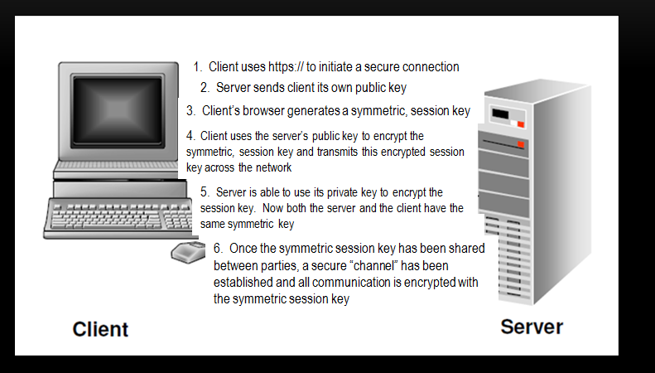
SSL/TLS Hybrid Cryptography
(8675309)
(8675309)

Slide 171
SSL/TLS Hybrid Cryptography
Client initiates a secure connection
Server responds by sending it’s public key to the client
The client then generates a symmetric session key.
Client encrypts uses the server’s public key to encrypt the session key.
Client sends the session key (encrypted with the server’s public key) to the server
Server uses it’s private key to decrypt the session key
Now that a symmetric session key has been distributed, both parties have a secure channel across which to communicate.

Slide 172
Public Key Infrastructure

Slide 173

Sounds Good, but….
How does the server get a key pair?
What happens if keys are compromised?
How do we know we have compatible software to exchange keys?
Do keys ever expire?
How would we renew them?
Stay tuned to the answers to these and many more questions…

Slide 174
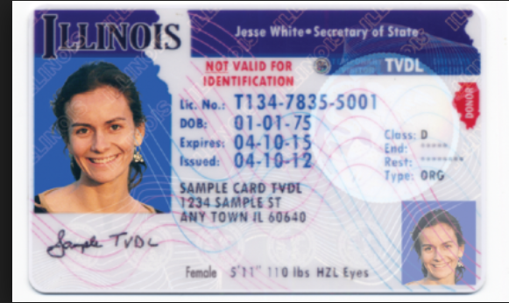
How Do we Prove our Identity?
Name?
Expiration Date
Class?
Serial Number?
Is it standardized?
Is it issued by a trusted authority?

Slide 175
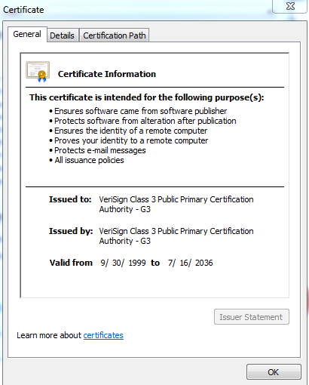
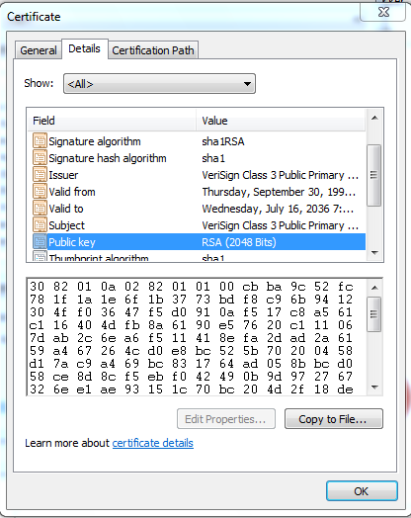
Certificates
X.509 v.4 standard
Provides authenticity of a server’s public key
Necessary to avoid MITM attacks with server’s using SSL or TLS
Digitally signed by Certificate Authority

Slide 176
PKI (Public Key Infrastructure)
Certificate Authority (CA)
Registration Authority (RA)
Certificate Repository
Certificate Revocation List

Slide 177
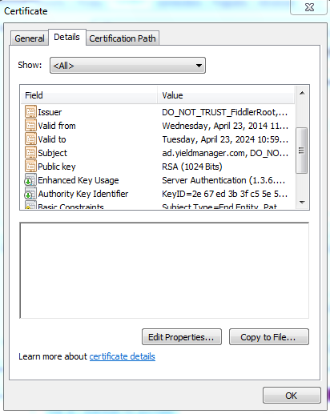
Certificate Contents

Slide 178
Certificate Revocation
CRL: CA publishes CRL. Client is responsible for downloading to see if a certificate has been revoked.
OCSP (Online Certificate Status Protocol) Streamlines the process of verifying whether or not a certificate has been revoked.

Slide 179
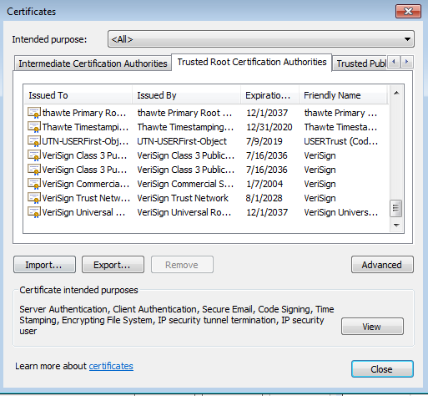
Trusted Certificate Authorities

Slide 180
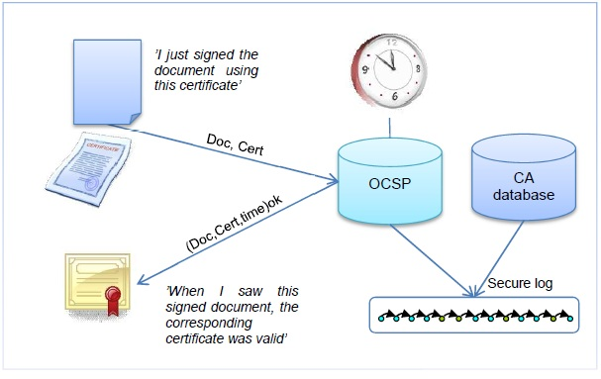
OCSP (Online Certificate Status Protocol)
OCSP: Streamlines the process of verifying whether a certificate has been revoked

Slide 181
MACs (Message Authentication Codes)

Slide 182
Integrity
Data could be modified
Accidentally through corruption
Intentionally through malicious alteration
Hash: only good for accidental modification
MAC: Provides reasonable authenticity and integrity not strong enough to be non-repudiation (because it uses a symmetric key)
Digital Signatures: Can detect both malicious and accidental modification, but requires an overhead. Provides true non-repudiation

Slide 183
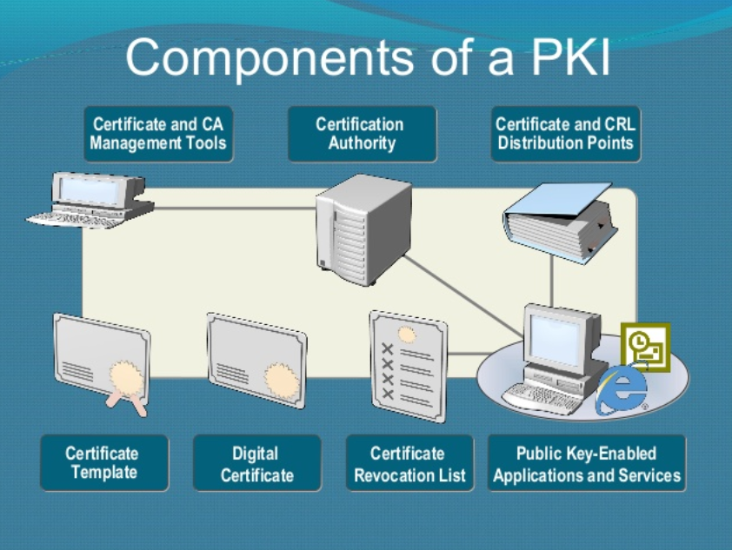
Quick Integrity Review
Hashing is only good for accidental modification/corruption, because a malicious attacker would simply modify the hash to evade detection
Digital Signatures use the sender’s private key + a hash to guarantee the integrity AND the origin of a message…but it requires lots of OVERHEAD of a Public Key Infrastructure

Slide 184
MAC (Message Authentication Code)
Message + Symmetric Number +Hashing algorithm
= HMAC➔ CBC MAC
Integrity and (reasonable) authenticity
A MAC does not provide true authenticity (symmetric)

Slide 185
How It All Fits Together

Slide 186
Applications, Protocols, Cryptosystems and Algorithms For Web Traffic
Application: User interface—Web Browser (Explorer, Edge, Firefox, etc) & Web Server (Apache, IIS)
Protocol: Specifies rules of communication—HTTP or HTTPS (which mandates a cryptosystem be used)
Cryptosystem: Framework to provide protection for data--SSL/TLS
Algorithm: Provides the math for the actual encryption.

Slide 187
Applications, Protocols, Cryptosystems and Algorithms For Mail
Application: User interface—Mail Client (Outlook) and Mail Server (Exchange)
Protocol: Specifies rules of communication—Secure SMTP or Secure POP3 or Secure IMAP
Cryptosystem: Framework to provide protection for data—S/MIME or PGP
Algorithm: Provides the math for the actual encryption process: AES is most popular or if using PGP the algorithm is IDEA

Slide 188

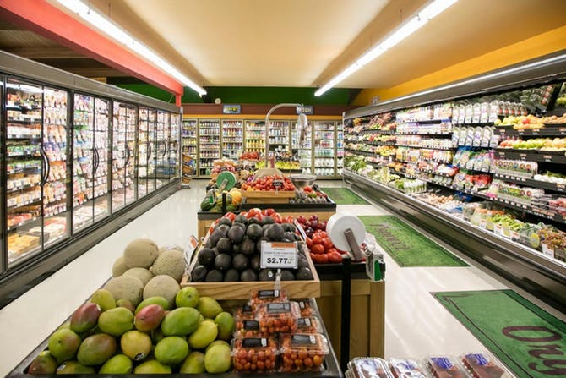
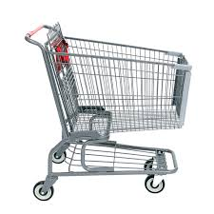
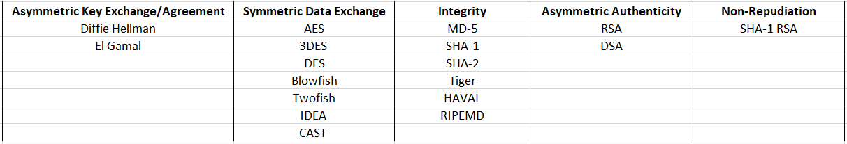
CRYPTO-MART

Slide 189
IPSec

Slide 190
IPSec
Provides the framework for services such as encryption, authentication, integrity (any or all of these services may be provided)
IPSec provides encapsulation, not encryption
What is encapsulated can be protected through the protocols within IPSec

Slide 191




Encapsulation: Packaging (Not Encrypting)
Think about shipping something fragile… for instance, Champaign glasses. You could just stick a stamp on them, but they would break….so, you add packaging them up to get to the correct destination safely and intact.
We wrap Champaign glasses in bubble wrap to protect them
Then we put the glasses in a box with bubble wrap
We gift wrap the box and write, “Best wishes, Uncle Steve!”
We put that box in a bigger box with packing peanuts for more protection
We put that box in a Fed Ex box with a Fed Ex label to provide information for the package to traverse the carrier’s network
We hand off the package to Federal Express and the champaign glasses are on their way!
Missing step: Remove Pug from bubble wrap
Missing Step: Remove Cat from Packing Peanuts

Slide 192
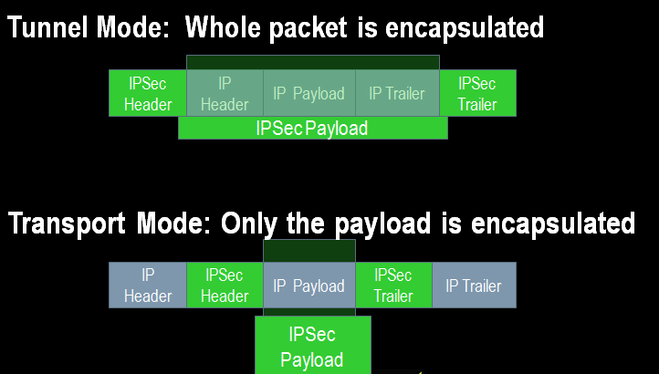
IPSEC
IPSEC is an encapsulation framework. Tunnel vs. Transport mode dictates what portion of the IP Packet is to be encapsulated.

Slide 193
IPSec Sub-protocols
AH (Authentication Header) Provides integrity, authenticity, and non-repudiation through the use of an ICV (Integrity Check Value). The ICV is run on the entire packet (header, data, trailer) except for particular fields in the header that are dynamic (like TTL, etc). NO CONFIDENTIALITY
ESP (Encapsulating Security Payload) Provides authenticity and integrity through a MAC (no non-repudiation since a MAC is symmetric). The main service provided is ENCRYPTION. ICV is run on payload only.
IKE: Internet Key Exchange---No Security Services. Just management of secure connection
Oakley: Uses Diffie Hellman to agree upon a key
ISAKMP (Internet Security Association and Key Management Protocol) Manages Keys, Security Associations (SAs)and Security Parameters Index (SPI)
Notes:
IPSEC (Internet Protocol Security) Made up of several sub-protocols:
AH: Provides Authentication and Integrity. To provide integrity, AH uses an ICV (Integrity Check Value), which is essentially the same as a Message Authentication Code (provides system based, aka data origin authentication). This integrity check is performed on the whole packet, not just the data. This ensures that neither the data nor headers/trailers have been altered. This can cause problems with NAT.
ESP (Encapsulating Security Payload) provides encryption, authentication, and integrity checking on just the payload, so it is compatible with NAT.
IPSEC can operate in transport or tunnel mode. Transport mode is used for securing communications between end users on a network. Just the payload is encrypted.
Tunnel Mode is for securing WAN communication. Data, headers, trailers encrypted.
An SA (Security Association) functions in a manner similar to a socket. It tracks each secured session and contains information about that session and allows multiple IPSec connections to/from the same system. Each connection has two SA’s, one on each end. Computer A will have an SA to identify connection1 to Computer B—that SA might be called “1234”. Computer B will have an SA to identify it’s session with Computer A. That SA could be called “4321”. The point is, though the SA is known by different “names” on each computer, it’s really identifies the one connection.
There are two ways IPSEC manages keys. Each device wishing to communicate can be configured with a symmetric key, SA info, and other info. Or, the Internet Key Exchange (IKE) can be used. IKE is made up of two protocols, ISAKMP—Internet Security Association and Key Management Protocol-- and Oakley). How does this come into play?
If I want to establish a secure VPN connection between two routers, those routers will use a handshaking process to exchange security parameters like algorithms, key size, etc. This is information that you would not want a hacker to acces. Here’s where IKE comes in. First IKE is used to establish a secure channel between the routers. It uses Diffie Hellman to get a secure session key on each end. Second, that session key is used to encrypt VPN parameters. These parameters are stored as a part of the SA. Now, the data can be transmitted securely.

Slide 194

Security Associations and SPIs
Security Association
There will be at least two SAs for every secure connection

Slide 195
Email Cryptosystems

Slide 196
Implementation of Cryptography: Digital Envelopes in S/MIME
S/MIME (Secure Multipart Internet Mail Exchange) :
Standards based secure email by creating a digital envelope
Sender functions:
Calculate hash value on message
Encrypt message with session key
Encrypt hash value with private key
Encrypt session key with receiver’s public key
Receiver functions:
Decrypt session key with private key
Decrypt hash value with sender’s public key
Decrypt message
Calculate hash value and compare with one sent

Slide 197
Implementation of Cryptography: PGP (Pretty Good Privacy)
Proprietary mail standard from Phil Zimmerman
Free, but proprietary software must be installed
Uses Web of Trust
Passphrases instead of passwords
Learned keys are stored in a file called the key ring

Slide 198
Attacks on Cryptography

Slide 199
Attacks on Cryptography
Ciphertext Only: Attacker has captured encrypted text on the network. Usually means all the attacker can do is brute force
Known Plain Text: The attacker has captured cipher text, but also knows what a portion of the message is in plain text (like an automatic signature)
Chosen Plaintext: Attacker can see the full text encrypted and decrypted. Usually the attacker has initiated the message
Chosen Ciphertext: An attacker can see whatever they want in plain or ciphertext. They have compromised a workstation. Sometimes called a lunchtime or midnight attack.

Slide 200
Attacks on Cryptography Continued
Meet in the Middle (Not to be confused with Man in the Middle). These attacks are targeted towards algorithms like 3DES where there are multiple key. An attacker tries to learn what each key does individually.

Slide 201
Cryptography Review
Cryptography throughout History
Cryptography Basics
Symmetric Cryptography
Asymmetric Cryptography
Hybrid Cryptography
Public Key Infrastructure
MACs
IPSec
Email Crytography
Attacks on Cryptography

Slide 202
Domain 3 Security Architecture and Engineering
Part 2 : Security Architecture and Design

Slide 203
Domain 3 Part 2: Security Architecture and Design Agenda
Security Models
System Architecture
The Trusted Computing Base
Hardware Architecture
Software: Operating System Architecture
Software: Application Architecture
Secure Modes of Operation
Certification and Accreditation

Slide 204
Security Models

Slide 205
Security Models and Architecture
A security model Provides the means to formalize a system policy into an explicit set of rules that a computer can follow to implement the fundamental security concepts, processes, and procedures that make up a security policy
The system architecture, in turn, is the overall design and description of the interaction of (HW, SW, Applications, etc.) of an information system.
This architecture should enforce the specifications provided by the security model.

Slide 206
Security Models
State Machine Model
**The Bell-LaPadula Model
**The Biba Model
The Clark-Wilson Model
The Brewer & Nash Model
The Information Flow Model
The Non-Interference Model
The Lattice Model

Slide 207
State Machine Model
The state of a system is its snapshot at any one particular moment. The state machine model describes subjects, objects, and sequences in a system. The focus of this model is to capture the system’s state and ensure its security.
When an object accepts input, the value of the state variable is modified. For a subject to access this object or modify the object value, the subject should have appropriate access rights.
State transitions refer to activities that alter a systems state.

Slide 208
Bell-LaPadula Model
Confidentiality model
Developed by David Elliot Bell and Len LaPadula
This model focuses on data confidentiality and access to classified information.
A Formal Model developed for the DoD multilevel security policy
This formal model divides entities in an information system into subjects and objects.
Model is built on the concept of a state machine with different allowable states (i.e. Secure state)

Slide 209

Bell Lapadula
Three Rules to enforce confidentiality:
Simple Security Property – “no read up”
A subject cannot read data from a security level higher than subject’s security level.
*_Security Property – “no write down”
A subject cannot write data to a security level lower than the subject’s security level.
Strong * Property – “no read/write up or down”.
A subject with read/write privilege can perform read/write functions only at the subject’s security levels.
Tranquility Property: Security Lables cannot be arbitrarily changed

Slide 210
Brooke has “confidential” clearance. According to BLP’s *_ Security Policy, which files can Brooke write? According to Biba’s simple Integrity Axiom, to which files can Brooke read?
 | A | B | C | D
TOP |  | X
SECRET | X
CONFIDENTIAL |  |  |  | X
SBU |  |  | X

Slide 211
Biba Integrity Model
Protecting the Sanctity of Knowledge
3 D’s Down Data’s Dirty
Developed by Kenneth J. Biba in 1977 based on a set of access control rules designed to ensure data integrity
No subject can depend on an object of lesser integrity
Based on a hierarchical lattice of integrity levels
Authorized users must perform correct and safe procedures to protect data integrity

Slide 212


Biba Integrity Model
Three Rules:
Simple integrity axiom – “no read down” – A Subject cannot read data from an object of lower integrity level.
*_Integrity axiom – “no write up” A Subject cannot write data to an object at a higher integrity level.
Invocation property – A subject cannot invoke (call upon) subjects at a higher integrity level.
Simple Integrity Axiom
*_Integrity Axiom
Invocation Property

Slide 213
Clark-Wilson
Integrity model
Model Characteristics:
Clark Wilson enforces well-formed transactions through the use of the access triple:
User➔Transformation Procedure➔CDI (Constrained Data Item)
Deals with all three integrity goals
SEPARATION of DUTIES
Prevents unauthorized users from making modifications
Prevents authorized users from making improper modifications
Maintain internal and external consistency – reinforces separation of duties

Slide 214
Commercial Models: Brewer-Nash
Brewer-Nash Model – a.k.a. Chinese Wall
Developed to combat conflict of interest in databases housing competitor information
Publish in 1989 to ensure fair competition
Defines a wall and a set of rules to ensure that no subject accesses objects on the other side of the wall
Way of separating competitors data within the same integrated database

Slide 215
According to Brewer-Nash, upon initial access, a user can access which of the following? A. Any B. None C. All D. One According to Brewer-Nash, upon subsequent access, a user can access which of the following? A. Any B. None C. All D. One

Slide 216
Information Flow Model
Data is compartmentalized based on classification and the need to know
Model seeks to eliminate covert channels
Model ensures that information always flows from a low security level to a higher security level and from a high integrity level to a low integrity level.
Whatever component directly affects the flow of information must dominate all components involved with the flow of information

Slide 217
Non-interference Model
Model Characteristics:
Model ensures that actions at a higher security level does not interfere with the actions at a lower security level.
The goal of this model is to protect the state of an entity at the lower security level by actions at the higher security level so that data does not pass through covert or timing channels.

Slide 218
Lattice Model
Model consists of a set of objects constrained between the least upper bound and the greatest lower bound values.
The least upper bound is the value that defines the least level of object access rights granted to a subject.
The greatest lower bound is value that defines the maximum level of object access rights granted to a subject
The goal of this model is to protect the confidentiality of an object and only allow access by an authorized subject.

Slide 219
System Architecture

Slide 220
Security Architecture Overview
Security architecture directs how the components included in the system architecture should be organized and interact to ensure that security requirements are met.
A description of the locations in the overall architecture where security measures should be placed.
A description of how various components of the architecture should interact to ensure security.
The security specifications to be followed when designing and developing the system.

Slide 221
The Trusted Computing Base

Slide 222
The Trusted Computing Base
Trusted Computing Base: The trusted computing base (TCB) consists of all hardware, software, and firmware within a system that provide enforces the security of a system and provides a description of the trust of a system.
Security Perimeter: Conceptual separation between the TCB and the untrusted elements of a system
TCB components include the CPU, RAM, the OS Kernel, BIOS, etc.
The TCB is what is evaluated when certifying a system

Slide 223
Hardware Architecture

Slide 224

Hardware Architecture
Central Processing Unit (CPU)
Registers
ALU
Math Co-processor
Memory
ROM
RAM
SRAM
Cache L1, L2, etc
DRAM
Flash
Virtual Memory
Input/Output (I/O)
System Bus & Channels
System Bus
Data Bus
Control Bus
Storage
Magnetic
Optical
Solid State
Notes:
A system bus is a single computer bus that connects the major components of a computer system
Data bus carries information
An Address Bus determines where in memory the data should be sent,
Control bus to determine its operation

Slide 225
CPU Protection Mode
The unrestricted mode is often called kernel mode (aka supervisor mode, privileged mode, etc.).
the CPU may perform any operation, access any location in RAM, perform I/O operations, without restrictions
Restricted mode is usually referred to as user mode or problem state. In this mode, the CPU is prevented (by other elements of the architecture) from performing any activity that may impact the security of a system

Slide 226
Memory
Memory
ROM (Read Only Memory)
RAM (Random Access Memory)
SRAM (Static RAM)
Cache L1, L2, etc
DRAM (Dynamic RAM)
Flash
Virtual Memory (Swap or paging file located on permanent storage

Slide 227

Storage
Temporary
RAM
Permanent
Magnetic
Optical
Solid State

Slide 228
System Buses
There are generally two buses within a computer. The first is the internal bus (sometimes called the front-side bus, or FSB for short). The internal bus allows the processor to communicate with the system's central memory (the RAM).
The second is the expansion bus (sometimes called the input/output bus), which allows motherboard components (i.e. USB, serial, sound, NIC], cards inserted in expansion slots, hard drives, CD-ROM and CD-RW drives, etc.) to communicate with one another.

Slide 229
Software: Operating System Architecture

Slide 230

CPU Modes & Protection rings
Protection Rings isolate layers of trust to ensure that competing processes do not affect each other or harm critical system components.
Ring 0 – Operating system kernel (supervisor /privilege mode)
Ring 1 – Remaining parts of the operating system (OS)
Ring 2 – Operating system and I/O drivers and OS utilities
Ring 3 – Applications (Programs) and user activity

Slide 231
Operating System Kernel
The reference monitor concept deﬁnes the set of design requirements to make the determination regarding subject/object access. It provides the rules that govern access. Think: The law
The security kernel are the actual components which enforce the rules of the reference monitor. Think: The police
Three requirements for the reference monitor/security kernel
Must facilitate isolation of processes
Must be invoked at every access attempt.
Must be small enough to be tested and verified in a comprehensive manner.
Security Policy – a set of rules on how resources are managed within a computer system.

Slide 232
Programs, Processes, Threads
Program: An Application
Process: A program loaded into memory
Thread: Each individual instruction within a process
Multi-programming: Multiple programs “open” but no true isolation
Multi-tasking: Isolation of processes—more than a single Process can run at one time
Multi-processing – more than one CPU
Multi-threading—in the past multiple CPUs were needed.
Multi-core processors provide hardware multithreading

Slide 233
Software: Application Architecture

Slide 234

Web Services
Web Services allow different applications to communicate with each other regardless of platform, programming language or operating system
Web Services rely on standards-based APIs and Service Oriented Architecture

Slide 235

APIs
Programing code that governs how a web service can request information or services. APIs define 3 primary elements:
Access: who is allowed to ask for data or services.
Request: what data or services can be asked for (e.g., if I give you an address can you tell me how to get there?). Requests have two main parts:
Methods: the type of questions you can ask, assuming you have access (it also defines the type of responses available).
Parameters: additional details you can include in the question or response.
Response: the data or service for your request.
The map we left her and the fact that the coffee shop was open gave her access to the API.
When she got to the coffee shop, she had access to the menu with all the different options. She knew what you can ask for (methods) and the options and details (parameters). This told her how to place her request for food. Once Rachel placed her request, the barista played the role of the API and sent a message to the kitchen.
Rachel then just had to wait for the response in the form of food and beverage, which the barista, acting as the API, delivered to her with a smile (nice folks at The Grind).

Slide 236

Cloud Architecture
https://www.pinterest.com/backboneforbigd/sme/

Slide 237
Secure Modes of Operation

Slide 238
Secure Modes of Operation
Single State
Multi State
Compartmented
Dedicated

Slide 239

Multi-state
Single State

Slide 240


Compartmented
Dedicated

Slide 241

Single State Compartmented
Single State Dedicated

Slide 242


Multi-State, Comparted
Multi-State, Dedicated

Slide 243
Certification and Accreditation

Slide 244
Evaluation Criteria
Why Evaluate?
To carefully examine the security-related components of a system
Trust vs. Assurance
CMMI
The Orange Book (TCSEC)
The Orange Book & the Rainbow Series
ITSEC (Information Technology Security Evaluation Criteria)
Common Criteria

Slide 245
Trusted Computer Security Evaluation Criteria (TCSEC)
Developed by the National Computer Security Center (NCSC)
Also known as the Orange Book
Based on the Bell-LaPadulla model (deals with only confidentiality)
Uses a hierarchically ordered series of evaluation classes
Defines Trust and Assurance, but does not allow for them to be evaluated independently

Slide 246
TCSEC Evaluation
Trusted Computer Security Evaluation Criteria (TCSEC) aka “The Orange Book”
Ratings:
A1 – Verified Protection
B1, B2, B3 – Mandatory Protection
C1, C2 – Discretionary Protection
D – Minimal Security

Slide 247
IT Security Evaluation Criteria (ITSEC)
Created by a collection of European nations in 1991 as a standard to evaluate security attributes of computer systems
The First Criteria to evaluate functionality and assurance separately
F1 toF10 rates for functionality
E0 to E6 for assurance

Slide 248

Common Criteria ISO 15408
International Standard to certify based on the TRUST and ASSURANCE of a system
Protection Profile: Requirements from Agency or Customer
Target of evaluation: System Designed by Vendor
Security target Documentation describing how ToE meets Protection Profile
Evaluation Assurance Level (EAL 1-7) Describes the level to which ToE meets Protection Profile

Slide 249
Common Criteria EAL Ratings
EAL 1 – Functionally tested
EAL 2 – Structurally tested
EAL 3 – Methodically tested and checked
EAL 4 – Methodically designed, tested, and reviewed
EAL 5 – Semi formally designed and tested
EAL 6 – Semi-formally verified designed and tested
EAL 7 – Formally verified designed and tested

Slide 250
Certification & Accreditation
Certification:
A process that ensures systems and major applications adhere to formal and established security requirements that are well documented and authorized.
It is usually performed by a vendor.
Accreditation:
A formal declaration by a Designated Accrediting Authority (DAA) that information systems are approved to operate at an acceptable level of risk based on the implementation of an approved set of technical, managerial, and procedural safeguards.

Slide 251
Domain 3 Part 2: Security Architecture and Design Review
Security Models
System Architecture
The Trusted Computing Base
Hardware Architecture
Software: Operating System Architecture
Software: Application Architecture
Secure Modes of Operation
Certification and Accreditation

Slide 252
Domain 4 Networking and Telecommunications

Slide 253
Communications and Network Security Agenda
OSI Reference Model
Physical
Data Link
Network
Transport
Session
Presentation
Application
TCP/IP Model and OSI Review
Security Zones and Firewalls
Remote Access Protocols
Tunneling
Wireless Networking

Slide 254
The OSI Reference Model

Slide 255

What is the OSI Model and Why Do We Need It?
Promotes interoperability between vendors
Enables standardization
Describes the encapsulation (Packaging) of data to enable it to get from point A to point B
DATA
DATA
DATA
SEGMENT
PACKET
FRAME
BITS

Slide 256
Physical Layer

Slide 257

1. Physical Layer

Slide 258







OSI Model – Layer 1 Physical
Layer 1 Physical – simply put is concerned with physical connectivity and sending electric signals over a medium.
All hardware devices have a point of connection, therefore at least partially have a layer 1 element
HUB

Slide 259







Layer 1 (Physical) Threats
Threats:
Theft
Unauthorized Access
Vandalism
Sniffing
Interference
Data Emanation

Slide 260
Data Link Layer

Slide 261

OSI model – Layer 2 Data Link
Data Link Layer
Only Layer of the OSI Model with 2 Sub-layers
LLC Logical Link Control—error detection
MAC Media Access Control—
CSMA/CD Carrier Sense Multiple Access with Collision Detection (IEEE standard) 802.3 Ethernet
CSMA/CA Carrier Sense Multiple Access with Collision Avoidance(IEEE standard) 802.11 Wireless
Token Passing: 24 bit control frame passed around the network environment with the purpose of determining which system can transmit data. There is only one token and since a system can’t communicate without the token, there are no collisions.

Slide 262

Ethernet
Carrier Sense Multiple Access with Collision Avoidance
Used by ethernet
Contention (or collision based)
Multiple systems can access the network, but data will collide
Collisions slow things down!
Ethernet requires the resolution of an IP address to a MAC address

Slide 263

MAC Addresses
Notes:
A MAC address is a 48 bit hexadecimal address used to identify each network interface uniquely on the network. Every network card should have a unique MAC address assigned at the manufacturer. The first 24 bits identify the manufacturer and the last 24 bits identify the individual NIC. Though this address does not contain enough information to locate the interface anywhere in the world, once traffic has been resolved to the local network, the MAC is then used to find the interface. ARP (Address Resolution Protocol) is the protocol used to broadcast an IP address to learn the corresponding MAC. ARP cache is used to store MAC addresses already learned. ARP Poisoning is the modification of that cache, usually for malicious redirection.

Slide 264


ARP
Notes:
ARP poisoning is manipulating a system’s ARP cache, usually for the purpose of redirection to a rogue device. Block unsolicited replies as a way of limiting the risk associated with cache poisoning—this could also be called cache pollution and can happen with webservers, DNS servers and any application that uses cache

Slide 265

Switch
By default, switches operate at layer 2
Uses MAC addresses to direct traffic
Isolates traffic into collision domains
Does NOT isolate broadcasts natively
Notes:
Never underestimate the important of physical security for network devices. If possible restrict remote access and only allow administrative access through the local console. This method will force an intruder to go through a layer of physical security. If remote access must be allowed, use SSH (encrypted) instead of telnet (unencrypted).
MAC flooding will overwhelm a switch’s CAM table where learned MAC addresses are stored. If the CAM table does not a have an address, the switch sends a broadcast out all ports, just like a hub. This means an attacker can listen (sniff) for that traffic on any port.

Slide 266
Hub Layer 1—All data out all ports all the time—Connectivity that is cheap and easy
J
A
B
Y
HUB
HUB
HUB
K
C
D
Z
SNIFFER Promiscuous Mode

Slide 267
Hub Layer 1—All data out all ports all the time—Connectivity that is cheap and easy
Switch Layer 2—Uses MAC addressing to address traffic out the appropriate port; Collision Domain Isolation
J
A
B
Y
HUB
HUB
HUB
K
C
D
Z
SWITCH

Slide 268
Hub Layer 1—All data out all ports all the time—Connectivity that is cheap and easy
Switch Layer 2—Uses MAC addressing to address traffic out the appropriate port; Collision Domain Isolation
J
A
B
Y
Switch
Switch
Switch
K
C
D
Z
SNIFFER Promiscuous Mode

Slide 269
Hub Layer 1—All data out all ports all the time—Connectivity that is cheap and easy
Switch Layer 2—Uses MAC addressing to address traffic out the appropriate port; Collision Domain Isolation
Router Layer 3—Uses IP Addressing; Broadcast Domain Isolation $$$
VOIP
HR
192.168.1.x
Sales
172.16.x.x
10.x.x.x
J
A
B
Y
Switch
Switch
Switch
K
C
D
Z
Router

Slide 270
Hub Layer 1—All data out all ports all the time—Connectivity that is cheap and easy
Switch Layer 2—Uses MAC addressing to address traffic out the appropriate port; Collision Domain Isolation
Router Layer 3—Uses IP Addressing; Broadcast Domain Isolation $$$
VLAN (Virtual LAN)—Isolates broadcast traffic on a switch (cheaper, easier to configure)
Layer 3 Switch to allow inter-VLAN communication
192.168.1.x
Sales VLAN
HR VLAN
VOIP VLAN
10.x.x.x
172.16.x.x
J
A
B
Y
Switch
Switch
Switch
K
C
D
Z
Router
Layer 2 Switch with VLAN

Slide 271
Hub Layer 1—All data out all ports all the time—Connectivity that is cheap and easy
Switch Layer 2—Uses MAC addressing to address traffic out the appropriate port; Collision Domain Isolation
Router Layer 3—Uses IP Addressing; Broadcast Domain Isolation $$$
VLAN (Virtual LAN)—Isolates broadcast traffic on a switch (cheaper, easier to configure)
Layer 3 switch allows inter-VLAN communication
VOIP
Sales VLAN
HR
192.168.1.x
10.x.x.x
172.16.x.x
J
A
B
Y
Switch
Switch
Switch
K
C
D
Z
Layer 3 Switch with VLAN

Slide 272
Network Layer

Slide 273

OSI model layer 3 network
Routers Isolate traffic into broadcast domains and use IP addressing to direct traffic
Notes:
o secure routers, use access controls lists (ACLs) to limit permitted traffic. Also implement physical security. IP Forwarding should be turned off of devices with multiple interfaces that are NOT acting as routers. Restrict the interfaces on which routers “learn” routes

Slide 274

VLANs
Routers are expensive
To get broadcast isolation on a switch, a VLAN is necessary
Not all switches support VLANs
A Layer 2 switch (even with a VLAN) doesn’t truly understand Layer 3 IP Addressing
A Layer 3 switch is necessary for inter-Vlan Communication

Slide 275
Layer 3 Protocols
All Protocols that start with the letter “I” except IMAP (which is a layer 7 mail protocol)
IP
ICMP – IP “helpers” (like ping)
IGMP – Internet Group Message Protocol
IGRP
IPSEC
IKE
ISAKMP

Slide 276





ICMP
Ping Flood: Sends an overwhelming amount of ICMP echo request packets
SMURF: Uses a spoofed source address (Target) and directed broadcasts to launch a DDos

Slide 277
Transport Layer

Slide 278
OSI model Layer 4 Transport
OSI Layer 4 Transport – Provides end-to-end data transport services and establishes a logical connection between 2 computers systems”
The “pony express”
Protocols used at layer 4-7
SSL/TLS (Discussed in Cryptography Domain)
TCP
UDP

Slide 279
TCP (Transmission Control Protocol)
Connection oriented “guaranteed” delivery.
Advantages
Easier to program with
Truly implements a session
Adds security
Disadvantages
More overhead / slower
SYN Floods

Slide 280

TCP
A reliable, connection-oriented protocol, which uses the three way handshake as seen below

Slide 281
UDP (User Datagram Protocol)
Connectionless
Unreliable
No handshaking
Desirable when “real time” transfer is essential
Media Streaming, Gaming, live time chat, etc
FTP uses TCP
TFTP uses UDP

Slide 282

Best Joke Ever…..
What’s the best thing about a UDP Joke???
I don’t care if you get it or not!

Slide 283
Session Layer

Slide 284

OSI Model Layer 5 Session
OSI Layer 5 (Session) – responsible for establishing a connection between two applications (either on the same computer or two different computers)
Dialogue control
Release connection

Slide 285
Presentation Layer

Slide 286
OSI model Layer 6 Presentation
Present the data in a format that all computers can understand
This is the only layer of OSI that does NOT have any protocols.
Concerned with encryption, compression and formatting
Making sure data is presented in a universal format
File level encryption
Removing redundancy from files (compression)

Slide 287
Application Layer

Slide 288
OSI model Layer 7 – Application
This defines a protocol (way of sending data) that two different programs or applications understand.
HTTP, HTTPS, FTP, TFTP, SMTP, SNMP, etc.
Application Proxies
Non-Repudiation
Certificates
Integration with Directory Services
Time awareness---NTP Network Time Protocol—Controls synchronization of time on systems---Kerberos, digital forensics, and many other services require time synchronization.

Slide 289
I was going to tell you an NTP joke but…
My timing is always off

Slide 290
TCP Model and OSI Review

Slide 291

OSI vs. TCP/IP model

Slide 292
Data and the OSI
Layer | OSI Layer | Functions/Mechanisms
7 | Application | Protocols that support the applications for users. HTTP, HTTPS, SMTP, POP3 Telnet, FTP, TFTP, NTP, NNTP, SNMP, and others
6 | Presentation | Formatting of message and multimedia formatting. GIF, JPEG, MP4, etc.
5 | Session | Headers are added to data for application-to-application communication (client-server.) RPC, SQL, LDAP Identification of communication streams
4 | Transport | Headers are added for acknowledgements and flow control. Port numbers added.. Data has now become a segment. TCP, UDP, SSL, TLS
3 | Network | Logical addressing and best path determination information is added to a segment, which now has become a packet. IP, ICMP, IPSec, IGRP Routers
2 | Data Link | Packet is delivered to layer 2 where MAC Addressing, Media Access Determination, Framing information are added. The packet is now a frame. ARP, RARP, Ethernet, Token Passing. Switches
1 | Physical Layer | Data placed on media. Wiring standards and protocols. Cable types, hubs. Frames are now converted to signal to traverse the physical media.
Layer | OSI Layer | Functions/Mechanisms
7 | Application | Reads the application layer protocol commands (such as, http) and display accordingly thru the user application
6 | Presentation | Interprets and formats the information correctly
5 | Session | Appropriate service is used to access data (based on port numbers) Then session information is used to id the appropriate data stream
4 | Transport | Segments assembled, acknowledgements sent. Port number is used to determine which service is needed. The data is passed upwards to layer 5
3 | Network | Removes the IP header of the Packet and passes the data on so that Transport layer information can be accessed by Layer 4. Data becomes a Segment after Network layer information is removed
2 | Data Link | Data Link headers including MAC addresses, etc are removed and the frame is converted to a packet
1 | Physical Layer | Physical signal is received and translated into bits. Bits are translated into frames and sent to Data Link Layer

Slide 293
Security Zones and Firewalls

Slide 294
Security Zones
It is common practice in network and physical security to group different security levels into different areas or zones. Each zone is either more or less trusted then the other zones. Interfaces between zones have some type of access control to restrict movement between zones (like biometric and guard stations) or firewalls.) In Network security there is often a median zone between the Internet and internal network called a DMZ.

Slide 295

DMZ
A buffer zone between an unprotected network and a protected network that allows for the monitoring and regulation of traffic between the two.
Internet accessible servers (bastion hosts) are placed in a DMZ between the Internet and Internal network
Untrusted
Semi-Trusted
Trusted

Slide 296

Firewalls
Designed to provide filtering between Trust Zones
Software or Hardware Based
Provide isolation and separation
Create zones based on trust
Used Rule-based access control

Slide 297
Firewalls and the OSI Model
Layer 3 (Network Layer)
Stateless Inspection
Packet Filtering
Screening Routers
Inspect Layer 3 & Layer 4 Headers
Source and Destination IP
Source and Destination Port
Protocol (TCP or UDP)

Slide 298
Firewalls and the OSI Model
Layer 5 (Session Layer)
Stateful Filtering
Awareness of the initiation of the session and the state
Can block unsolicited replies
Can understand syntax of lower layer protocols and can block “misbehaving” traffic

Slide 299
Firewalls and the OSI Model
Internet
Internet
Layer 7 (Application Layer)
Called Application Proxies/Firewalls
Deep Packet Inspection
Forward Proxy inspects traffic from inside going out
Reverse Proxy inspects traffic from outside going in
Can inspect on content, time, application-awareness, certificates, etc.
Specific to the application protocol
Forward Proxy
Reverse Proxy
LAN
LAN

Slide 300

NAT/PAT
Source Address of 137.186.57.8 : 5689
NAT 1 to 1
PAT 1 to Many
Private internal use only
10.x.x.x
172.16.x.x-172.31.x.x
192.168.x.x

Slide 301
NAT Network Address Translation—Security (Hiding internal IP addresses from the public)
PAT (Port Address Translation)—Many to One mapping
RFC 1918 Private, Internal IP Address
10.x.x.x
172.16.x.x-172.31.x.x
192.168.x.x.
Internet Connection Sharing
Source: 13.69.2.9 : 7689
A
D
192.168.0.1
Router
13.69.2.9
192.168.0.4
B
C
192.168.0.3
192.168.0.1: 7689
192.168.0.2

Slide 302
NAT / PAT
Advantages
Allows you to use private addresses Internally, you don’t need to get real public IP addresses for each computer
Allows the use of RFC 1918 IP addresses
10.x.x.x
172.16.x.x-172.31.x.x
192.168.x.x
Hides internal network structure
Transparent, doesn’t require special software
Disadvantages
Single Point of Failure / Performance Bottleneck
Doesn’t protect from bad content

Slide 303
Overall Firewall best practices
Block un-necessary ICMP packets types.
(Be careful though, know your environment)
Keep ACLS simple
Use Implicit deny*
Block directed IP broadcasts
Perform ingress and egress filtering*
Block traffic leaving the network from a non-internal address (indicates the network is possibly being used as zombie systems ina possible DDoS attack.
Block all traffic entering the network from an internal address (indicates a potential spoofing attack)
Enable logging
Drop fragments or re-assemble fragments
Firewalls process ACLs in order. The first rule that is valid to the access attempt will be applied immediately (no other rules will be applied)

Slide 304
WAN Technology

Slide 305
LAN, WAN
LAN – local area network
High speed
Small physical area
WAN – wide area network
Used to connect LANS
Generally slow, using serial links

Slide 306

Circuit Switching
PSTN
ISDN
DSL
T-carriers

Slide 307

Packet Switching
X.25
Frame Relay
ATM
IP Networks
VOIP
MPLS
Cable

Slide 308


MPLS (Multi Protocol Labeled Switching)
Label edge router A label edge router (LER, also known as edge LSR or “ingress node”) is a router that operates at the edge of an MPLS network and acts as the entry and exit points for the network. These edge router places an MPLS label on an incoming packet and sends it forward into the MPLS domain. The same job is performed upon receiving a labeled packet which is destined to exit the MPLS domain, the LER removes the label and forwards the IP packet using normal IP address.
Provider router In an MPLS based virtual private network (VPN) environment, LERs that functions as ingress and/or egress routers to the VPN are often called PE (Provider Edge) routers. Devices that function only as transit routers are similarly called P (Provider) routers. The job of a P router is significantly easier than that of a PE router, so they can be less complex and may be more dependable because of this.
Label Distribution Protocol Labels are distributed between LERs and LSRs using the Label Distribution Protocol (LDP). LSRs in an MPLS network regularly exchange label and reachability information with each other using standardized procedures in order to build a complete picture of the network they can then use to forward packets. CE is the “Customer Edge”, the customer device or router a PE router talks

Slide 309

VOIP Voice Over IP

Slide 310
VOIP Security Issues
Eavesdropping (greatest threat)—Enable S/RTP
Toll Fraud
Vishing
SPIT
Performance Issues
Latency
Jittering

Slide 311
Remote Access Protocols

Slide 312
Remote Access
Dial Up
PPP
PAP, CHAP EAP
Tunneling
PPTP
PAP, CHAP EAP
MPPE
GRE
L2TP
IPSEC
IPSEC
Wireless
Encryption
WEP, WPA, WPA II
Authentication
802.1x

Slide 313

Dial-up
PPP Point to Point Protocol: Provides Layer 2 framing for dial-up. Needs other protocols for security
Authentication:
PAP (Password Authentication Protocol): Clear Text
CHAP (Challenge Handshake Authentication Protocol) Client responds to a challenge from the server. The only way the client can answer correctly is if the correct password had been entered.
EAP (Extensible Authentication Protocol) Extends capabilities beyond passwords (smart cards, biometrics, token devices, etc)

Slide 314
Tunneling

Slide 315

Tunneling
A function of VPNs - Tunnel encapsulates one protocol within another creating a virtual network.
Can encrypt original IP headers
Can encrypts data
Allows for routing non routable protocols and IP addresses
Can provide remote/internal IP addresses

Slide 316
Tunneling protocols
Different protocols
PPTP
L2TP
IPSEC
GRE

Slide 317
PPTP
Point to Point Tunneling Protocol
Based on PPP (uses MPPE for encryption and PAP, CHAP or EAP for authentication)
Lead by Microsoft protocol for a tunneling VPN
Only works across IP networks
Remote user connects to ISP, gets an Internet Address
Establishes VPN connection to work VPN server, get’s Internal IP address.
Sends private IP packets encrypted within other IP packets.

Slide 318
L2TP
Layer 2 Tunneling Protocol
Cisco designed L2F to break free of dependence on IP networks, but kept it proprietary.
L2TP was a combination of L2F and PPTP
Designed to be implemented in software solutions
THERE IS NO SECURITY with L2TP. It MUST use IPSec to secure

Slide 319
Generic Routing Encapsulation (GRE)
Point to point link between two networks. It adds an extra IP header to the original packet. Much more frequently used in the past to encapsulate AppleTalk, IPX and other older protocols.
Data encapsulation – GRE tunnels encapsulate packets that allow protocols to traverse an incompatible network. For example, to route IPv4 packets across a network that only uses IPv6.
Simplicity – GRE tunnels lack mechanisms related to flow-control and security by default. This lack of features can ease the configuration process. However, you probably don’t want to transfer data in an unencrypted form across a public network; therefore, GRE tunnels can be supplemented by the IPSec suite of protocols for security purposes. In addition, GRE tunnels can forward data from non-contiguous networks through a single tunnel, which is something VPNs cannot do.
Multicast traffic forwarding – GRE tunnels can be used to forward multicast traffic, whereas a VPN cannot. Because of this, multicast traffic such as advertisements sent by routing protocols can be easily transferred between remote sites when using a GRE tunnel.

Slide 320
Wireless Networking

Slide 321

Wireless Networking
Mobility − A wireless communications system allows users to conduct business from anywhere without
Reachability − Wireless communication systems enable people to be stay connected and be reachable, regardless of their location.
Simplicity − Wireless communication system are easy and fast to deploy in comparison of cabled network. Caution: Ease of use is often the enemy of security!
Maintainability − In a wireless system, you do not have to spend too much cost and time to maintain the network setup.
Roaming Services − Using a wireless network system, you can provide service any where any time including train, buses, airplanes etc.
Additional Services − Wireless communication systems provide various smart services like SMS and MMS

Slide 322
Wireless security problems
Unauthorized access
sniffing
War driving
Unauthorized access points (Man in the middle)

Slide 323

Wireless Security
Encryption
WEP
Shared authentication passwords
Weak IV (24 bits)
IV transmitted in clear text
RC-4 (stream cipher)
Easily crackable
Only option for 802.11b
WPA
Stronger IV
Introduced TKIP
Still used RC-4
WPA2
AES
CCMP
NOT backwards compatible
Authentication
WPA and WPA2 Enterprise Uses 802.1X authentication to have individual passwords for individual users (RADIUS)

Slide 324
RADIUS 802.1x—Remote Authentication Dial-In User Service (EAPoL)
Authenticators (Policy Enforcement Points)
Supplicant
Central Authentication Server
AP
AP
Wi-Fi
Dial-up Clients
VPNs
LAN
AP
RADIUS
(Policy Decision Point—PDP)
Centralized Administration for Remote Access
AP
RAS
RAS
VPN
VPN
VPN

Slide 325

Bluetooth
Bluetooth is a Personal Area Network protocol designed to free devices from physical wires.
Bluetooth Modes
Discovery Mode
Automatic Pairing
Blue jacking
Sending SPAM to nearby bluetooth devices
Blue Snarfing
Copies information off of remote devices
Blue bugging
More serious
Allows full use of phone
Allows one to make calls
Can eavesdrop on calls

Slide 326
Discover: Client broadcast to determine if any DHCP servers are available Offer: All DHCP Servers reply and offer an IP address Request: Client requests address from first DHCP server who responded Acknowledge: Server acknowledges the request and removes the IP from its scope. DHCP Snooping can be enabled on switches to detect unauthorized DHCP servers.
DHCP

Slide 327
Communications and Network Security Review
OSI Reference Model
Physical
Data Link
Network
Transport
Session
Presentation
Application
TCP/IP Model and OSI Review
Security Zones and Firewalls
Remote Access Protocols
Tunneling
Wireless Networking

Slide 328
Doman 5
Identity and Access Management

Slide 329
Domain 5 Identity and Access Management
Overview
Identity Management
Identity Proofing
Account Provisioning/Deprovisioning
Authentication
Type 1, Type 2, Type 3
Kerberos and Single Sign on
Single Sign on: Federated Services
Authorization
Access Control Models
Enforcing Access Control
Access Control Management
Auditing/Accountability
Data Emanation

Slide 330

Identity and Access Management
Per ISC2, Identity and Access Management solutions “focus on harmonizing the provisioning of users and managing their access across multiple systems with different native access control systems”.
Identity Management
Controls the life cycle for all accounts in a system
Access Management
Controls the assignment of rights/privileges to those accounts

Slide 331
IAAA of Access Control
The components of Access Control that we are about to discuss are:
Identification:
Make a claim (userid etc)
Authentication:
Provide support (proof) for your claim
Authorization:
What rights and permissions you have
Auditing:
Accountability—matching actions to subjects

Slide 332
Identity Management

Slide 333

Identity Proofing
Precedes the creation of a user account
Not the same as authentication
Requires the prospective employee to prove their identity to the employer.
Long before an employee is given a user account to identify with on the network, they have proven their identity to their employer

Slide 334
Account Provisioning
Account provisioning or identity provisioning technology creates, modifies, disables and deletes user accounts and their profiles across IT infrastructure and business applications.
Discretionary account provisioning: Administrators determine which applications and data a user should have access to
Self-Service account provisioning: users participate in some aspects of the provisioning process, thus reducing administrative overhead. Often, users are allowed to request an account and manage their passwords.
Workflow-based account provisioning - gathers the required approvals from the designated approvers before granting a user access to an application or data. For example, the business rules in a finance application might require that every new account request be approved by the company's Chief Financial Officer (CFO).
Automated account provisioning -- requires every account to be added the same way through an interface in a centralized managment application. This streamlines the process of adding and managing user credentials and provides administrators with the most accurate way to track who has access to specific applications and data sources.
Notes:
Types of user account provisioning include:
Discretionary account provisioning - allows a network administrator to decide for himself which applications and data the end user should be able to access. A discretionary approach is often used in small or mid-sized companies.
Self-service account provisioning - allows users to participate in some aspects of the provisioning process in order to reduce the administrator's overhead. Typically, users are able to request an account and manage their own passwords.
Workflow-based account provisioning - gathers the required approvals from the designated approvers before granting a user access to an application or data. For example, the business rules in a finance application might require that every new account request be approved by the company's Chief Financial Officer (CFO).
Automated account provisioning -- requires every account to be added the same way through an interface in a centralized managment application. This streamlines the process of adding and managing user credentials and provides administrators with the most accurate way to track who has access to specific applications and data sources.

Slide 335

Identity/Account Provisioning

Slide 336

Sales Force
Office 365
ACCTS
Service Providers (SPs)
Webex
ACCTS
ACCTS
SAML Authentication Tokens
Open ID Connect Authentication Tokens
LAN
Active Directory
IDP
DMZ
SCIM—replacing SPML

Slide 337
Identity Management: Provisioning/Deprovisioning
Traditionally, different cloud vendors used non-standard provisioning APIs
Enterprises to develop and maintain proprietary connectors to integrate with multiple SaaS providers
Alternatively, Provisioning can be managed easier through
Service Provisioning Markup Language (SPML)
Older, seldom implemented due to the inflexibility and lack of vendor support
System for Cross-domain Identity Management…or…Simple Cloud Identity Management (SCIM)
Defines a Schema and an API for managing identities
System for Cross-domain Identity Management (SCIM) is an open standard for automating the exchange of user identity information between identity domains, or IT systems.

Slide 338
Authentication

Slide 339

Authentication
Proving a claimed identity
Type 1: Something you know
Type 2: Something you have
Type 3: Something you are
The Strongest authentication is multi-factor---a combination of the above
Mutual Authentication is desirable as well

Slide 340
Type 1: Something You Know

Slide 341

Type 1: Something You Know
Passwords/Passphrases/Cognitive Password
TRADITIONAL Best practices
8 characters
Change on a regular basis
Upper and Lower
Include Alphanumerics and non-alphanumeric
Enforce password history
Consider brute force and dictionary attacks
Ease of cracking cognitive passwords
Graphic Image
Enable clipping levels and respond accordingly

Slide 342
Type 2: Something You Have

Slide 343
Type 2: Something you have
Token Devices
Smart Card
Memory Card
Hardware Key
Cryptographic Key
Certificate
Cookies

Slide 344
Token Devices: One Time Password Generators
Password that is used only once then no longer valid
One time password reduces vulnerability associated with sniffing passwords.
Simple device to implement
Can be costly
Users can lose or damage
Two Types: Synchronous/Asynchronous

Slide 345


Token Devices
Synchronous Token Devices
Rely upon synchronizing with authentication server. Frequently time based, but could be event based
If damaged, or battery fails, must be re-synchronized
Authentication server knows what “password” to expect based on time or event.
Asynchronous/ Challenge Response
User logs in
Authentication returns a challenge to the user
User types challenge string into token device and presses enter.
Token device returns a reply
Only that specific user’s token device could respond with the expected reply.
More Complex than synchronous
May provide better protection against sniffing

Slide 346

Memory Cards

Slide 347


Memory Cards
Holds information, does NOT process
A memory card holds authentication info, usually you’ll want to pair this with a PIN… WHY?
A credit card or ATM card is a type of memory card, so is a key/swipe card
Usually insecure, easily copied.*

Slide 348



Smart Card
EMV CHIP
EMV chip technology is becoming the global standard for credit card and debit card payments. Named after its original developers (Europay, MasterCard® and Visa®), this technology features payment instruments (cards, mobile phones, etc.) with embedded microprocessor chips that store and protect cardholder data.

Slide 349
Type 3: Something You Are/Do

Slide 350
Type 3: Something You Are
Biometrics
Physiological (Static): Should not significantly change over time. Bound to a user’s physiological traits
Fingerprint, hand geometry, iris, retina, etc
Behavior-based (Dynamic): Based on behavioral traits
Voice, gait, signature, keyboard cadence, etc
Even though these can be modified temporarily, they are very difficult to modify for any significant length of time.

Slide 351
Out of the following, which is the least important characteristic when choosing a biometric solution: a. Cost b. Technology Type c. Accuracy d. User Acceptance

Slide 352

Crossover Error Rate
Accuracy
Type I Error: False Rejection--A legitimate user is barred from access. Is caused when a system identifies too much information. This causes excessive overhead.
Type II Error: False Acceptance—An impostor is allowed access. This is a security threat and comes when a system doesn’t evaluate enough information
As FRR goes down, FAR goes up and vice versa
The level at which the two meet is called CER (Crossover Error Rate). The lower the number, the more accurate the system
Iris Scans are the most accurate

Slide 353
Biometric Concerns
User Acceptance
Many users feel biometrics are intrusive
Retina scans can reveal health care information
Time for enrollment and verification can make user’s resistant
Cost/benefit analysis
No way to revoke biometrics

Slide 354
Kerberos and Single Sign On (SSO)

Slide 355
Single Sign On
Allows a user to provide credentials to an authentication server and receive accessed to interconnected and disparate systems.
Pros
Ease of use for end users
Centralized Control
Ease of administration
Cons
Single point of failure
Standards necessary
Keys to the kingdom
Kerberos
LDAP
Sesame
Krypto-Knight

Slide 356
Kerberos
A network authentication protocol designed from MITs project Athena. Kerberos tries to ensure authentication security in an insecure environment
Used in Windows2000+ and some Unix
Allows for single sign on
Never transfers passwords
Uses Symmetric encryption to verify Identifications
Avoids replay attacks

Slide 357
Kerberos Components
Essential Components:
AS (Authentication Server): Allows authentication of the user and issues a TGT
TGS: After receiving the TGT from the user, the TGS issues a ticket for a particular user to access a particular service KDC (Key Distribution Center) a system which runs the TGS (Ticket Granting Service) and the AS (Authentication Service)
Ticket: Means of distributing Session Key
Principles (users, applications, services)
Kerberos Software (integrated into most Operating Systems. MS Windows 2000 and up support Kerberos)
Main Goal: User needs to authenticate himself/herself without sending passwords across the network—needs to prove he/she knows the password without actually sending it across the wire.

Slide 358

The Carnival

Slide 359

The Kerberos Carnival
TICKET
SKEY: 8675309 encrypted with user’s password
SKEY: 8675309
Encrypted with the service’s key
8675309
8675309

Slide 360
Kerberos Concerns
Computers must have clocks synchronized within 5 minutes of each other
Tickets are stored on the workstation. If the workstation is compromised your identity can be forged.
If your KDC is hacked, security is lost
A single KDC is a single point of failure and performance bottleneck
Still vulnerable to password guessing attacks

Slide 361
Single Sign On Federated Services

Slide 362

Today’s Identity Management in the Cloud
Provisioning Identities
Authentication
Authorization
SPML
As a company on-boards and off-boards employees, they are added and removed from the company's electronic employee directory. As long as the service provider supports the SCIM standard, SCIM Could then be used to automatically add/delete (or, provision/de-provision) accounts for those users in external systems such as Google Apps for Work, Office 365, or Salesforce.com. Then, a new user account would exist in the external systems for each new employee, and the user accounts for former employees would be removed from those systems

Slide 363

SPML (Service Provisioning Markup Language) and SCIM (System Cross-Domain Identity Management

Slide 364
SAML (Security Association Markup Language)
SP (Service Provider)
Office 365
2
WebEx
The user navigates to the application of the SP.
SP requires the user to be authenticated at the IdP (SP may have mechanisms to check whether the user is currently authenticated at the IdP using session data). The unauthenticated user is redirected to the login page of the IdP.
The user authenticates with the IdP (by entering login credentials).
If the user credentials are properly validated, the user is authenticated and provided a SAML Token
The user goes back to the application with the obtained access token and the application allows the user to access the application.
The below diagram will help you understand the flow easily.
**With OpenID Connect, same capability, but quicker and more streamlined. OpenIDP and RP (Relying Party)
1
SalesForce
5
4
Authentication: SAML or OpenID Connect
3
DMZ
SSO Directory
IDP (Identity Provider)
X.500
HR Software

Slide 365
Authorization: OAUTH 2.0
OAuth (Open Standard for Authorization) has different intent
Not designed for SSO
Provides delegation of rights to applications
In simplest terms, it means giving your access to someone you trust, so that they can perform the job on your behalf. E.g. updating status across Facebook, Twitter, Instagram, etc. with a single click.
Could go to the sites manually, but easier to delegate access to an app that connect the above platforms
Authenticate yourself to Facebook, Facebook provides a consent page stating you are about give this app rights to update status on your behalf. If you agree, the app gets an opaque access token from Facebook, app stores that access token, send the status update with access token to Facebook
Facebook validates the access token (easy in this case as the token was issued by Facebook itself), and updates your status.

Slide 366
Authorization

Slide 367
Authorization
Now that I proved I am who I say I am, what can I do?
Both Operating Systems and Applications can provide this functionality.
Authorization can be provided based on user, groups, roles, rules, physical location, time of day (temporal isolation)* or transaction type (example a teller may be able to withdrawal small amounts, but require manager for large withdrawals)

Slide 368
Authorization principals
Default NO access (implicit deny)* - Unless a subject is explicitly given access to an object, then they are implicitly denied access.
Principle of Least Privelege
Need to know
Content-based vs. context-based

Slide 369
Access Control Models

Slide 370
Access Control Models
A framework that dictates how subjects access objects.
Uses access control technologies and security mechanisms to enforce the rules
Supported by Access Control Technologies
Business goals and culture of the organization will prescribe which model is used
Every OS has a security kernel/reference monitor (talk about in another Domain) that enforces the access control model.

Slide 371
Access Control Models
The models we are about to discuss are
From the TCSEC(Trusted Computer System Evaluation Criteria—Orange Book)
DAC (Discretionnary Access Control)
MAC (Mandatory Access Control)
Other Models
RBAC (Role Based Access Control)
ABAC (Attribute Based Access Control)
RuBAC (Rule Based Access Control)

Slide 372
DAC
Discretionary Access Control
Security of an object is at the owner’s discretion
Access is granted through anACL (Access Control List)
Commonly implemented in commercial products and all client based systems
Identity Based

Slide 373
MAC
MAC is used where classification and confidentiality is of utmost importance… military.
Generally you have to buy a specific MAC system, DAC systems don’t do MAC
SELinux
Trusted Solaris (now called Solaris with Trusted Extensions)
All objects in a MAC system have a security label*
Security labels can be defined the organization.
They also have categories to support “need to know” at a certain level.
Categories can be defined by the organization

Slide 374

Role Based Access Control
RBAC is a good solution to mitigate privilege creep and provides the strongest constraint on user access
RBAC is well-suited for environments with high turnover rates

Slide 375

Attribute Based Access Control
Permissions or privilege granted based on attributes of the subject. Attributes can be
Location
Role
Tenure
Any other attribute of the subject or object

Slide 376
Enforcing Access Control

Slide 377
Enforcing Access Control
We will talk more in depth of each in the next few slides.
Constrained User Interfaces
Access Control Matrix
Access Control Lists
Content-Dependant Access Control
Context-Dependant Access Control

Slide 378
Constrained User Interfaces
Restrict user access by not allowing them see certain data or have certain functionality (see slides)
Views – only allow access to certain data (canned interfaces)
Restricted shell – like a real shell but only with certain commands. (like Cisco's non-enable mode)
Menu – similar but more “GUI”
Physically constrained interface – show only certain keys on a keypad/touch screen. – like an ATM. (a modern type of menu) Difference is you are physically constrained from accessing them.

Slide 379

Physically Constrained Interface

Slide 380


Content vs. Context Dependant Access Control
Content: WHAT is accessed? Focus is on the asset
Context: How and Why is it being accessed? The asset isn’t the driver for decisions but things like time, location, type of connection, etc

Slide 381


Rule-Based Access Control
Rule-based access control is based on rules to deny or allow access to resource
If the rule is matched, access will be denied or allowed, based on the rule
Routers, Firewalls, Proxies and other filtering devices use rules to enforce access
Sometimes called “Non-Discretionary” because the rules cannot be arbitrarily bypassed

Slide 382
Access Control Management

Slide 383
Centralization vs. Decentralization
Centralization:
Greater Consistency
Ease of Administration
Greater Control
Usually considered more secure
Decentralization
Granularity
Flexibility
“Greater alignment with business objectives.

Slide 384
Centralized Access Control Administration
A centralized place for configuring and managing access control
All the ones we will talk about (next) are “AAA” protocols
Authentication
Authorization
Auditing
Radius
TACACS, TACACS+
Diameter

Slide 385

Centralized Authentication for Remote Clients: 802.1x
802.1X is a security feature that provides a means to authenticate devices before they can access network resources.

Slide 386

RADIUS, DIAMETER, TACACS (AAA Servers)
RADIUS
Designed for dial-up, but extensions are available to allow additional functionality as needed
RADIUS encrypts only the password in the access-request packet, from the client to the server.
RADIUS uses UDP
TACACS+
Provides same services
Developed by Cisco
Separates roles of AAA
USES TCP
DIAMETER
DIAMETER is a protocol designed as the next generation RADIUS
RADIUS is limited to authenticating users via SLIP and
PPP dial-up modem connections

Slide 387
TACACS+
Provides the same functionality of Radius
TACACS+ can support one time passwords
Encrypts ALL traffic data
TACACS+ separates each AAA function.
For example can use an AD for authentication, and an SQL server for accounting.
Uses TCP

Slide 388
Diameter
Supposed to be the next generation of RADIUS (Diameter is TWICE the RADIUS)
Includes better message transport, proxying, session control, and higher security for AAA transactions
Provides encryption for the communication, not just the password
Never gained the application support RADIUS did
USES TCP

Slide 389
Auditing

Slide 390

Audits
Associate Audits with compliance:
Compliance with policy
Compliance with Standards
Remember Auditors do not need write protection
Also, auditors do not provide suggestions on remediation

Slide 391
Data Emanation Security

Slide 392

Emanation Security
All electronic devices emit radiation. TEMPEST was a study t o determine if anything meaningful could be learned. YES!
Tempest then became a standard to develop countermeasures to protect against this.
Faraday cage – a metal mesh cage around an object, it negates a lot of electrical/magnetic fields.
White Noise – a device that emits radio frequencies designed to disguise meaningful transmission.
Control Zones – protect sensitive devices in special areas with special walls etc.

Slide 393
Domain 5 Identity and Access Management Review
Overview
Identity Management
Identity Proofing
Account Provisioning/Deprovisioning
Authentication
Type 1, Type 2, Type 3
Kerberos and Single Sign on
Single Sign on: Federated Services
Authorization
Access Control Models
Enforcing Access Control
Access Control Management
Auditing/Accountability
Data Emanation

Slide 394
Domain 6
Security Assessment and Testing

Slide 395
Security Assessment and Testing Objectives
Audits
Vulnerability Assessments
Penetration Testing
Log Reviews
Intrusion Detection and Prevention
Host-based IDS
Network-based IDS
Analysis Engines

Slide 396
Audits

Slide 397
Information System Security Audit Process
What are the objectives of the audit? To serve provide actionable information to Senior Management
Involve the right business unit leaders to ensure the needs of the business are identified and addressed.
Determine the scope, because not everything can be tested.
Choose the audit team, which may consist of internal or external personnel, depending on the goals, scope, budget, and available expertise.
Plan the audit to ensure all goals are met on time and on budget.
Conduct the audit while sticking to the plan and documenting any deviations therefrom.
Document the results, because the wealth of information generated is both valuable and volatile.
Communicate the results to the right leaders in order to achieve and sustain a strong security posture

Slide 398
Internal Audit
Internal Audits
Benefits
Auditors familiar with inner workings
Allows the organization to be more agile in its assessment efforts
Disadvantage
Limited exposure to other approaches to both securing and exploiting information systems.
Potential conflict of interest

Slide 399
External Audity
Third-Party Audits
Advantages
Experience testing other organizations
Unaware of the internal dynamics and politics of the target organization
Disadvantage
Cost
Signing a nondisclosure agreement is almost always a prerequisite before a third-party team is permitted to audit an organization’s systems

Slide 400
Service Organizational Control Documents
Service Organizations are replacing traditional in-house functions (payroll processing, medical claims processing, human resources, document, workflow, and tax processing.
SOC for Service Organizations reports help service providers build trust and confidence in their services and controls
SOC 1 Pertains to financial controls
SOC 2 Pertains to trust services (Security, Availability, Confidentiality, Process Integrity, and Privacy)
SOC 3 Also pertains to trust services (Security, Availability, Confidentiality, Process Integrity, and Privacy)

Slide 401
Vulnerability Assessment

Slide 402
Vulnerability Assessment
Passive evaluation of security posture and determines if known weaknesses exist
Audits measure degree of compliance. Assessments look for known flaws (Unauthorized hosts, vulnerable services, weak passwords, default or misconfigured settings)
Assessors do not correct problems, they assess and report
Vulnerability assessments should only be conducted with senior management’s approval in writing

Slide 403
Types of Assessments
Personnel testing: Includes reviewing employee tasks and identifying vulnerabilities in the standard practices and procedures
Physical testing includes reviewing facility and perimeter protection mechanisms. For instance, do the doors actually close automatically, and does an alarm sound if a door is held open too long?
System and network testing: Automated scanning product identifies known system vulnerabilities, and some may

Slide 404

Footprinting the Network
Vulnerability Scans: Probe systems, applications, and networks, looking for weaknesses that may be exploited by an attacker. Discovery, vulnerability
Network Discovery Scanning: Scan a range of IP addresses, searching for systems with open network ports.
TCP SYN Scanning Sends a single packet to each scanned port with the SYN flag set.
TCP Connect Scanning Opens a full connection to the remote system on the specified port.
TCP ACK Scanning Sends a packet with the ACK flag set, indicating that it is part of an open connection.
Xmas Scanning Sends a packet with the FIN, PSH, and URG flags set
NMAP: tool used for network discovery scanning

Slide 405
Assessing Web Applications
Web Vulnerability Scanning tools provide focused testing for web applications
Scan all applications when you begin performing web vulnerability scanning for the first time. This will detect issues with legacy applications.
Scan any new application before moving it into a production environment for the first time.
Scan any modified application before the code changes move into production.
Scan all applications on a recurring basis.
“Fuzzing” is the term for testing applications for lack of input validation and/or other known flaws

Slide 406
Penetration Testing

Slide 407
Penetration Testing
Active, potentially intrusive process of simulating attacks on a network and its systems
Three basic requirements:
Meet with Senior management to determine the goal of the Assessment
Document Rules of Engagement
Get sign off from Senior Management
Penetration testing uses a set of procedures and tools designed to test and possibly bypass the security controls of a system
Goal is to measure an organization’s level of resistance to an attack and to uncover any weaknesses within the environment
Emulates the same methods attackers would use
Penetration testing should only be conducted with senior management’s approval in writing (It’s only ethical hacking if it’s authorized!)

Slide 408
Rules of Engagement
Specific IP addresses/ranges to be tested
Any restricted hosts
A list of acceptable testing techniques
Times when testing is to be conducted
Points of contact for the penetration testing team, the targeted systems, and the networks
Measures to prevent law enforcement being called with false alarms
Handling of information collected by penetration testing team
Notes:
Rules of Engagement

Slide 409
Penetration Testing Steps
Penetration Testing Process
Discovery: Footprinting and gathering information about the target
Enumeration: Performing port scans and resource identification methods
Vulnerability mapping: Identifying vulnerabilities in identified systems and resources
Exploitation: Attempting to gain unauthorized access by exploiting vulnerabilities
Report to management: Delivering to management documentation of test findings along with suggested countermeasures

Slide 410
Degree of Knowledge
Zero knowledge: The team does not have any knowledge of the target and must start from ground zero.
Partial knowledge: The team has some information about the target.
Full knowledge: The team has intimate knowledge of the target.
Blind Test: Assessors only have publicly available data to work with. The network security staff is aware that this type of test will take place
Double-blind: blind test to the assessors and network security staff is not notified.
Targeted Test: Focused tests on specific areas of interest. For example, before a new application is rolled out, the team might test it for vulnerabilities before installing it into production.

Slide 411
Log Reviews

Slide 412
Log Reviews
Examination of system log files to detect security events or to verify the effectiveness of security controls
Ensure that time is standardized across all networked devices. The Network Time Protocol (NTP) version 4, described in RFC 5905, is the industry standard for synchronizing computer clocks between networked devices.
By default, most log files are stored locally on the corresponding device. The challenge with this approach is that it makes it more difficult to correlate events across devices to a given incident.

Slide 413
Preventing Log Tampering
Log files are often among the first artifacts that attackers will use to attempt to hide their actions. Top 5 steps to protect logs:
Remote logging: Putting the log files on a separate box will require the attackers to target that box too, which at the very least buys you some time to notice the intrusion.
Simplex communication: Use one-way (or simplex) communications between the reporting devices and the central log repository.
Replication: By making multiple copies and keeping them in different locations, you make it harder for attackers to alter the log files
Write-once media: If one of the locations to which you back up your log files can be written to only once, you make it impossible for attackers to tamper with that copy of the data.
Cryptographic hash chaining: To let you know if files changed.
Notes:
Preventing Log Tampering Log files are often among the first artifacts that attackers will use to attempt to hide their actions. Knowing this, it is up to us as security professionals

Slide 414
Security information and event managers (SIEMs)
Systems that enable the centralization, correlation and retention of event data in order to generate automated alerts.
Typically, an SIEM provides a dashboard interface that highlights possible security incidents. It is then up to the security specialists to investigate each alert and determine if further action is required
Also useful for forecasting and trend analysis

Slide 415
Intrusion Detection and Prevention

Slide 416
IDS
IDS are a tool in a layered security model.
identify suspicious activity
log activity
Respond (alert people)
Needs an interface in “Promiscuous” Mode—Can capture all traffic regardless of the destination address
Sniffer + Analysis Engine = IDS
Port Mirroring/Span needs to be enabled to view traffic on a switch

Slide 417
IDS categories
IDS systems we are about to discuss.
HIDS – Host Based Intrusion Detection System
NIDS – Network Intrusion Detection System

Slide 418
IDS Components
Both type of IDS have several components that make up the product
Sensor – Data Collector
On network segments (NIDS)
Or on Hosts (HIDS)
Analysis Engine – Analyzes data collected by the sensor, determines if there is suspicious activity
Signature Database – Used by the AE, defines signatures of previously known attacks
User Interface and Reporting – the way the system interacts with users
(visualization next)

Slide 419

IDS Components

Slide 420
Host-based IDS

Slide 421
HIDS
Hosts Based Intrusion Detection Systems – Examine the operation of a SINGLE system Logins
System Log files / audit files
Application Log Files / audit files
File Activity / Changes to software
Configuration Files changes
Processes being launched or stopped
Use of certain programs
CPU usage
Network Traffic to/from Computer

Slide 422
Advantages of HIDS
Can be operating system and application specific – might understand the latest attack against a certain service on a host.
They can look at data after it’s been decrypted (network traffic is often encrypted)*

Slide 423
Disadvantages of HIDS
Only protect one machine (or must be loaded on every machine you want to protect)
Use local system resources (CPU/memory)
They don’t see what’s going on, on other machines.
Scalability
The HIDS could be disabled if machine is hacked

Slide 424
Network-based IDS

Slide 425
Network Based IDS
A concept focused on watching an entire network and all associated machines. Focuses specifically on network traffic, in this case the “sensor” is sometimes called a “traffic collector”
SRC IP
DEST IP
Protocol
Port Numbers
Data Content

Slide 426
Network Based IDS
A NIDS system will often look for
DoS Attacks
Port Scans
Malicious content
Vulnerability tests
Tunneling
Brute Force Attacks

Slide 427
NIDS Advantages
A single NIDS sensor can cover a whole network. What happens if I want to cover multiple networks?
Deployment is usually easier
A NIDS can see things that are happening on multiple machine, it gets a bigger picture and may see distributed attacks that a HIDS would miss

Slide 428
NIDS problems
Data must be UNENCRYPTED for a NIDS to analyze. So many protocols are now encrypted, it’s hard for the NIDS to see what’s going on.*
Switches cause problems for NIDS—port span should be implemented on the switch port
If only on the perimeter, it can miss things on the inside.
It must be able to handle LOTS of data to be effective! (should be able to handle wire speed+)
It does not see what’s going on a server directly

Slide 429
IDS vs. IPS
An IDS is generally a passive device.
An IPS is an IDS that takes an active approach.
Examples:
Activate Firewall rules dynamically
Shuts down TCP traffic

Slide 430
Analysis Engines

Slide 431
Analysis Engines
Pattern Matching
Profile Matching

Slide 432
Signature Based (pattern Matching)
Most network attacks have distinct “signatures” that is data that is passed between attacker and victim. A Signature Based NIDS has a database of known attack signatures, and compares network traffic against this database.
Concerns for Signature Based systems.
Pay for a signature subscription from vendor*
Keep signatures updated*
Does not protect against 0day attacks!

Slide 433
Anomaly/Behavior/Heuristics (Profile Matching)
Anomaly based systems, look for changes in “normal” behavior. To do this generally you let a anomaly based system learn what normal behavior is over a few days or weeks, creating a baseline. The anomaly based system will then look for traffic types and volume that is outside of the normal behavior.

Slide 434
Anomaly/Behavior/Heuristics
Advantages
Can possibly detect 0days*
Can detect behavioral changes that might not be technical attacks (like employees preparing to commit fraud)*
Disadvantages
Lots of false positives*
Often ignored due to reason above
Requires a much more skilled analyst

Slide 435
Bypassing an IDS
Evasion Attack “Flying under the RADAR”. Many small attacks from different directions
Insertion attack (geared toward signature-based systems) Adding meaningless information (without modifying the payload) to a known attack

Slide 436
Rules Based
Uses expert system/knowledge-based systems.
These use a database of knowledge and an “inference engine”) to try to mimic human knowledge. It’s like of a person was watching data in real time and had knowledge of how attacks work.

Slide 437
Honeypots
Deployment:
Pseudo Flaw: Loophole purposely added to operating system or application to trap intruders
Sacrificial lamb system on the network
Administrators hope that intruders will attack this system instead of their production systems
It is enticing because many ports are open and services are running
Be careful of Enticement vs. Entrapment
Notes:
Honeypot
A honeypot is a computer set up as a sacrificial lamb on the network. The system is not locked down and has open ports and services enabled. This is to entice a would-be attacker to this computer instead of attacking authentic computers on a network. The honeypot contains no real company information and thus will not be at risk if and when it is attacked. This enables the administrator to know when certain types of attacks are happening and allows the administrator to fortify the environment and perhaps track down the attacker. The longer the hacker stays at the honeypot, the more will be disclosed about their techniques.
It is important to draw a line between enticement and entrapment when implementing a honeypot system. There are legal and liability issues around each. If the system only had open ports and services an attacker might want to take advantage of, this would be an example of enticement. If the system had a Web page indicating that the user can download files, and once the user does this, the administrator charges this user with hacking, this would be entrapment. Entrapment is illegal and cannot be used when charging an individual with hacking or unauthorized activity.

Slide 438
Padded Cell and Vulnerability Tools
Concept used in software programming where a “safe” environment is created for applications and processes to run in
Similar to a virtual machine
Concept used in IDS where identified intruder is moved to a “safe” environment without their knowing
Simulated environment to keep the intruder happy and busy
Hopefully leave production systems alone
aka: Self Mutating Honeypot, Tarpit
Notes:
Padded Cell
Ensure that when using a honeypot or padded cell that laws are not being broken. The tools should be used to entice intruders, not entrap them.

Slide 439
6 Security Assessment and Testing Objectives
Audits
Vulnerability Assessments
Penetration Testing
Log Reviews
Intrusion Detection and Prevention
Host-based IDS
Network-based IDS
Analysis Engines

Slide 440
Domain 7
Security Operations

Slide 441
Security Incident Management

Slide 442
Making the Case for Incident Response Planning

Slide 443
Security Incident Response
Event: A measureable change in state
Incident: Event(s) that has a negative impact on the company and its security
Incident response focuses on containing the damage of an attack and restoring normal operations
Forensic investigations focuses on gathering evidence of an attack with the goal of prosecuting the attacker

Slide 444
Value to the Business
Impact on the business will be minimized
Higher return on investment of security tools
Effective plans are in place and understood by stakeholders, providing assurance
Laws/Regulations satisfied
Less potential liability
Incidents are identified and contained
Identification of root causes
Desired recovery of services within the AIW (Acceptable Interruption Window,) MTD (Maximum Tolerable Downtime,) and RTO (Recovery Time Objective) RPO (Recovery Point Objectives)
REDUCED LOSS = HIGHER VALUE

Slide 445
Responsibilities of the CISSP
The CISSP may be responsible for
Development of Incident management policy with a risk-based methodology
Set expectations for stakeholders
Maintain the consistency and reliability of services
Provide documentation for roles and responsibilities
Set requirements for identified alternatives for important functions
Development of incident management and response plans
Handling and coordinating incident response activities
Verifying, validating and reporting of countermeasures
Planning, budgeting and program development for all matters related to IS incident management

Slide 446
Response Capability
Incident Response
Corporate incident response polices, procedures and guidelines should be in place
Legal, HR, Executive management, and key business units must be involved
If handling in-house, an incident response team must be in place
Items the Computer Incident Response Team must have at its disposal
List of outside agencies and resources to contact or report to
Computer Emergency Response Team (CERT)
List of computer or forensics experts to contact
Steps on how to secure and preserve evidence
Steps on how to search for evidence
List of items that should be included on the report
A list that indicates how the different systems should be treated in this type of situation
Notes:
Incident Response
When a company endures a computer crime, they should leave the environment and evidence unaltered and contact the authorities. Someone who is unfamiliar with the proper process of collecting data and evidence from a crime scene could destroy evidence, and all hope of prosecuting and achieving a conviction would be lost. Companies should have procedures for many issues in computer security such as enforcement procedures, disaster recovery and continuity procedures, and backup procedures. It would be best if they also had a procedure for dealing with a cyber crime. Most companies do not have a clue who to call or what to do right after they have been the victim of a cyber crime. This means the company should have an incident response policy and procedures set up just for this type of event before it actually takes place. The incident response policy should indicate if systems can be taken offline to try and save evidence or if systems have to continue functioning with the risk of destroying evidence. Each system and functionality should have a priority assigned to it. For instance, if the file server is hit, it should be removed from the network but not shut down. However, if the mail server is hit, it should not be removed from the network or shut down because of the priority the company attributes to the mail server over the file server. Trade-offs and decisions will have to be made, but it is better to think through these issues before the situation occurs because better logic is usually possible before a crisis when there is less emotion and chaos.
If the company would like to handle these types of issues in-house, then an incident response team should be developed who is responsible for responding to major security incidents. The team should have someone from senior management, the network administrator, a security officer, possibly a network engineer and/or programmer and a liaison for public affairs. The purpose of having an incident response team is to ensure that there is a group of people who are properly skilled, who follow a standard set of procedures, and who are singled out and called upon when this type of event takes place. The team should have proper reporting procedures established, the ability to provide prompt reaction, have coordination with law enforcement, and be an important element of the overall security program. When a suspected crime is reported, there are some steps that should be followed that ensure uniformity in approach and help to make sure steps have not been skipped. First, the report should be investigated, and it should be determined that an actual crime has been committed. Senior management should be informed immediately. The sooner the documenting of events begins, the better, so if the starting time of the crime could be documented along with the company employees and resources involved, it would provide a good start. At this point, the company must decide if it wants to conduct its own forensics investigation or call in the big guns. If experts are going to be called in, the system that was attacked should be left alone to try and preserve as much evidence of the attack as possible. Computer Emergency Response Team (CERT) is a coordination center that is responsible for monitoring and advising organizations about Internet security. Management must continually be kept in the loop during a computer crime investigation.

Slide 447
Roles and Responsibilities in Incident Response
Emergency action team: designated evacuation and safety team
Damage assessment team: Qualified team who assesses the extent of the damage to physical assets and determines salvage capability of resources and assets
Emergency management team: Coordinates the actions of other recovery teams and makes key decisions when necessary
Relocation team: Responsible for coordination of process of moving to offsite facility, and back to the restored facility or facility of permanence
Security team: Often called the CIRT responsible for monitoring the system and communication links, containing security threats, resolving issues that impede recovery

Slide 448
Incident Response and Handling
Detection
Response
Mitigation
Reporting
Recovery
Remediation
Lessons Learned
Notes:
Triage
Detection: Violation Analysis—was it an attack, or a false positive
Identification: Classifying the type of incident (internal vs. external, leading to more specific: worm vs. virus, etc). These classifications are used to determine which parties must be notified
Notification: Based on appropriate identification of incident, appropriate parties are notified
Investigations: Collection , analysis, interpretation and preservation of evidence from the incident
Containment: Preventing the attack from spreading. Remember that this must be done in such a way as to protect digital evidence
Analysis and Tracking: Focus on determining the root cause

Slide 449
Computer Forensics
Computer Forensics: The discipline of using proven methods toward the collection, preservation, validation, identification, analysis, interpretation, documentation and presentation of digital evidence.
IOCE and SWGDE are two entities that provide forensics guidelines and principles as follows
All forensic principles must be applied to digital evidence
Evidence should not be altered as a result of collection
If a person is to access original digital evidence, that person must be trained for such a purpose
All activity relating to the seizure, access, storage, and transfer of digital evidence must be fully documented and available for review
An individual is responsible for actions affecting digital evidence while that evidence is in their possession
Any entity responsible for seizing, accessing, storing or transferring digital evidence is responsible for compliance with these principles
Notes:
IOCE (International Organization of Computer Evidence)
SWGDE (Scientific Working Group on Digital Evidence)

Slide 450
The Forensics Investigation Process
Identification
Preservation
Collection
Examination
Analysis
Presentation
Decision

Slide 451
The Forensics Investigation Process
Identification
Locard’s principle of Exchange: when a crime is committed, the attacker takes something and leaves something behind. What they leave behind can help us identify aspects of the responsible party

Slide 452
The Forensics Investigation Process
Preservation
Chain of Custody must be well documented
A history of how the evidence was
Collected
Analyzed
Transported
Preserved
Necessary because digital evidence can be manipulated so easily
Hashing Algorithms are used to show the integrity of the evidence has not been modified by the investigation process
Notes:
For evidence to be admissible, it is crucial to ensure the chain of custody has been well documented. Evidence is easily dismissed from court because of improper handling; it is important to follow very strict and organized procedures when collecting and tagging evidence. When copies of data need to be made, this process must meet certain standards to ensure quality and reliability. Specialized software for this purpose can be used. The copies must be able to be independently verified and tamperproof. Each piece of evidence should be marked in some way with the date, time, initials of the collector and a case number if one has been assigned. Magnetic disk surfaces should not be marked on and diskettes should only be marked with a felt tip pen. Wires and cables should be labeled and a photograph of the labeled system should be taken before it is actually dissembled. Media should be write-protected and storage should be dust free, kept at room temperature without much humidity, and of course, not close to any strong magnets. If possible, the crime scene should be photographed, including behind the computer if the crime involved some type of physical break in. Documents, papers, and devices should be handled with cloth gloves and placed into containers and sealed. All storage media should be contained, even if it has been erased, because data still may be obtainable. Because this type of evidence can be easily erased or destroyed and is complex in nature, identification, recording, collection, preservation, transportation and interpretation are all important. After everything is properly labeled, a chain of custody log should be made of each container and an overall log should be made capturing all events.
For a crime to be successfully prosecuted, solid evidence is required. Computer forensics is the art of retrieving this evidence and preserving it in the proper ways to make it admissible in court. Without proper computer forensics, hardly any computer crimes could ever be properly and successfully presented in court. The most common reasons for improper evidence collection are no established incident response team, no established incident response procedures, poorly written policy and a broken chain of custody.
Note:
Evidence life-cycle = collection and identification, storage, preservation and transportation, present

Slide 453
The Forensics Investigation Process
Collection
Minimize handling/corruption of evidence
Keep detailed logs of your actions
Do not exceed your knowledge
Follow organization’s security policy
Capture an accurate image of the system
Ensure actions are repeatable
Work Fast (digital evidence may have a short lifespan)
Work from volatile to persistent evidence
DO NOT run any programs or open any files on the infected system until a forensic copy of the disk has been made
Notes:
Collecting Evidence
It is very important that the person, or people, conducting the forensics investigation are skilled in this trade and know what to look out for. If a person reboots the attacked system or goes around looking at different files, it could corrupt viable evidence, change timestamps on key files, and erase footprints the criminal may have left. In most situations, it is best to remove the system from the network, dump the contents of the memory, power down the system, and make a sound image of the attacked system and perform forensic analysis on this copy. Working on the copy instead of the original drive will ensure that the evidence stays unharmed on the original system in case some steps in the investigation actually corrupt or destroy data. Also, the memory of the system should be dumped to a file before doing any work on the system or powering it down. This is another method of capturing fragile information. The response team will need specialized forensics tools, an evidence collection notebook, containers, a camera and evidence identification tags. It is important that the notebook is not a spiral notebook, but a notebook that is bound in a way that one can tell if pages have been removed. The next crucial piece is to keep a proper chain of custody of the evidence. Because evidence from these types of crimes can be very volatile and easily dismissed from court because of improper handling, it is important to follow very strict and organized procedures when collecting and tagging evidence. When copies of data need to be made, this process must meet certain standards to ensure quality and reliability. Specialized software for this purpose can be used. The copies must be able to be independently verified and tamperproof. Each piece of evidence should be marked in some way with the date, time, initials of the collector and a case number if one has been assigned. Magnetic disk surfaces should not be marked on and diskettes should only be marked with a felt tip pen. Wires and cables should be labeled and a photograph of the labeled system should be taken before it is actually dissembled. Media should be write-protected and storage should be dust free, kept at room temperature without much humidity, and of course, not close to any strong magnets. If possible, the crime scene should be photographed, including behind the computer if the crime involved some type of physical break in. Documents, papers, and devices should be handled with cloth gloves and placed into containers and sealed. All storage media should be contained, even if it has been erased, because data still may be obtainable. Because this type of evidence can be easily erased or destroyed and is complex in nature, identification, recording, collection, preservation, transportation and interpretation are all important. After everything is properly labeled, a chain of custody log should be made of each container and an overall log should be made capturing all events.
For a crime to be successfully prosecuted, solid evidence is required. Computer forensics is the art of retrieving this evidence and preserving it in the proper ways to make it admissible in court. Without proper computer forensics, hardly any computer crimes could ever be properly and successfully presented in court. The most common reasons for improper evidence collection are no established incident response team, no established incident response procedures, poorly written policy and a broken chain of custody.

Slide 454
The Forensics Investigation Process
Collection (Continued)
Steps to evidence collection:
Photograph area, record what is on the screen
Dump contents from memory
Power down system
Photograph inside of system
Label each piece of evidence
Record who collected what and how
Have legal department and possibly human resources involved

Slide 455
The Forensics Investigation Process
Collection (Continued)
The Fourth Amendment protects against illegal search and seizure
Exceptions to previous statement
Private citizen not subject to Fourth Amendment rules unless acting as a police agent
Citizen may be subject to restrictions of Electronic Communications Privacy Act
Computer evidence can be obtained by law enforcement only through:
Subpoena
Search warrant
Voluntary consent
Exigent Circumstances

Slide 456
The Forensics Investigation Process
Examination
Look for signatures of known attacks
Review audit logs
Hidden data recovery
Analysis
Primary image (original) vs. Working image (copy)
Working image should be a bit by bit copy of original
Both copies must be hashed and the working copy should be write-protected
What is the root cause?
What files were altered/installed?
What communications channels were opened?

Slide 457
The Forensics Investigation Process
Presentation
Interpreting the results of the investigation and presenting the findings in an appropriate format
Documentation
Expert Testimony
Decision
What is the result of the investigation?
Suspects?
Corrective Actions?

Slide 458
Controlling the Crime Scene
The scene of the crime should be immediately secured with only authorized individuals allowed in
Document, document, document—the integrity of the evidence could be called in to question if it is not properly documented
Who is at the crime scene/who has interaction with the systems and to what degree. Also, any contamination at the crime scene must be documented (contamination does not always negate the evidence)
Logs should be kept detailing all activities. In most instances, an investigator’s notebook is not admissible as evidence, however the investigator can use it to refer to during testimony

Slide 459
Evidence Types
Direct Evidence: Can prove a fact by itself and does not need backup information. Information provided based on the 5 sense of a (reliable) witness.
Real Evidence: Physical evidence. The objects themselves that are used in a crime.
Best Evidence: Most reliable—an original signed contract

Slide 460
Evidence Types
Secondary: Not strong enough to stand alone, but can support other evidence. Expert Opinion
Corroborative Evidence: Support evidence. Backs up other information presented. Can’t stand on its own.
Circumstantial: Proves one fact which can be used to reasonably to suggest another. Again, can’t stand on its own.

Slide 461
Evidence Types
Hearsay: 2nd hand oral or written. Usually not admissible. “John heard that Bill heard that…..” Copies of a document.
Demonstrative: Presentation based. Photos of a crime scene, x-rays, diagrams.

Slide 462
Who Should Do The Investigation?
Law Enforcement
Available skilled resources for this investigation?
Fourth amendment, jurisdiction, Miranda, privacy issues
More restrictions than private citizen
Information dissemination is not controlled

Slide 463
Suspect’s Actions and Intent
Enticement
Tempting a potential criminal
Legal and ethical
Honeypot
Entrapment
Tricking a person into committing a crime
Illegal and unethical
Pointing user to a site and then saying they trespassed
Notes:
Suspect’s Actions and Intent
There can be a thin line between enticement and entrapment when it comes to capturing a suspect’s actions. Enticement is legal and ethical - entrapment is neither legal nor ethical. In the world of computer crimes, a honeypot is always a good example to show the difference between enticement and entrapment. Companies put systems in their demilitarized zone (DMZ) that either emulate services attackers usually like to take advantage of or actually have the services enabled on those systems. The hope is that if an attacker breaks into the company’s network, they will go right to the honeypot instead of to the systems that are actual production machines. The attacker will be enticed to go to the honeypot system because it has many open ports and services running and exhibits vulnerabilities that the attacker would want to exploit.
The company can log the attacker’s actions and later attempt to prosecute. This example is legal unless the company crosses the line to entrapment. For example, if there were a link on one computer Web page that indicated that if the attacker clicked on it, he could then download thousands of MP3 files for free, then if the attacker actually clicked on that link, he was taken to the honeypot system instead, and the company recorded all of the attacker’s actions and attempted to prosecute. This would be entrapment. Entrapment does not prove that the suspect had the intent of committing a crime — it only proves that he was successfully tricked.

Slide 464
Business Continuity and Disaster Recovery Planning

Slide 465
Fault Management
Spares
Redundant Servers
UPS
Clustering
RAID
Shadowing, Remote Journaling, Electronic Vaulting
Back Ups
Redundancy of Staff
Business Continuity
Notes:
The goal of high availability is to reduce/eliminate downtime within an organization. Though there are a variety of ways to provide availability most revolve around the idea of fault tolerance and eliminating a single point of failure.

Slide 466
Spares
Redundant hardware
Available in the event that the primary device becomes unusable
Often associated with hard drives
Hot, warm and cold swappable devices
SLAs
MTBF and MTTR
Mean time between failure = 785 days; Mean time to repair = 16 Hours
Mean time between failure =650 days; Mean time to repair = 12 Hours
Mean time between failure =652 days; Mean time to repair = 24 Hours
Notes:
Having spare components available is certainly one way to reduce the impact of a device failures. We often call the extra components “spares”. However, more commonly, when people talk about spares in reference to computing systems, they’re often speaking of hard drives, often in reference to a hardware based RAID solution. A hot swappable drive is one that is already installed in the system and ready to take over when needed. A warm swappable drive is installed, but not powered on, until there is user action. And a cold spare is available, but would need to first be installed.
Two metrics that can be used to assess the durability of a device are MTBF and MTTR. Mean Time Between Failures indicates the average lifetime of a component. Mean Time To Repair is not used today as frequently as many devices are replaced rather than repaired.

Slide 467
RAID
RAID-0 : Disk striping provides no redundancy or fault tolerance but provides performance improvements for read/write functions
RAID-1: Disk Mirroring-Provides redundancy but is often considered to be the least efficient usage of space
RAID-5: Disk Striping with Parity: Fault tolerance + Speed. Restoration can be destructive
RAID-6 Double Parity Drives
RAID-10 Mirrored Stripe Set

Slide 468

Redundant Servers
Primary server mirrors data to secondary server
If primary fails it rolls over to secondary
Server fault tolerance

Slide 469
Clustering
Group of servers that are managed as a single system
Higher availability, greater scalability, easier to manage instead of individual systems
May provide redundancy, load balancing, or both.
Active/Active
Active/Passive
Cluster looks like a single server to the user
Server farm
Notes:
Clustering
Clustering is a fault tolerant server technology that is similar to redundant servers, except each server takes part in processing services that are requested. A server cluster is a group of servers that are viewed logically as one server to users and are managed as a single logical system. Clustering provides for availability and scalability.
It groups physically different systems and combines them logically, which provides immunity to faults and improves performance. Clusters can work as an intelligent unit to balance traffic, and users that access the cluster do not know that they may be accessing different systems at different times. To the users, all servers within the cluster are seen as one unit.
If one of the systems within the cluster fails, processing continues because the rest pick up the load, although there could be degradation in performance. This is more attractive than having a secondary server that waits in the wings incase a primary server fails, because this secondary server may just sit idle for a long period of time, which is wasteful.
***the primary purpose of server clustering is redundancy. There are implementations of a clustering that do not provide load balancing, only redundancy. Also, servers can be configured in different modes: Active/Active or Active/Passive. In the Active/Active implementation load balancing is provided. In the active passive mode, one server is active and the other is offline until failover.

Slide 470
Uninterruptible Power Supply
Issues to Consider
Size of load UPS can support
How long it can support this load (battery duration)
Speed the UPS takes on the load when the primary power source fails
Physical space required
Desirable Features
Long battery life
Remote diagnostic software
Surge protection and line conditioning
EMI/RFI filters to prevent data errors caused by electrical noise
High MTBF values
Allow for automatic shutdown of system
Notes:
Uninterruptible Power Supply

Slide 471
Backups
Backing up software and having backup hardware is a large part of network availability
It is important to be able to restore data:
If a hard drive fails
A disaster takes place
Some type of software corruption
Notes:
Backups
A policy needs to be developed that indicates what gets backed up, how often, and how. If users have important information on their workstations, then a method needs to be worked out that indicates that backups include certain directories on users’ workstations, or that user’s move their critical data to a server share at the end of each day to ensure that it gets backed up. Backups may occur once or twice a week, every day, or every three hours. It is up to the company to determine this routine. The more frequent the backups, the more staff time will be dedicated to it, thus there needs to be a balance between backing up costs and the actual risk of potentially losing data.
A company may find that it is more economical and effective to have automatic backups done through specialized software instead of spending IT work hours towards the task. It is important to check the integrity of these backups to ensure that things are happening as expected, versus finding out right after two major servers blow up that the automatic backups were only saving temporary files.
Note
Data backups’ proper logic
o What to backup
o How to store the backup
o Where to store the back ups
o When to make back ups

Slide 472
Backups
Full backup
Archive Bit is reset
Incremental backup
Backs up all files that have been modified since last backup
Archive Bit is reset
Differential backup
Backs up all files that have been modified since last full backup
Archive Bit is not reset
Copy backup
Same as full backup, but Archive Bit is not reset
Use before upgrades, or system maintenance

Slide 473
Backup Issues
Identify what needs to be backed up first
Media Rotation Scheme
Grandfather, Father, Son
Tower of Hanoi
Backup schedule needs to be developed
If restoring a backup after a compromise, ensure that the backup material does not contain the same vulnerabilities that were exploited

Slide 474
Redundancy of Staff
Eliminate Single Point of Failure
Cross Training
Job Rotation
Mandatory Vacations
Training and Education

Slide 475
Business Continuity and Disaster Recovery Planning

Slide 476
BCP vs. DRP
Disaster Recovery Planning:
The goal is to minimize the effects of a disaster and to take the necessary steps to ensure that the resources, personnel and business processes are able to resume operations in a timely manner. Deals with the immediate aftermath of the disaster, and is often IT focused. Short Term focused
Business Continuity Planning:
Focuses on sustaining operations and protecting the viability of the business following a disaster, until normal business conditions can be restored. The BCP is an “umbrella” term that includes many other plans including the DRP. Long Term focused
Notes:
Often these terms are used interchangeably in the field, however they are distinctly different. The BCP is a large scale plan geared towards sustaining the organization after a disaster. The BCP looks at all the business processes within an organization and provides information on how to restore operations for each process.
The Disaster Recovery Plan, on the other hand, is simply one of eight sub-plans of the BCP and is usually IT focused.

Slide 477

BCP Relationship to Risk Management
Notes:
In Domain 1, Information Security and Risk Management, we looked at Risk Management. Risk Management deals with Identifying, Assessing, Analyzing and Mitigating risks to a level acceptable by management. Notice, the definition says nothing about eliminating risks, because it’s simply not possible. In most cases, the best we can do is to mitigate them. With risk mitigation, we are lessening the probability and/or impact of a risk event. However, as you’ll remember, the amount of risk that’s left after a risk response is called residual risk. Business Continuity Planning and Disaster Recovery Planning are all about what to do when our mitigation strategies fail, or with that residual risk

Slide 478
Disaster Recovery

Slide 479
Categories of Disruptions
Incident: Non-disaster: Inconvenience. Hard drive failure
Disruption of service
Device malfunction
Emergency/Crisis
Urgent, immediate event where there is the potential for loss of life or property
Disaster
Entire facility unusable for a day or longer
Catastrophe
Destroys facility
A company should understand and be prepared for each category
ANYONE CAN DECLARE AN EMERGENCY, ONLY THE BCP COORDINATOR CAN DECLARE A DISASTER (Anyone can pull the fire alarm or trigger an emergency alarm. Only the BCP coordinator or someone specified in the BCP can declare a disaster which will then trigger failover to another facility)
Notes:
Categories of Disruptions
There are four main categories of disruptions; they are usually classified as non-disasters, emergencies, disasters, and catastrophes. A non-disaster is a disruption in service as a result of a device malfunction or failure. The solution could include hardware, software, or file restoration. An emergency is an event (actual or perceived) that has the potential for loss of life or property. An emergency often precedes a disaster. A disaster is an event that causes the entire facility to be unusable for a day or longer. This usually requires the use of an alternate processing facility and restoration of software and data from offsite copies. The alternate site must be available to the company until their main facility is repaired and usable. A catastrophe is a major disruption that destroys the facility altogether. This requires a short-term solution, which would be an offsite facility, and a long-term solution, which may require rebuilding the original facility.
Disasters and catastrophes are rare compared to non-disasters. Non-disasters can usually be taken care of by replacing a device or restoring files from on-site backups. On-site backup requirements need to be thought out, and decisions should be made with good judgment. It might make sense for a company to have an on-site backup of the server that processes all of their important transactions and customer purchases, but not so smart to have a backup of the file server that is hardly used. The critical equipment needs to be identified, and their mean time between failure (MTBF) and mean time to repair (MTTR) should be estimated to provide the necessary statistics of when a device may be meeting its maker and a new device may be required.

Slide 480
Phases of a Disaster
Declaration: Communicate the state of the disaster to employees based on pre-defined criteria and means.
Recovery: Focus is on the immediacy of the disaster. Human life comes first. Next, the restoration of critical business services per the BIA, beginning with MOST critical services first
Reconstitution: Return to a state of full operations at the permanent facility. Restore operations beginning with LEAST critical

Slide 481
BCP Frameworks
Standards help solve issues of inconsistency in terms, definitions and documents (within the organization)
The following institutes will provide guidance on BCP/DRP:
DRII (Disaster Recovery Institute International)
NIST 800-34 rev 1
ISO 27031
BCI GPG (Business Continuity International Good Practice Guidelines)
ISC2.org Four Processes of Business Continuity
Notes:
ISO/IEC 27031:2011 describes the concepts and principles of information and communication technology (ICT) readiness for business continuity, and provides a framework of methods and processes to identify and specify all aspects (such as performance criteria, design, and implementation) for improving an organization's ICT readiness to ensure business continuity. It applies to any organization (private, governmental, and non-governmental, irrespective of size) developing its ICT readiness for business continuity program (IRBC), and requiring its ICT services/infrastructures to be ready to support business operations in the event of emerging events and incidents, and related disruptions, that could affect continuity (including security) of critical business functions. It also enables an organization to measure performance parameters that correlate to its IRBC in a consistent and recognized manner.
The scope of ISO/IEC 27031:2011 encompasses all events and incidents (including security related) that could have an impact on ICT infrastructure and systems. It includes and extends the practices of information security incident handling and management and ICT readiness planning and services.
While this proposed standard is in draft mode, there are many internationally recognized standards
in existence, but they do not seem to line up exactly, thus causing confusion among practitioners.
Even in the US government sector, terminology is not always consistent. For example, FEMA
standard documentation refers to the BCM field as COOP, but in NIST documentation SP800-34,
COOP is seen as a subset of BCP (Business Continuity Planning). Unfortunately, in my opinion, there
is very little “common knowledge” in the BC/DR field.

Slide 482
NIST SP 800-34 Rev 1

Slide 483

NIST SP 800-34 revision 1

Slide 484
ISC2 Four BCP Processes

Slide 485
The ISC² Four Business Continuity Planning Processes
Project scope and planning
Business impact assessment
Continuity planning
Approval and implementation

Slide 486
ISC² BCP Processes: Step 1 Project Scope and Planning

Slide 487
Step 1: Project Scope and Planning
Acquire BCP Policy Statement from Senior Management
Understand Context of Organization
BCP Team Creation, including Project Manager. Should be cross-functional team, including representation of senior management
An assessment of available resources
Analysis of the legal and regulatory landscape that governs an organization’s response to a catastrophic event

Slide 488
Step 1: Project Scope and Planning: BCP Team Selection
Representatives from each of the organization’s departments responsible for the core services performed by the business
Representatives from the key support departments identified by the organizational analysis
IT representatives with technical expertise in areas covered by the BCP
Security representatives with knowledge of the BCP process
Legal representatives familiar with corporate legal, regulatory, and contractual responsibilities
Representatives from senior management

Slide 489
ISC² BCP Processes: Step 2 Business Impact Assessment

Slide 490
Step 2: Business Impact Assessment: Identify Priorities
Identifies and prioritizes all business processes/resources based on criticality
Risk Identification
Internal vs. 3rd Party—MoA (Memorandums of Agreement) and SLAs (Service Level Impacts)
Probability and Impact
Create an in-depth list of business processes and their impact on the organization
Often delegated to individual departments for accuracy and buy-in
Criticality is driven by the amount of loss the organization will suffer if the resource is unavailable
MTD/MTO: Maximum Tolerable Downtime/Outage: Longest time the function can be inoperable before causing a loss to senior management that is unacceptable
RTO Recovery Time Objective: This is the amount of time in which you think you can feasibly recover the function in the event of a disruption (must be less than MTD)
RPO Recovery Point Objective: Tolerance for data loss

Slide 491

Goals of the BIA

Slide 492
Step 2: Business Impact Assessment: Probability and Impact Assessment
Asset Value * Probability * Impact= Total Risk
Total Risk* Controls Gap= Residual Risk
AV=Asset Value
Probability=ARO
Impact EF
SLE Single Loss Expectancy
ALE annual Loss Expectancy
Remember, some losses can’t be quantified

Slide 493
Step 2: Business Impact Assessment: Resource Prioritization
Qualitative Analysis can be used to prioritize risk
Quantitative Analysis is need to perform cost/benefit analysis and to provide justification for mitigation strategies

Slide 494
ISC² BCP Processes: Step 3 Continuity Planning

Slide 495

Step 3: Continuity Planning
Strategy development: Examines the BIA for metrics and maps controls to meet the objectives
Current State →Gap Analysis→ Desired State
Provisions and processes
People—first priority always
Buildings/Facilities
Infrastructure
Plan testing and approval
Checklist
Structured Walkthrough/Tabletop
Simulation
Parallel
Full Interruption
Plan implementation
Training and education

Slide 496
ISC² BCP Processes: Step 4 Plan Approval

Slide 497
Step 4: Plan Approval and Implementation
Plan Approval
If possible, CEO should endorse plan
Otherwise another senior officer
Indicates dedication of the business to the process of business continuity planning
Plan Implementation
Create Implementation guide/schedule
Deploy resources
Supervise maintenance of plan
Train and Educate Employees
Distribute plan on need to know basis
Everyone should get at least an overview

Slide 498
Maintaining the BCP
Keeping plan in date—Revisit at least once per year or in the event of major change
Make it a part of business meetings and decisions
Centralize responsibility for updates
Part of job description
Personnel evaluations
Report regularly
Audits
As plans get revised, original copies should be retrieved and destroyed
Notes:
Plan Maintenance

Slide 499
Roles and Responsibilities

Slide 500
Developing the Teams
Management should appoint members
Each member must understand the goals of the plan and be familiar with the department they are responsible for
Agreed upon prior to the event:
Who will talk to the media, customers, shareholders
Who will setup alternative communication methods
Who will setup the offsite facility
Established agreements with off-site facilities should be in place
Who will work on the primary facility
Notes:
Developing a Recovery Team
Once it is decided that these plans are needed, senior management must appoint specific people to perform the necessary tasks. Knowing the actual tasks of the job will help management ensure that they appoint the right people to the team. The team must then work with the management staff to develop the ultimate goals of the plan, identify the critical parts of the business that must be dealt with first during a disaster, and determine the priorities and tasks of departments. Once these directives are handed
down from management, the team now has goals, objectives, and priorities with which to shape the program. The team must focus on each threat and how that threat can affect the issues deemed most important by management. They develop procedures and tasks that must be performed in each situation and assign responsibility to different employees in charge of the different tasks. The more time that is given to this step in the process, the more likely the team will produce a very useful, effective, and complete plan.
The team may need to contact outside vendors to establish offsite solutions, redundant communication methods, data backup services, and redundant hardware. All agreements must be documented and outlined so that there is less confusion in a time of crisis. It is important that the team is made up of people who are either familiar with each and every department within the company, or is made up of representatives from each department. This is because each department is unique in its functionality and has unique risks and threats. The best plan is when all issues and threats are brought to the table and discussed; this cannot be done effectively with a few people who are only familiar with a couple of departments. It is important that representatives from each department are involved with not only the planning stages, but also the testing and implementation stages.

Slide 501
Roles and Responsibilities: Senior Management
Senior Executive Management
Consistent support and final approval of plans
Setting the business continuity policy
Prioritizing critical business functions
Allocating sufficient resources and personnel
Providing oversight for and approving the BCP
Directing and reviewing test results
Ensuring maintenance of a current plan
Senior management has the ultimate legal responsibility. They may be: Held responsible and liable under various laws and regulations
Sued by their stockholders if not managing with due diligence and due care
Sued by employees or families in the event of injury or loss of life

Slide 502
Roles and Responsibilities: Functional Management
Functional Management
Develop and document maintenance and testing strategy
Identify and prioritize mission-critical systems
Monitor progress of plan development and execution
Ensure periodic tests
Create the various teams necessary to execute the plans
Notes:
Roles and Responsibilities

Slide 503
Roles and Responsibilities: BCP Steering Committee
BCP Steering Committee
Conduct the BIA
Coordinate with department representatives
Should include:
Business units
Senior management
IT department
Security department
Communications department
Legal department

Slide 504
Roles and Responsibilities: DRP Teams
Teams:
Emergency action team: designated evacuation and safety team
Damage assessment team: Qualified team who assesses the extent of the damage to physical assets and determines salvage capability of resources and assets
Emergency management team: Coordinates the actions of other recovery teams and makes key decisions when necessary
Relocation team: Responsible for coordination of process of moving to offsite facility, and back to the restored facility or facility of permanence
Security team: Often called the CIRT responsible for monitoring the system and communication links, containing security threats, resolving issues that impede recovery
Rescue: Responsible for dealing with the immediacy of disaster—employee evacuation, “crashing” the server room, etc
Recovery: Responsible for getting the alternate facility up and running and restoring the most critical services first.
Salvage: Responsible for the return of operations to the original or permanent facility (reconstitution)
Notes:
Roles for executing the plans

Slide 505
Security Operations Objectives
Incident Response, Evidence Collection and Forensics
Fault tolerance and recovery strategies
Business Continuity and Disaster Recovery

Slide 506
Domain 8
Software Development Security

Slide 507
Software Development Security
Design Process
Design Considerations
Security Common Used Architecture
Secure Technologies
OWASP Top 10 2017
Secure Database Design
Malware

Slide 508
Hardening the System

Slide 509
Reducing the Attack Surface
Evaluate the attack surface of the product
User Input Fields
Protocols/Services/Interfaces/Processes
Resource files
Open named pipes/open sockets
How many items are accessible
Dynamic web pages (ASP, etc)
Guest accounts enabled
ACL configuration

Slide 510
Threat Modeling
Identify Security Objectives
Legislative Drivers
Contractual Requirements
Alignment with Business Objectives
CIA Triad
Tools for Threat Modeling
Data Flow Diagrams
Use/Misuse Cases

Slide 511

Use/misuse cases
https://www.owasp.org/index.php/Application_Threat_Modeling

Slide 512
Threat Modeling: Stride
Threat | Mitigation
Spoofing | Authentication, ICV on Packet Headers
Tampering | Integrity Verification (Message Digests/CRCs)
Repudiation | Non-Repudiation (Digital Signatures, Keys)
Information Disclosure | Confidentiality Through Encryption
Denial of Service | High Availability/Redundancy/Fault Tolerance
Escalation of Privilege | Authorization

Slide 513
Risks in Design
Code Reuse
Flaws vs. Bugs
Flaw: Inherent fault with the design of code
Bug: Implementation fault
Open vs. Closed Design

Slide 514
Controls Evaluation
Are controls meeting their stated objectives?
Examine KPIs, KRIs
Review Logs and Incident Reports

Slide 515
Secure Design

Slide 516
Considerations for Design
C-I-A
AAA
Secure Design Principles

Slide 517
Secure Software Development Methodologies
Secure Software Development Terms
Principles of Secure Design
Secure Coding Concepts
Secure Software Development Lifecycle
Common Methodologies

Slide 518
Secure Software Development terms
C-I-A Triad
Authentication
Authorization
Auditability
Session Management
Exception Management
Configuration/Change Management

Slide 519
Principles of Secure Design
Least Privilege
Separation of Duties
Layered Defense
Fail Secure
Economy of Mechanism
Open
Complete Mediation
Psychological Acceptance
Leveraging Existing Components
Redundancy

Slide 520
Software Development Methodologies

Slide 521
Software Development methodologies
Waterfall: Unidirectional Sequential phased approach
Prototype
Spiral
Agile

Slide 522

Waterfall
Image Source: http://www.softeng.rl.ac.uk/st/archive/SoftEng/SESP/Presentations/SoftwareEngineeringforCSED/sld016.htm

Slide 523
Pros and Cons with the Waterfall
Pros
Each phase has specific deliverables and a review process.
Phases are processed and completed one at a time.
Best for small projects where requirements are very well understood.
It reinforces “define before design” and “design before code”.
Cons
Adjusting scope during the life cycle can kill a project
No working software is produced until late during the life cycle.
High amounts of risk and uncertainty.
Poor model for long and ongoing projects.
Poor model if there is a high probability of change
The end of the project can be far removed from the beginning in which the initial requirements were specified

Slide 524

Prototyping
Image Source: https://qastation.wordpress.com/tag/sdlc/page/2/

Slide 525
Pros and Cons of Prototyping
Pros
The software designer and implementer can obtain feedback from the users early in the project
The client and the contractor can compare if the software made matches the software specification, according to which the software program is built.
It also allows the software engineer some insight into the accuracy of initial project estimates and whether the deadlines and milestones proposed can be successfully met.
Cons
Clients rarely understand all the ramifications of proposed changes
Developers may use shortcuts to create the prototype and sometimes do not formalize their processes for the actual product

Slide 526

Spiral

Slide 527
Pros and Cons of Spiral
Pros
High amount of risk analysis
Good for large and mission-critical projects.
Software is produced early in the software life cycle
Cons
Can be a costly model to use.
Risk analysis requires highly specific expertise.
Project’s success is highly dependent on the risk analysis phase.
Doesn’t work well for smaller projects.

Slide 528

Agile

Slide 529
THE SDLC (Software/Systems Development Lifecycle)
Planning and Requirements analysis: All business requirements should be defined and risks should be identified
Analyzing/Defining: Clearly defines the requirements, such as language and platform through a requirement specification document
Designing: Specifies hardware and system requirements and helps determining overall architecture
Developing: Work is divided into modules and the actual coding starts
Testing: Code is tested against requirements: Unit testing, integration testing, system testing and user acceptance testing, certification and authorization
Implement/Operate: Install systems in production enviromment
Maintenance: Continuous monitoring and updates as needed

Slide 530


Slide 531
OWASP

Slide 532
OWASP (Open Web Application Security Project) Top Ten
OWASP is an international non-profit organization
OWASP (Open Web Application Security Project) Top Ten
Offers a broad consensus on the most common security flaws/exploits
Designed to raise awareness and the stress the need for security in web-based applications
https://www.owasp.org/index.php/About_OWASP

Slide 533


Slide 534
Object Oriented Programming

Slide 535
Object Oriented Programming
Most widely used approach to software development
Traditional programing has looked like this:
Input➔Processing➔Output
Instead OOP is modular in nature and focuses on the solution of problems through objects, classes, methods, functions

Slide 536
Object Oriented Programming
Object
Class
Method
Functions

Slide 537
Classes and Objects
A Class is a concept
An Object brings that concept to life. For instance
“People” is an example of a class
“username: KellyH, password: sunshine, login hours: 8am-5pm, location: silver spring” is an object within the people class
Username, password, login hours, location are all attributes of the Kellyh object in the people class

Slide 538
Methods
Methods allow objects to “do something”
Methods are associated with a class and defines the behavior of the objects within the class—the action the object can perform
A method is bound to an object, which is referred to as “binding”
What are actions that entities in the people class could do?
Walking
Driving
Singing
Working

Slide 539
Functions
Functions are a combination of instructions combined to achieve a result
Functions are independent of objects and classes
Usually a function requires an input and provides an output
Example:
I want to create a function called MPG (miles per gallon.) The function would calculate distance/fuel consumption for everything on my used car lot—scooters, motorcycles, pickups, cargo vans and cars.
This function could be used in any context and could be called in any environment
BUT….if we had a class named “Car” and wanted to display MPG on the dashboard of the cars, it them becomes a method of the car

Slide 540
COHESION.
Cohesion—High coHesion is Desirable and indicates singleness of purpose. low cohesion indicates the likelihood of interfering elsewhere.
Coupling—Coupling: Interdependency—Loose coupLing is desirable

Slide 541

Cohesion vs. Coupling

Slide 542
Databases

Slide 543
Database Models

Slide 544
Database Management
Database Management
Database Models
Relational Database Components
Database Integrity
Database Security Issues
Data Warehousing & Data Mining

Slide 545
Database Models
Describes relationships between data elements
Used to represent the conceptual organization of data
Formal methods of representing information
Hierarchical
Distributed
Object-Oriented
Relational

Slide 546
Hierarchical Databases
Stores related information in a tree-like fashion
Info traced from major group to subgroup
Predetermined access paths to data
Data traced through parents (hierarchy)

Slide 547
Distributed Databases
Distributed
Client-server type of DB located on more than one server distributed in several locations
Synchronization accomplished via a two-phase commit or replication methods
Data accessible in a single search function despite separate location

Slide 548
Relational Databases

Slide 549
Relational Databases
Relational
A DB in the form of tables (rows & columns) related to each other
Stores data in such a way that a data manipulation language can be used independently on data
Uses a database engine (Oracle, Sybase, etc.)

Slide 550

Definitions
Primary Key
Foreign Keys
Data dictionary
Metadata (information that describes or augments the main data – it includes details on how to format data for display, processing instructions, or information about how pieces of the data are stored in memory)
View
Cell
Record
File
Schema
Tuple
Attribute

Slide 551
Databases: Vulnerabilities, Threats and Protections
Aggregation
Inference
Polyinstantiation
Code Injection
Input validation

Slide 552
Software Development Security Review
Design Process
Design Considerations
Security Common Used Architecture
Secure Technologies
Secure Cloud/Web Applications
OWASP Top 10 2017
Secure Database Design
Malware

Slide 553
The END…But Now What?????

Slide 554
Congratulations!!!!
Now what?
Schedule your exam (you can’t pass it if you don’t take it!)
Study
Review the material from class
Drill questions from the courseware
Don’t forget tinyurl.com/KellysCissp
Let me know how you do!!!!

